Slide 1
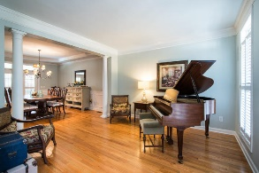
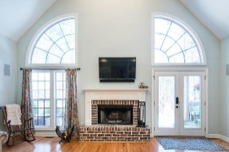
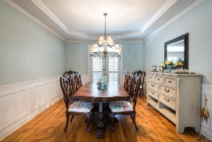
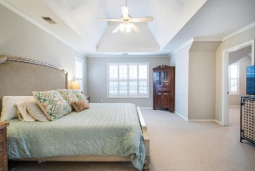
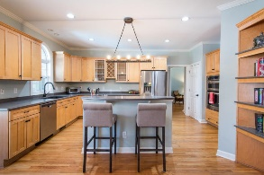
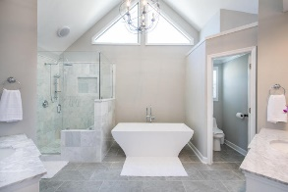
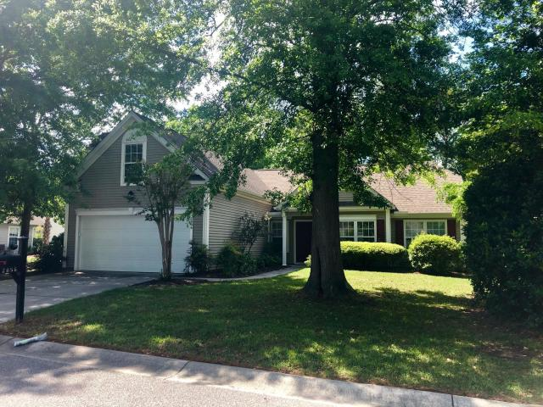
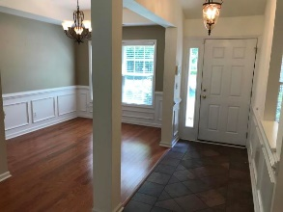
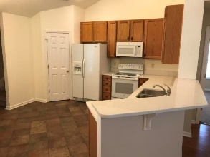
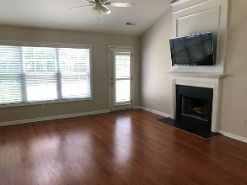
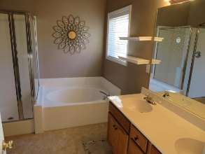
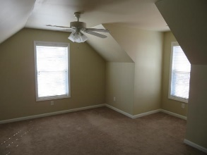
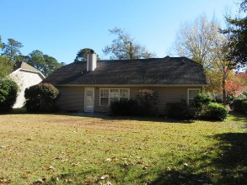

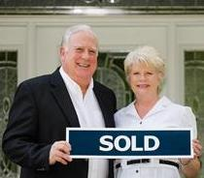
2856 Curran Place
Planters Pointe ~ Mount Pleasant, SC 29466
MLS# 18033238 ~ $356,900
Best Price, Location, & Condition for Mt Pleasant
RENT TO OWN
$2,400 PER MONTH!!!
Property can be purchased for $350,000 cash ($356,900 with seller paying up to $6900 in closing cost)
This rare single story 3br, 2ba ranch style home with bonus room is vacant with lots of upgrades added, new smooth top electric range and microwave oven, Bosch stainless steel dishwasher, side by side refrigerator, new Quartz kitchen counter tops, ceramic tile entry foyer, kitchen flooring and bathroom flooring, Sony Flat screen TV mounted over Fireplace, upgraded light fixtures, upgraded 15 Seer HVAC, Upgraded hot water heater, spacious two car garage, Large bonus room or 4th bedroom, large back yard and on cul de sac street. The best schools for Mt Pleasant, Pool, Tennis, Playground all inclusive in HOA. Walk to Harris Teeter and Lowes Super food store.
Tommy Lovett
Tommy - (843) 442-1276
tlovett@carolinaone.com
www.tommylovettrealestate.com
Carolina One Real Estate
628 Long Point Rd.
Mt Pleasant, SC 29464-3032

