Slide 1
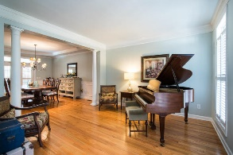
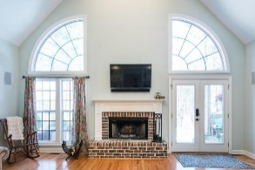
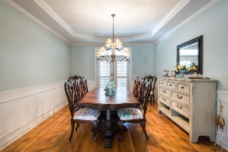
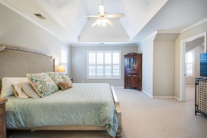
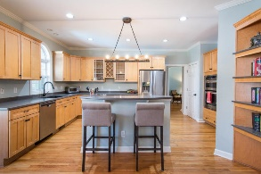
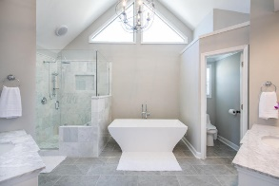
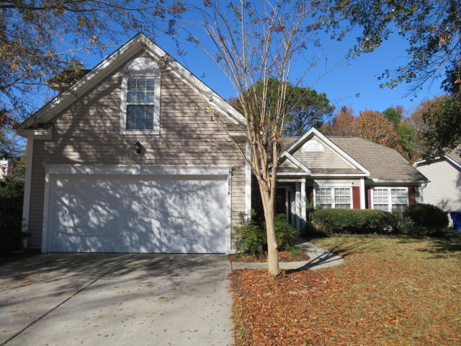
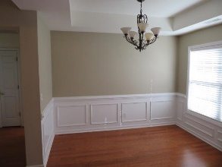
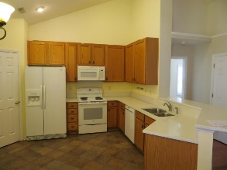
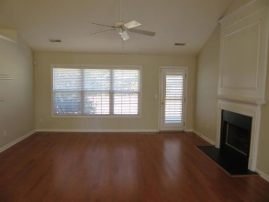
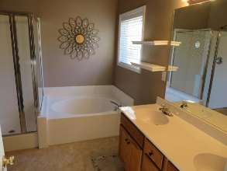
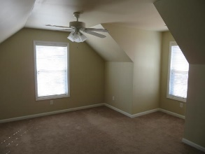
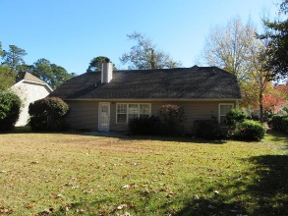


2856 Curran Place Planters Pointe ~ Mount Pleasant, SC 29466 MLS# 18033238 ~ $369,900
TRULY A RARE FIND ~ A MUST SEE!
$550,000
This immaculate three bedroom, 2 bath single story ranch home has finished room over double car garage which can be used as 4th bedroom. Better than new condition as owners have made almost every upgrade possible. Move in ready condition. Property can be rented for $2,400 per month with lease option. Seller willing to pay $1,500 towards buyers closing cost or provide washer and dryer not to exceed $1,500. Rarely does one find a home in this condition for the price in Mt Pleasant. Vacant. Rent until closing with pre approval letter, proof of funds and good credit score. Easy to show.
Tommy Lovett Tommy - (843) 442-1276
tlovett@carolinaone.com www.tommylovettrealestate.com
Carolina One Real Estate
628 Long Point Rd.
Mt Pleasant, SC 29464-3032

