Slide 1

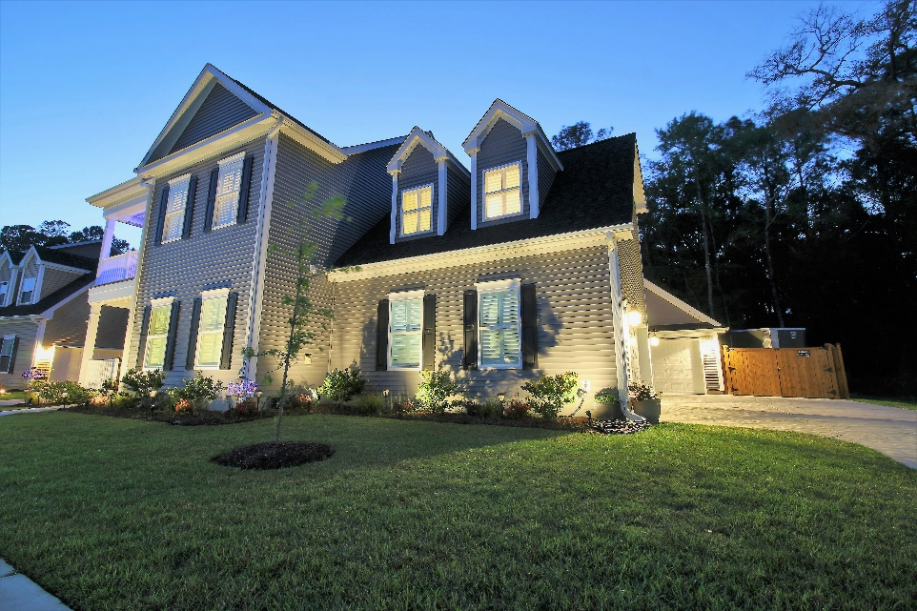
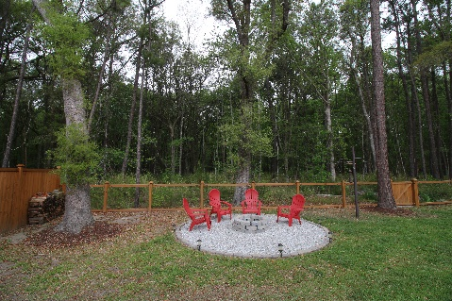
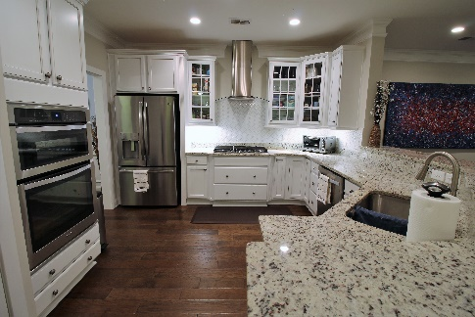

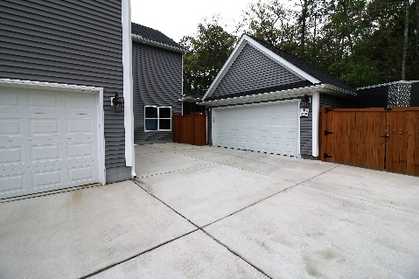
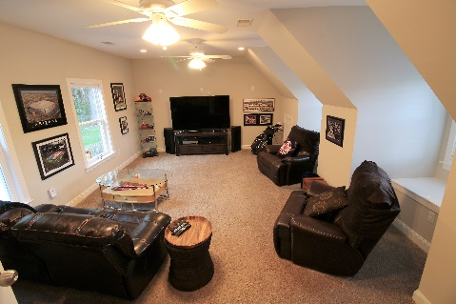
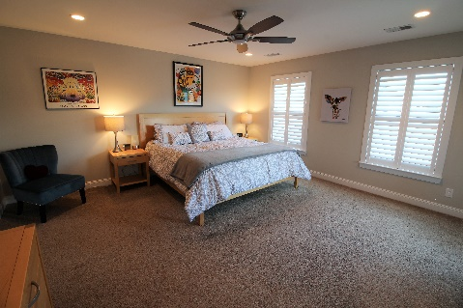


For sale $427,000
2859 Moonbeam dr. Johns Island SC 29455
Swygerts Landing w/ Boat Parking
Any Information of special interest including square footage should be obtained through independent verification.
Beautiful Home in highly desired Swygerts Landing Community. Home includes an extensive list of upgrades including premium privacy Lot which backs to wooded area. Property includes gourmet kitchen, hardwood floors, 4 car garage. Amenities; new beach entry community pool, 9+ acre park, nature trails & more. MLS# 17009780
5 Bedroom
3 Baths
2729 Sqft
Giant Bonus Room
4 Car Garage - 2x2
Boat Parking Pad
Backs up to Wooded Wetland
Covered & Screened in Patio
Natural Gas Home
Rinnai Gas Water Heater
Hardwood Flooring
9ft Smooth Ceilings
Hardwood Treads on Staircase
Gourmet Kitchen /Granite
2nd Master or Guest Suite
Fenced in Back Yard
Crown Molding & Wainscoting
Community Resort Style Pool
Listing Agent is Co-Owner
Add a caption for your photo here.
843-991-2110
Brad Christensen
Realtor - AgentOwned
Brad.Christensen@agentowned.com
www.CharlestonPremierAgent.com
902 Savannah Hwy, Charleston S.C. 29407
www.agentownedrealty.com

