Slide 1
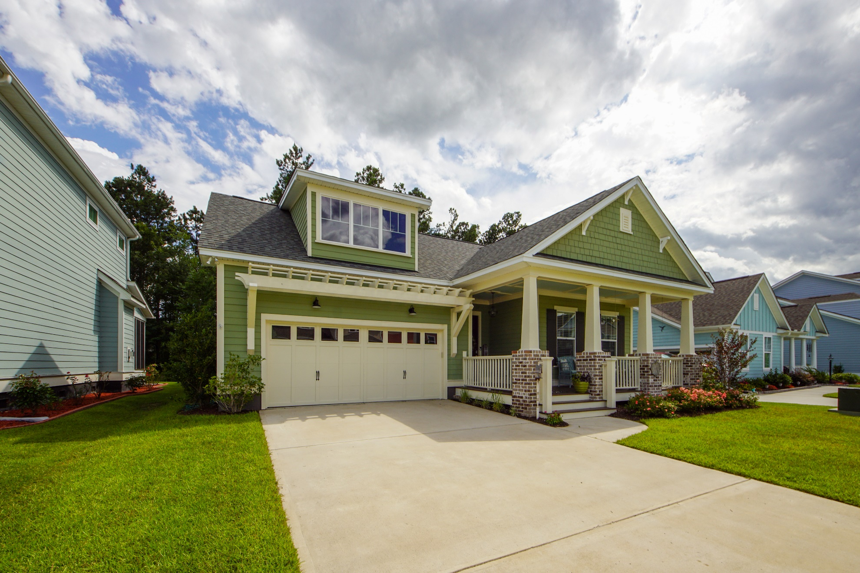
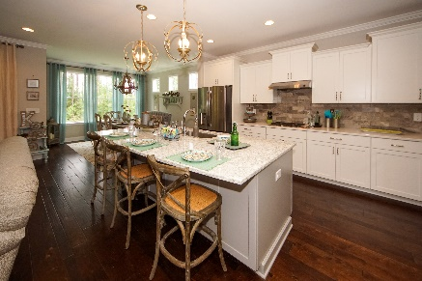
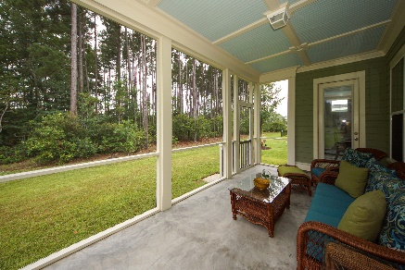
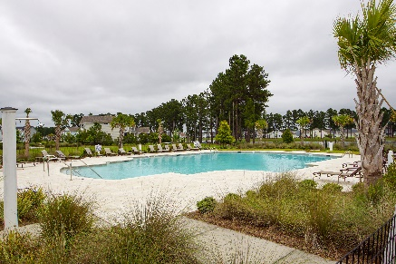


285 Calm Water Way Cane Bay Plantation :: Summerville, SC 29486 MLS# 20016577 :: $377,000 3 Bed / 2 Bath
Stunning Home
Reduced!
Stunning lake front community in The Coves! Turn key and ready for a new buyer that will appreciate sellers who maintained an almost new construction home with added upgrades after the new build in 2017. Open floor plan, chef kitchen, huge kitchen pantry, over sized kitchen island with new lighting and back splash, butlers pantry, mud room, tiled shower in the master bath with new lighting and mirrors add to a one story home exuding elegance and style! The Coves has access to a 300 acre lake, featuring 8 miles of navigable waterways and miles of walking/bike trails and a community pool with amenity area. Enjoy kayaking, canoeing, and paddle boarding in your own neighborhood! The Coves is in walking distance to the new YMCA. The pictures are worth a thousand words!
Connie White, Broker
843-532-3356
connie@chrepros.com · conniewhiterealestate.com
Charleston Homes · 597 Old Mt. Holly Road · Suite 301 · Goose Creek, SC 29445

