Slide 1
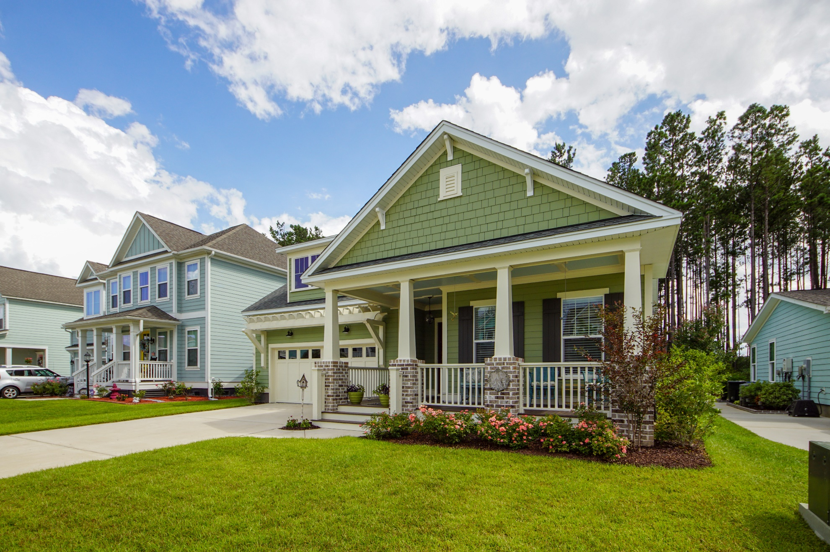
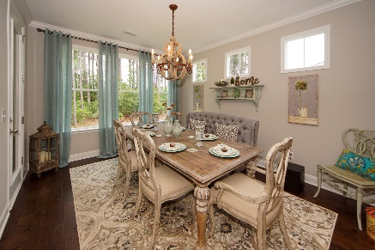
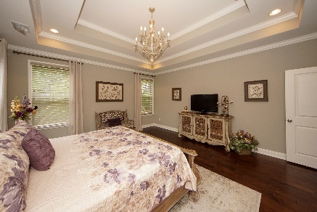
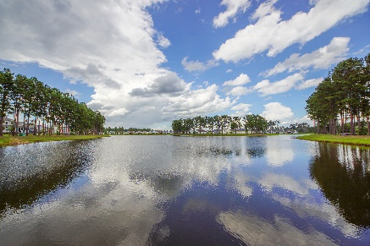


285 Calm Water Way
Cane Bay Plantation :: Summerville, SC 29486
MLS# 20016577 :: $365,000
3 Bed / 2 Bath
Stunning Home
Reduced 10K!
Stunning one level, low maintenance home in the Coves at the Lakes of Cane Bay. Plenty of character and designer upgrades. Open floor plan, chef's kitchen with quartz countertops, hardwood flooring and crown molding throughout and a HUGE master suite including a spa-like walk in shower. Low HOA, taxes and monthly utility costs. Serene lake front living in a quiet and friendly neighborhood with walking and biking trails. Private community pool and boathouse access for boating, fishing and kayaking on a 300 acre lake. Within walking distance to YMCA. 5 minute drive to supermarket, medical, dental offices and more. Abundance of medical services nearby, including a newly built hospital. Half mile to firehouse/EMS/police station. Many nearby shopping and dining options.
Connie White, Broker
843-532-3356
connie@chrepros.com · conniewhiterealestate.com
Charleston Homes · 597 Old Mt. Holly Road · Suite 301 · Goose Creek, SC 29445

