Slide 1
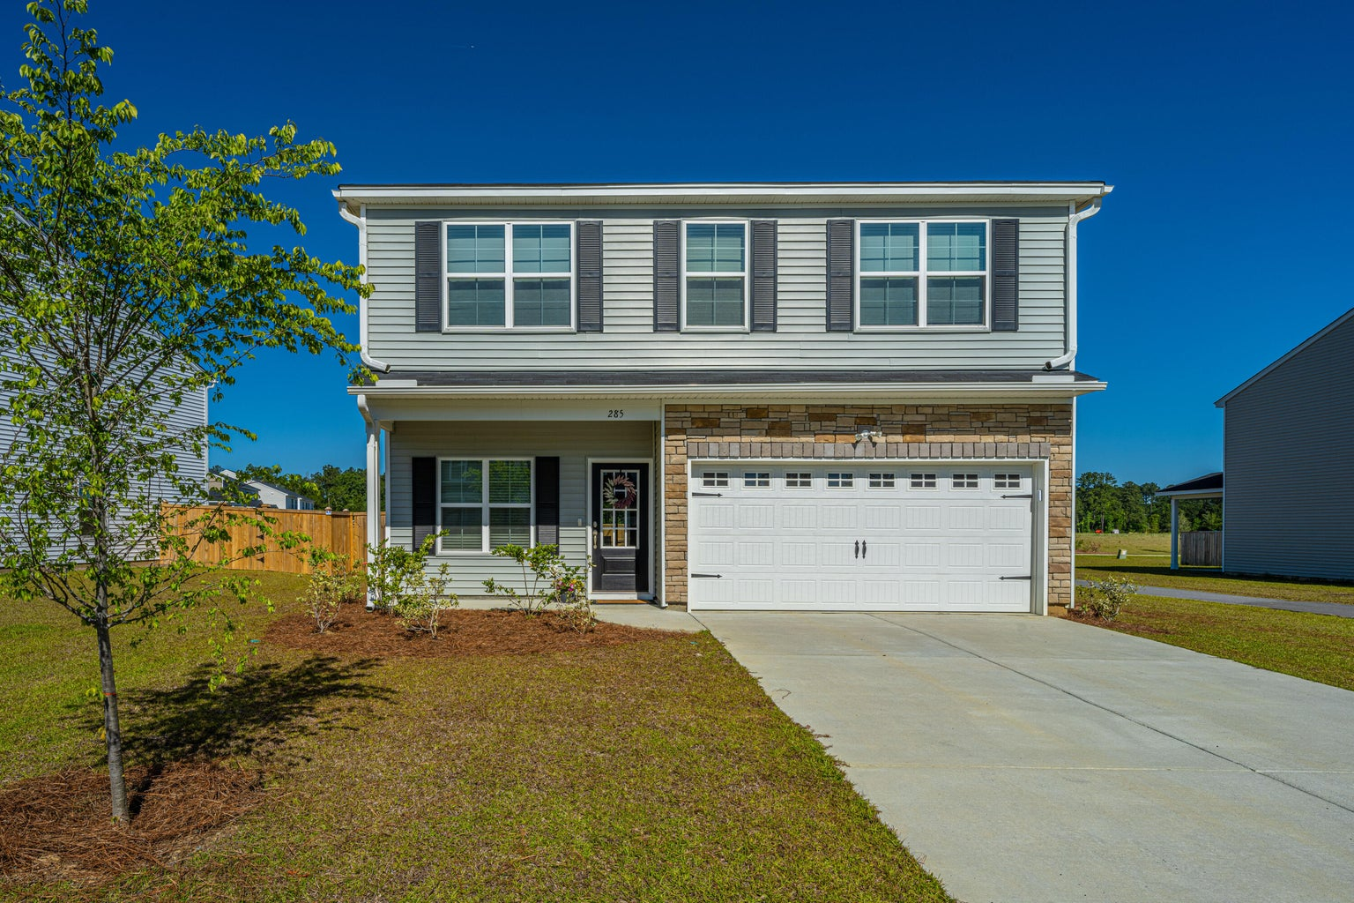
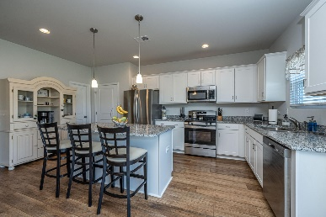
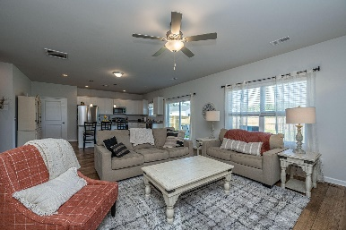
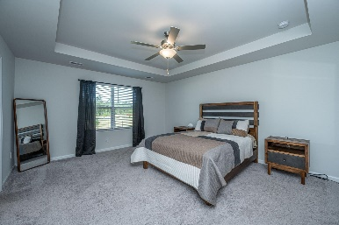
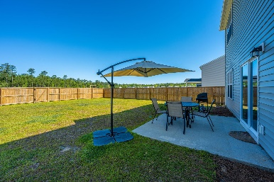


285 Torslanda Lane Petterson Meadows | Summerville, SC 29486 | MLS# 23009905 | $379,000
MOVE IN READY! BETTER THAN BUILDER PRICING!
Welcome Home to 285 Torslanda Lane! This newly built home has a transferable 10 year builder warranty and all the bells and whistles included!. As you enter the front door from the covered porch, you will see a well appointed flex space with french doors, currently used as a home office. This space could also be used as a playroom or dining room. The kitchen, filled with natural light has granite counter tops, stainless steel appliances, gas range, island with seating and is open to the family room. Be sure to checkout the built in pet pad for your furry friend. $1500 Lender Credit is available and will be applied towards the buyer's closing costs and pre-paids if the buyer chooses to use the seller's preferred lender. Sliding glass doors lead out to your patio and fully fenced back yard with direct access to the walking paths and neighborhood park with disc golf baskets, soccer nets and green space galore! Upstairs you will find 3 ample bedrooms with walk in closets, the laundry room and a loft for an additional flex space.
Kathryn Poe 843-568-0056
kathryn.poe@carolinaone.com
www.poeknowscharleston.com
Carolina One Real Estate
873 Orleans Road, Ste 102
Charleston, SC 29407-5753

