Slide 1
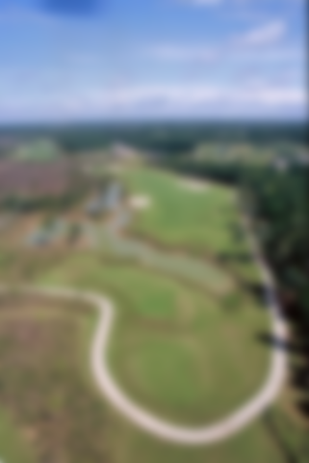
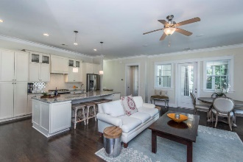
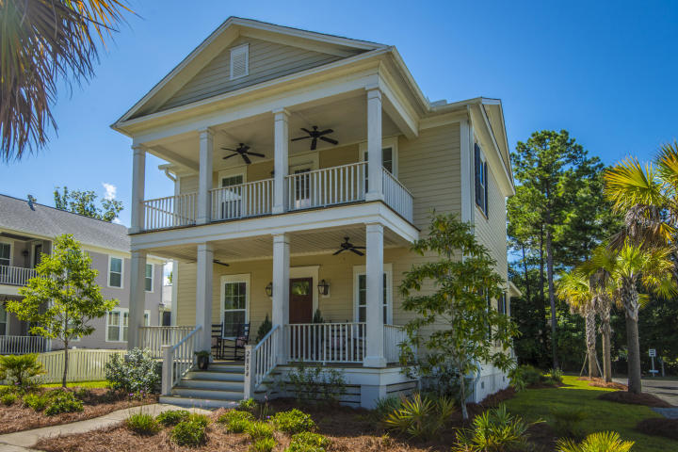
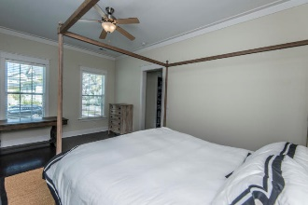
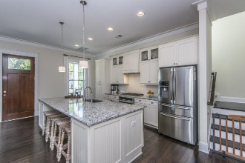
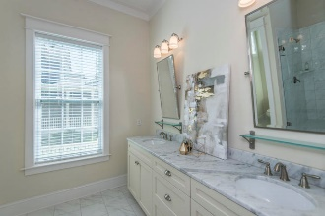
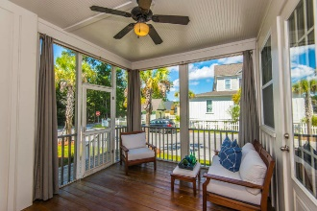
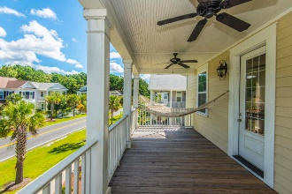
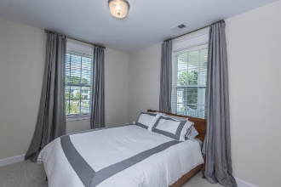
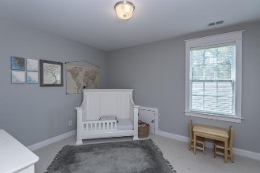
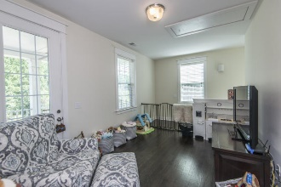
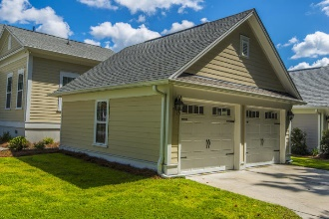
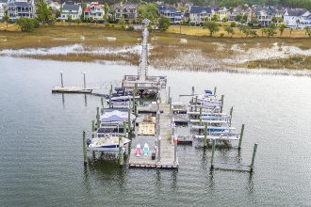


2864 Rivertowne Parkway
Mount Pleasant, SC 29466 | MLS# 18025633 | $449,500
Major Price Reduction! Motivated Sellers!
Old Charleston elegance meets coastal casual in this beautiful Rivertowne gem. Walking up to the classic stained wood front door with gas lanterns you'll feel the desire to pour a glass of iced tea and sit a spell, waving to neighbors as you relax on one of your double stacked piazzas. Step inside and you'll immediately notice details that hint at custom treatments found throughout the home. Extensive crown molding, striking dark hardwood floors and high ceilings welcome you into the living area. This spacious yet cozy family room will wow you with a gorgeous focal point fireplace complete with shiplap accent wall! Comfortable for everyday family living, yet ideal for entertaining, the open plan allows for all of the living space to flow seamlessly.
Located in the highly sought after neighborhood of Rivertowne on the Wando, you'll have access to outstanding amenities. There are three community docks for fishing, boating or just to relax and watch the amazing Wando River sunsets. Enjoy golf at Rivertowne Country Club's Arnold Palmer Signature Course then meet friends at the club for dinner. Additional amenities include neighborhood pool, tennis courts, walking trails and play park all conveniently located to beaches and the world class dining and shopping of historic downtown Charleston.
Asking $1,200,000
MLS# 17023051
3,692 SqFt
4 Bed/3½ Baths
Short Drive to Historic Downtown Charleston & Beaches
Don Dawson
843-514-0452
ddawson@carolinaone.com
Carolina One Real Estate • 2713 Highway 17 North • Mount Pleasant, SC 29466
www.TeamDawsonSC.com

