Slide 1
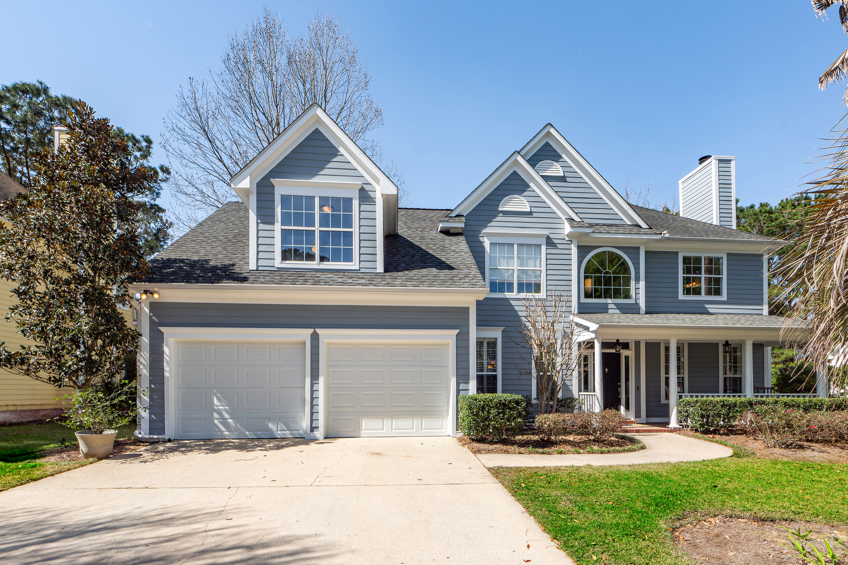
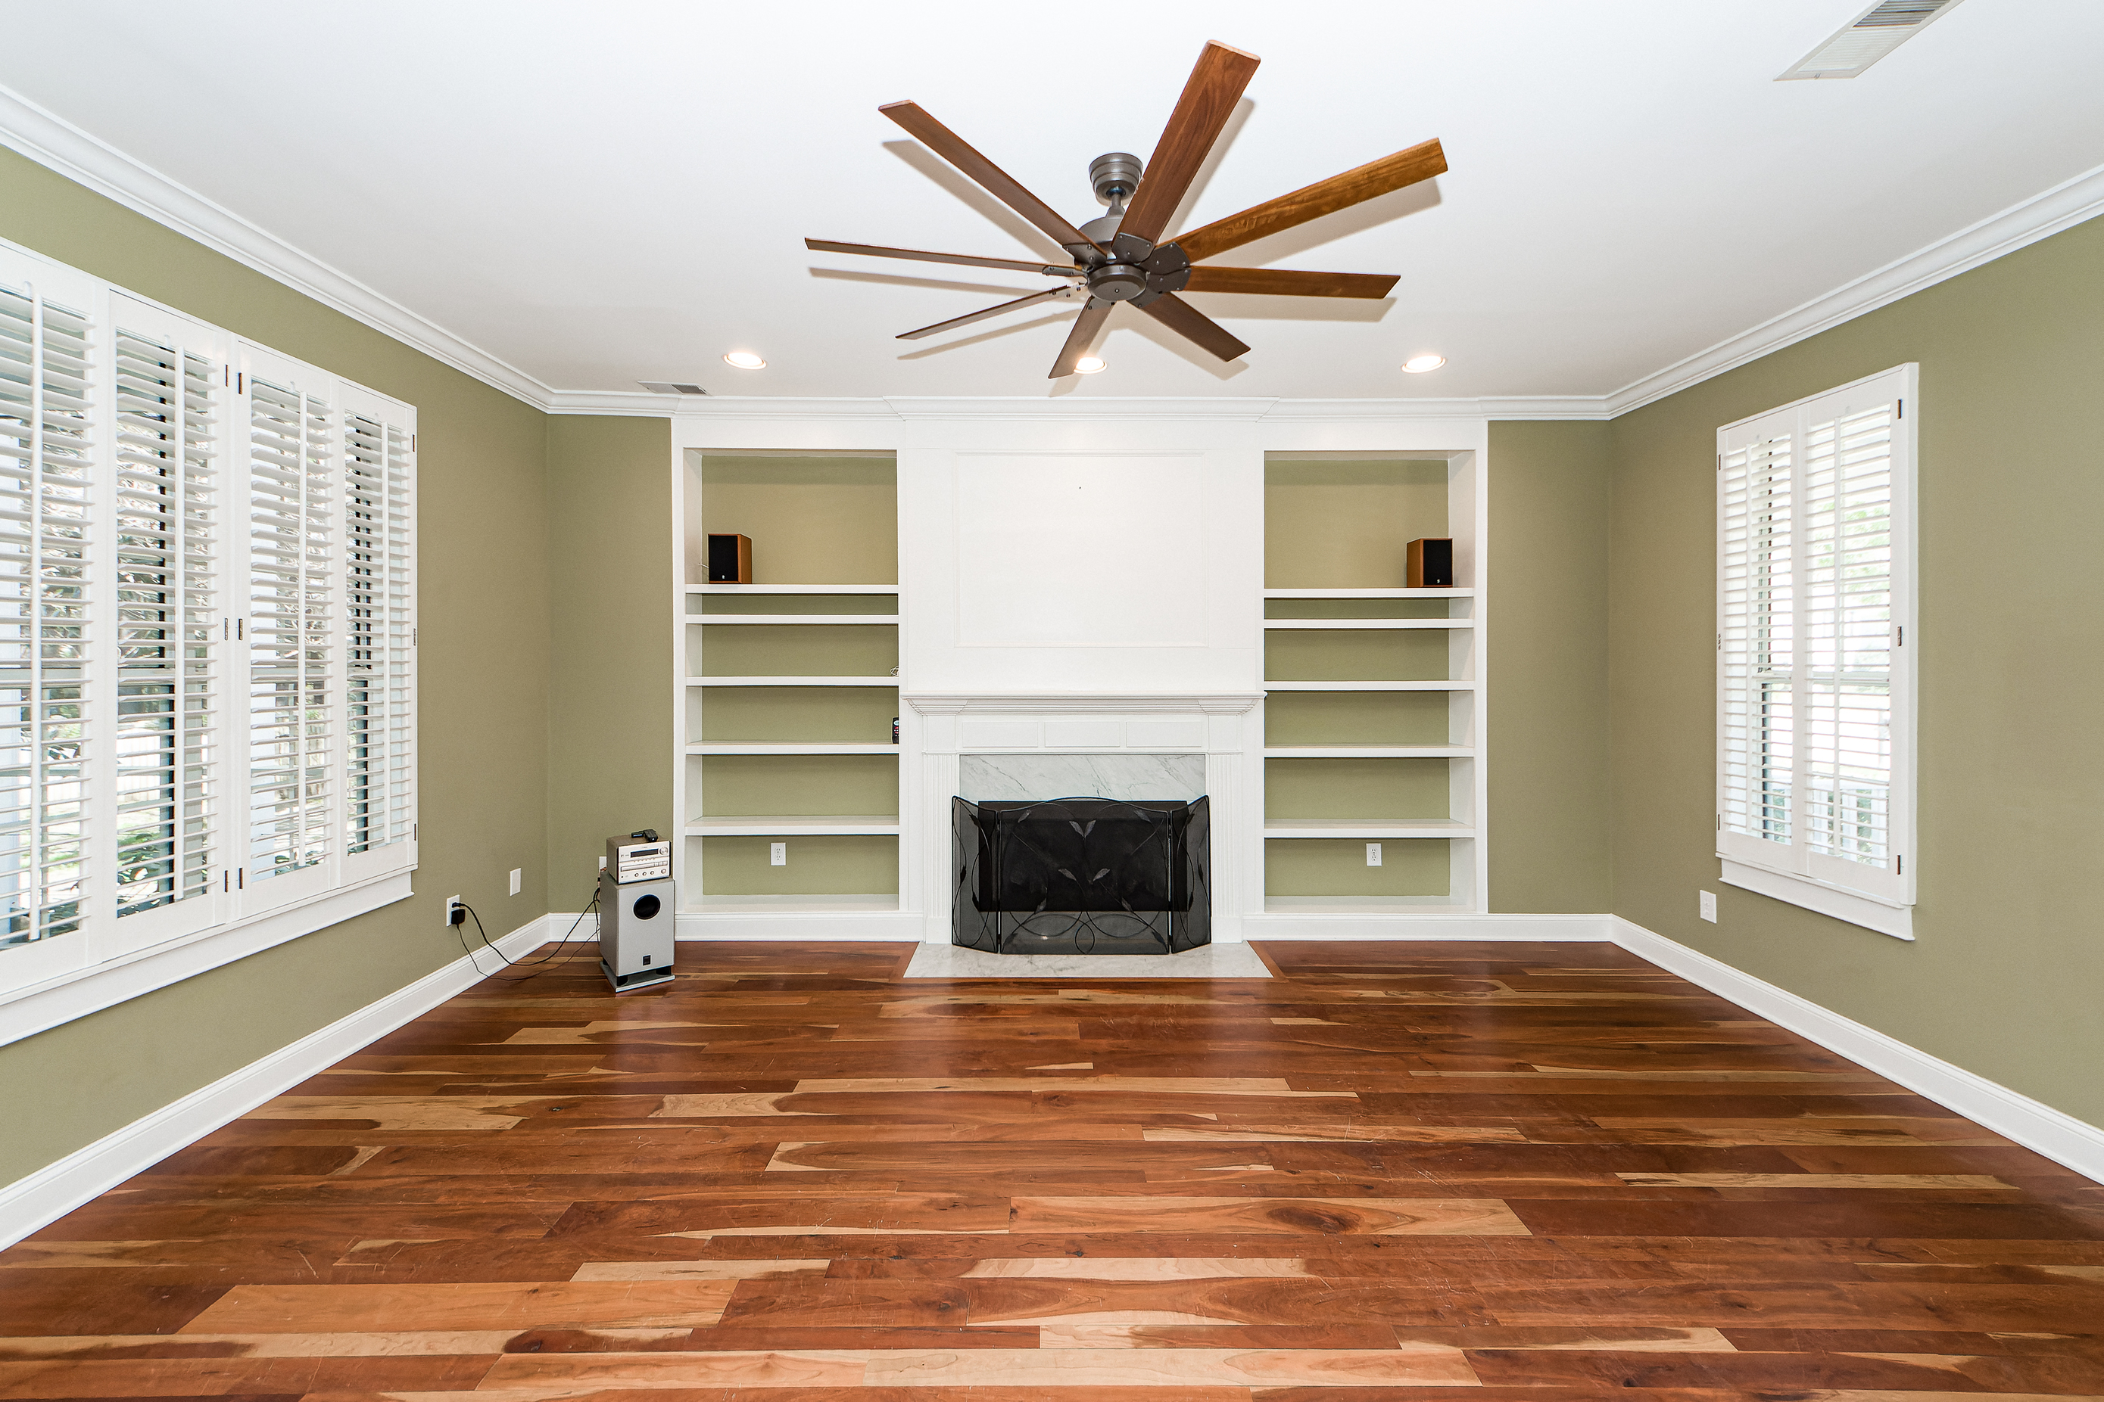
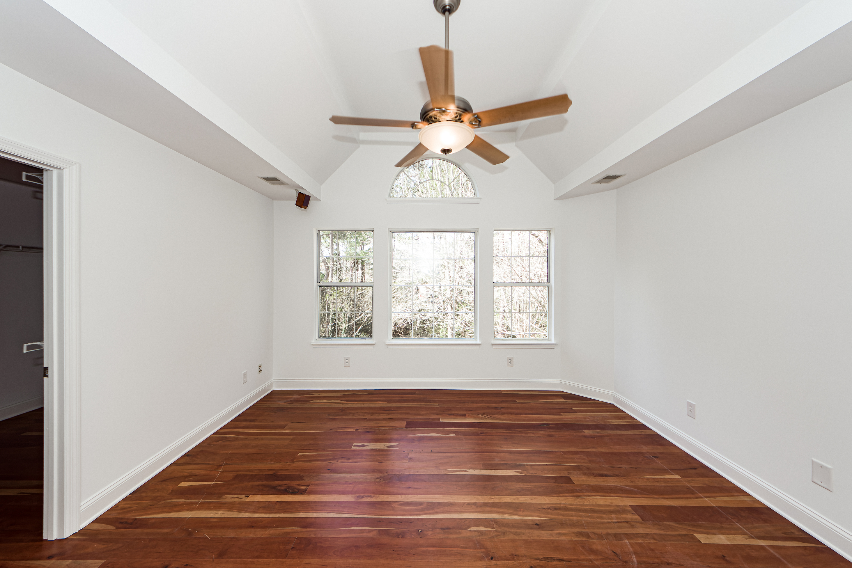
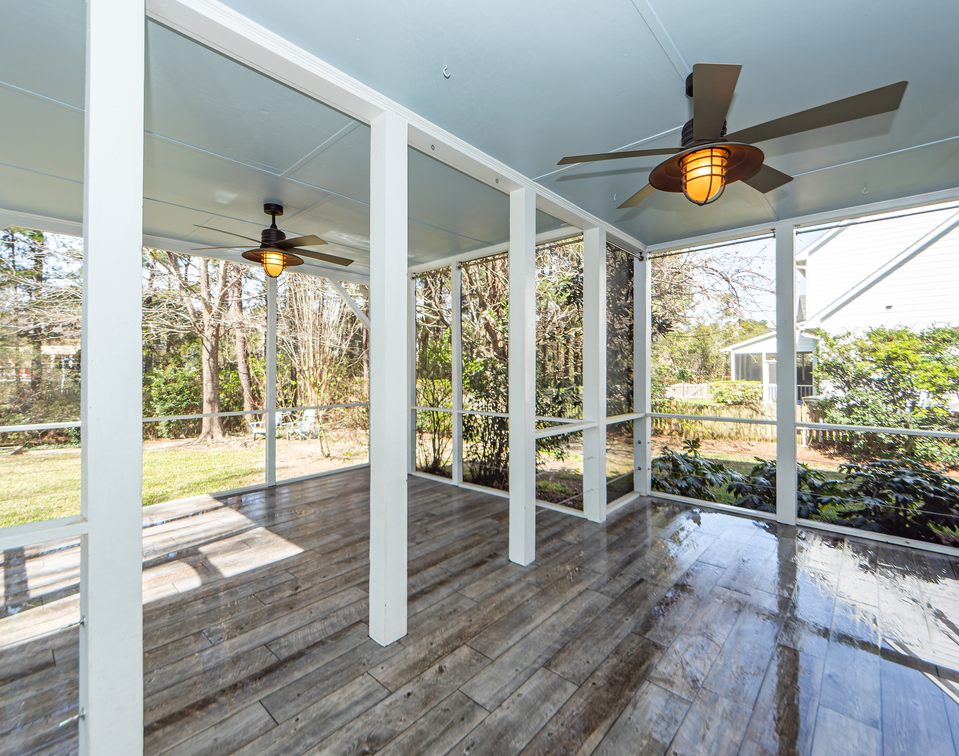

BRICKYARD PLANTATION - NEW LISTING
Moved to Saturday, 10/8 ~ 11:30 to 2:30
2868 Colonnade Drive
Mount Pleasant, SC 29466
MLS# 23004454
$785,000
4 Bedrooms
2½ Baths
2,220 Square Feet
Very Private
Extended screened porch
Cement Plank exterior
Tons of community amenities
SCHEDULE A SHOWING!!
Jen Nipper
REALTOR
843-478-1800
Jen@AgentOwned.com
AgentOwned.com
Notes:
DO NOT ALTER LAYOUT. YOUR FILE WILL BE RETURNED OR EDITED IF IT IS RECEIVED ALTERED.

