Slide 1
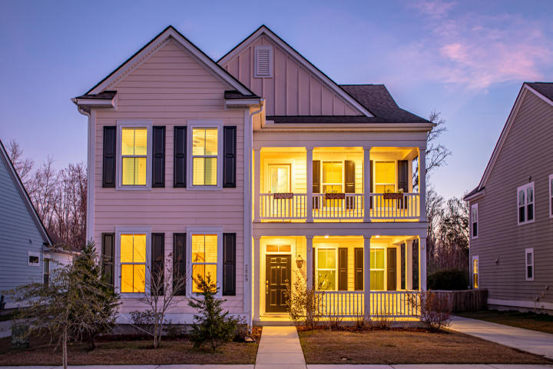
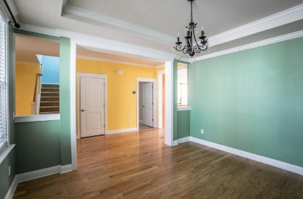
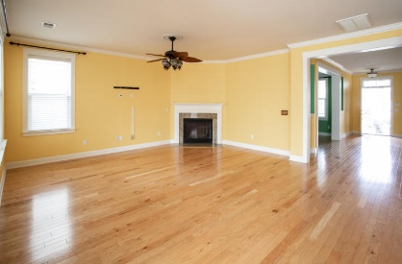
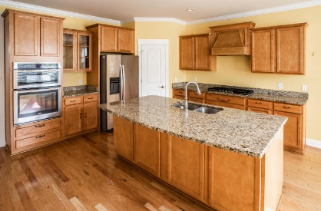
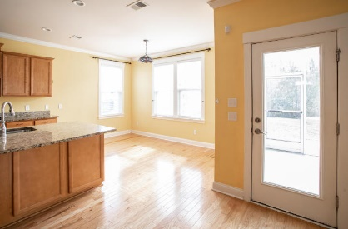
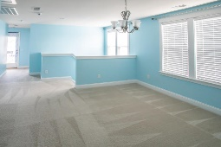
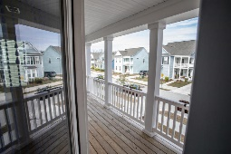
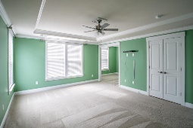
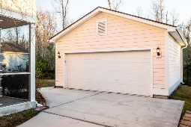
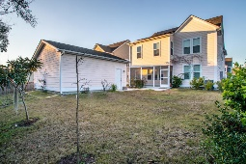


OPEN HOUSE
2/8 and 2/9 from 3-4pm
2869 Rutherford Way Carolina Bay | Charleston, SC 29414
MLS# 20003203 | $420,000
Just a quick stroll from Carolina Bay Park is this well-appointed gem.
The unique Calhoun Model sits on a private wooded buffer & boasts many spectacular features including a first-level bedroom with its own full bath, natural gas fireplace, tankless gas water heater, screened porch, gigantic loft, master with a sitting room & ENORMOUS walk-in closet & so much more!
Go Green & SAVE GREEN with paid-off Solar Panels ($24K+ value)! And last, but NOT least this HOME comes with a ton of EQUITY! Come SEE.
For more info on this listing, click here http://bit.ly/2869RutherfordWay
Jim Brantley
(843) 412-7647
brantleyjim@gmail.com
AGENTOWNED PREMIERE GROUP | 1800 TROLLEY RD | SUMMERVILLE, SC 29485

