Slide 1
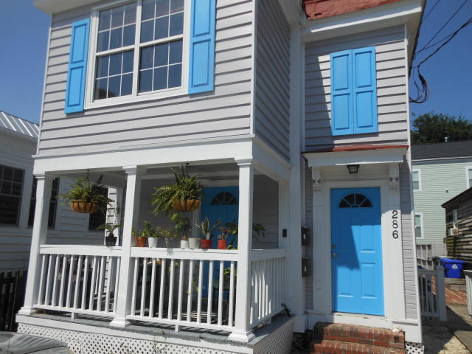
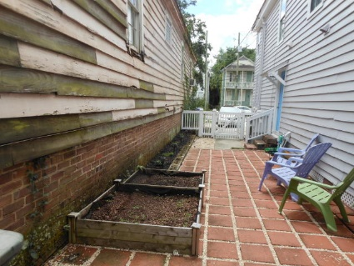
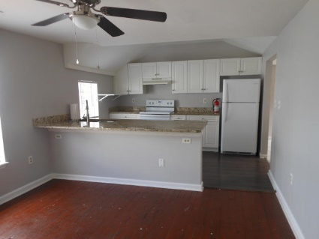
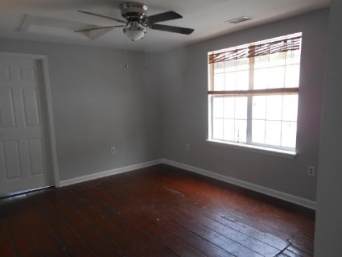
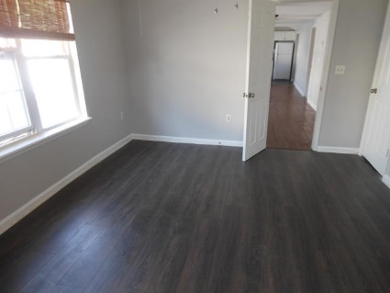
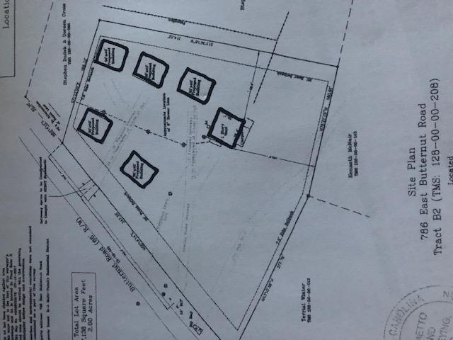
SALE / LEASE
Duplex 286 Ashley Ave
Fully updated/upgraded
MLS# 20016968 (Sale) / MLS# 20016972 (Lease)
$40,000
Price Reduction!
$650,000
3 Bd 2 Ba each unit
Newer Roof & AC Units.
Updated kitchens & baths
3140 Sq. Ft.
Separate Living & Dining Room
Large Closets
Off-street parking for 3 vehicles
Downstairs 1,473 Sq Ft Currently Rented $1,800/mo
Upstairs 1,673 Sq Ft VACANT Asking $2,400/mo
Motivated Seller
Asking Price below what owner paid plus owner invested over $50,000 after purchasing
Rick Willis
843-327-3017 Rick@RickWillis.com The Group, LLC

