Slide 1
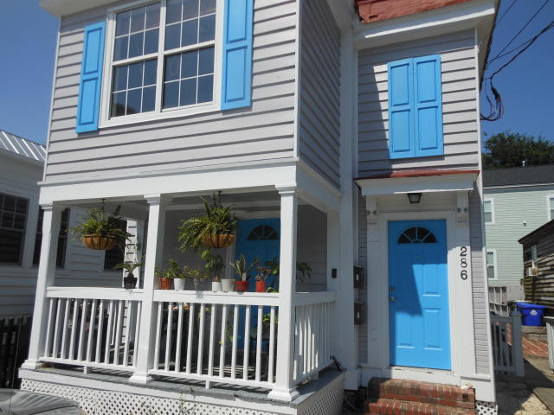
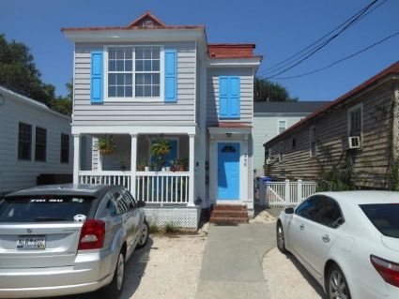
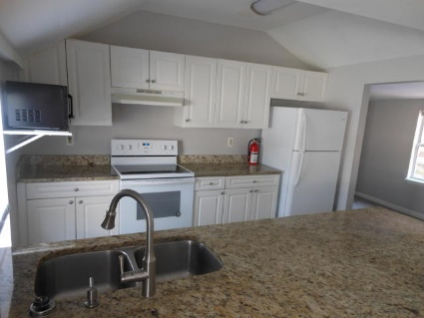
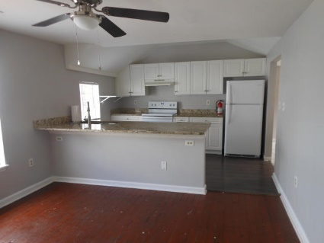
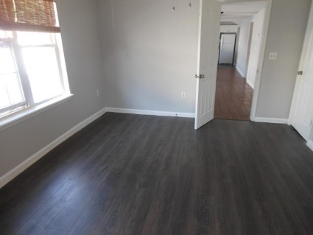
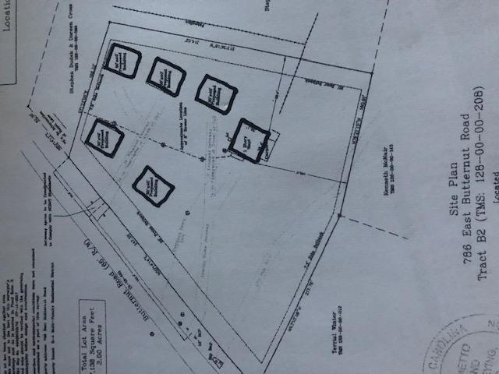
FOR RENT
DOWNTOWN
3 Bed · 2 Bath · Off-Street Parking
$40,000
Price Reduction!
Updated kitchen
Updated baths
2nd Floor
1,673 Sq. Ft.
Large Closets
Separate Living & Dining Room
$2,400/mo
DRAFT
AVAILABLE IMMEDIATELY
2 Blocks from The Crosstown
3 Blocks from The Citadel
6 Blocks from MUSC
Rick Willis
843-327-3017 Rick@RickWillis.com The Group, LLC

