Slide 1
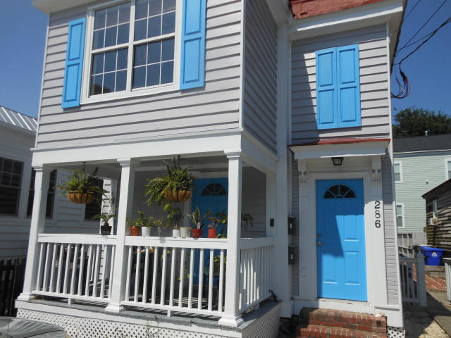
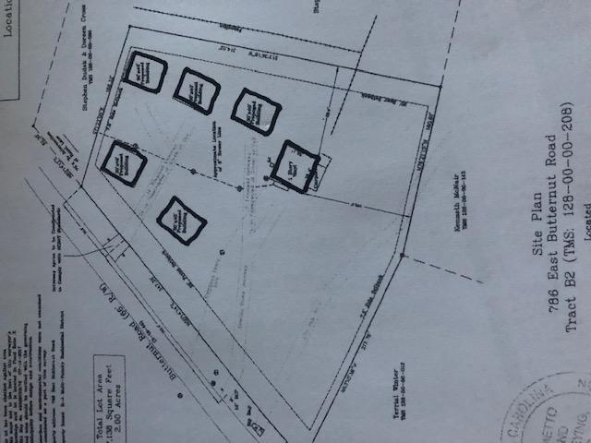
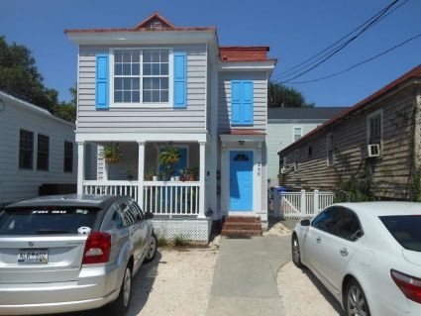
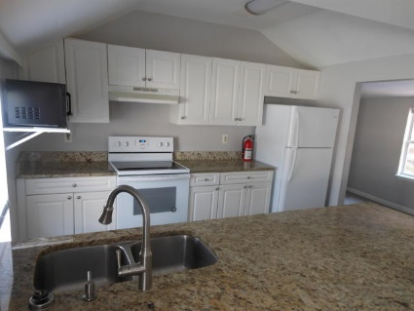
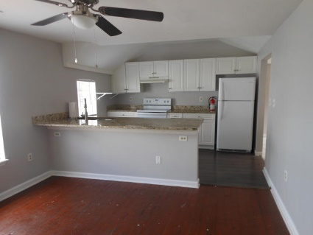
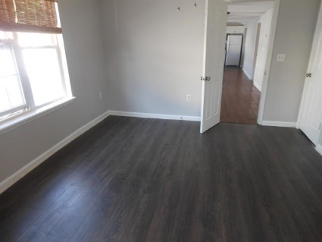
FOR SALE
Downtown Duplex · 286 Ashley Ave
$647,900 MLS# 20016968
Fully Updated & Upgraded
$40,000
Price Reduction!
3 Bedroom/2 Bath each unit
3,000+ square feet
Off-street parking for 3 vehicles
Separate Living & Dining Room
Newer Roof & HVAC
DRAFT
2 Blocks from The Crosstown
3 Blocks from The Citadel
6 Blocks from MUSC
Rental Income Downstairs $1,800/mo
Rental Income Upstairs $2,400/mo (Currently Vacant)
Rick Willis
843-327-3017 Rick@RickWillis.com The Group, LLC

