Slide 1
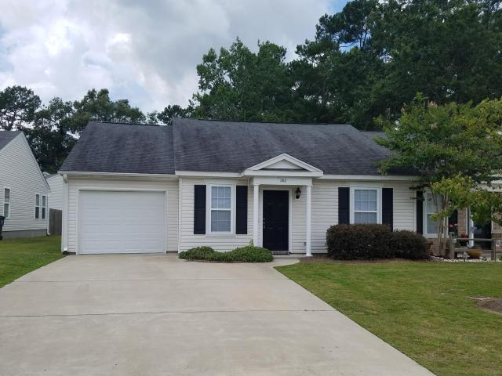
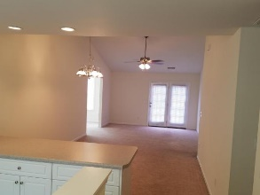
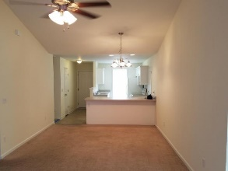
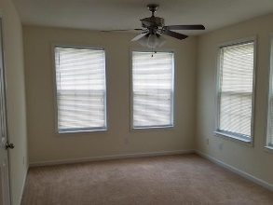
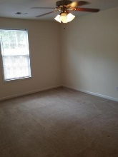
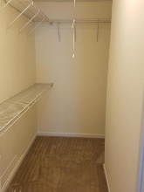
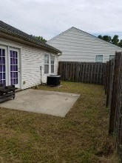
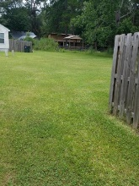



286 Reagan Drive Cedar Springs ~ Summerville, SC 29483 ~ MLS# 17016779 ~ $145,000
1 Story Townhouse Under $150,000
Freshly painted interior townhouse with 3 bedrooms and 2 bathrooms. (3rd bedroom is being used as a bonus room - doors will need to be installed) Kitchen overlooks dining and living room. Master bath has stand up shower with shower doors. 2nd bathroom has tub and shower with sliding doors. Home has automatic garage door opener and ample attic storage. Washer and dryer convey as is.
Michelle Riser
(843) 860-1229
mriser@ccim.net
Palmetto Group of AgentOwned | 597 Old Mt Holly Rd Ste 202 | Goose Creek, SC 29445

