Slide 1
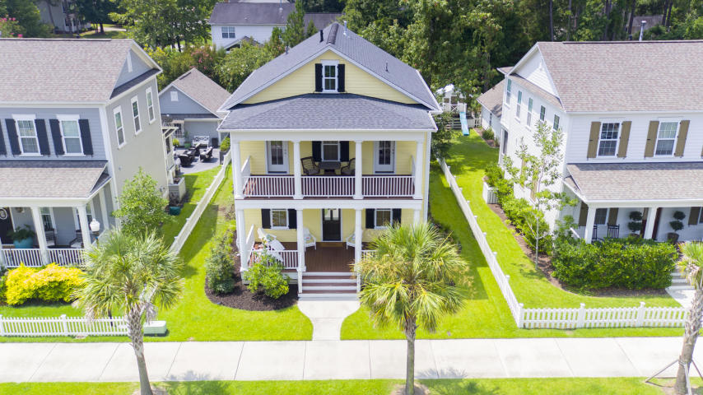
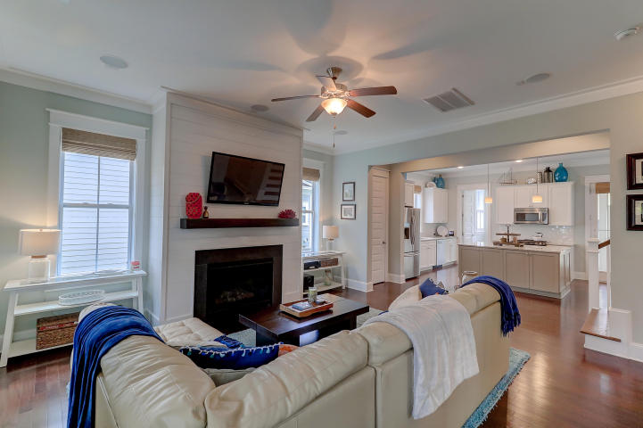
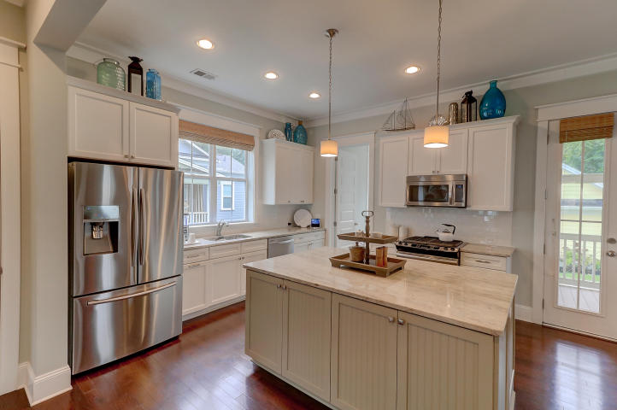
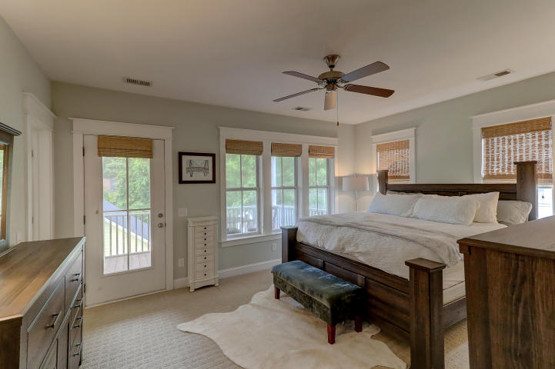
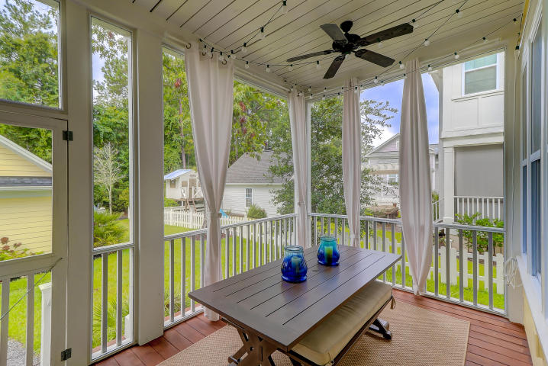


4 bed, 3.5 bath
Broker Open House!
Thursday July 26th
10:00AM - 12:00PM
Private Boatlift
Welcome home to 205 Magnolia Road, the best location in Charleston!
This 3 bedroom, 2 bath, 1636 sqft charming craftsman style cottage is footsteps from the most popular shops and restaurants of Avondale. Loaded with updates and upgrades, there is nothing you won't love about this home. Wonderful curb appeal and an adorable front porch with custom gate. Fresh paint throughout the entire downstairs. Gorgeous original hardwoods. Main floor master bedroom with oversized closet could almost double as an office! Brand new privacy fence captures one of the largest lots in the neighborhood. Kitchen loaded with updates and gas for cooking. Bathrooms have been updated / upgraded, bathtub re-glazed. Lighting has been updated with custom fixtures. Loads of storage. Oversized mudroom/laundry room. Huge storage shed with electrical provides endless options for use. All a few short minutes from downtown for work and play. This is the location and property in excellent condition that everyone's looking for. Come make this charming house your new home!
Offered for $470,000
2876 Rivertowne Parkway
Rivertowne ~ Mount Pleasant, SC 29466
Located in Tributary of Rivertowne. Move in ready, built in 2013.
3 beds, 3 full baths, plus office! Perfect floor plan! Competitively offered for $499,000.
Crissy Rowell
Mobile - (843) 377-5177
crissy.rowell@carolinaone.com
www.crissyrowell.com
Carolina One Real Estate | 195 W Coleman Blvd | Mt Pleasant, SC 29464

