Slide 1
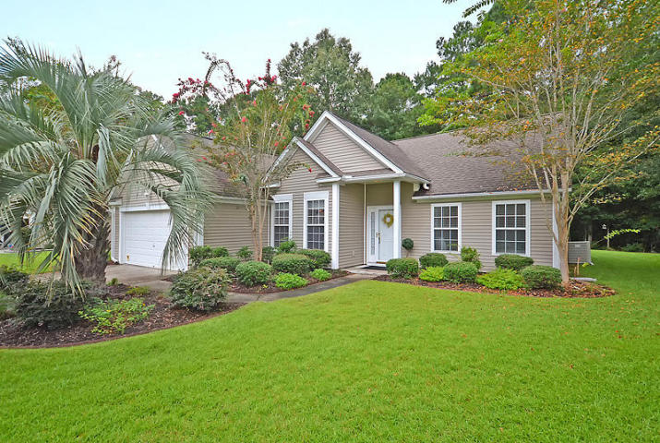
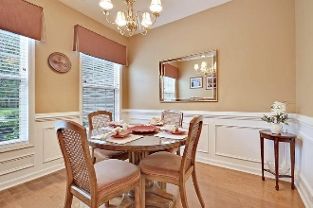
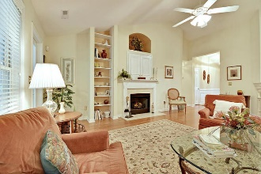
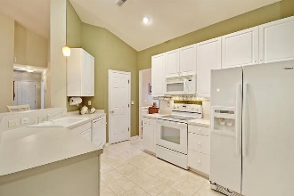
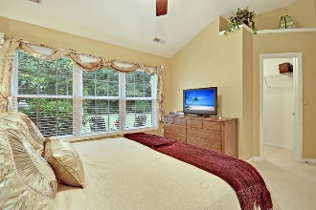
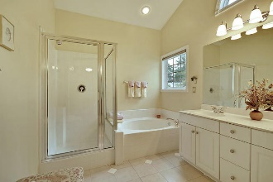
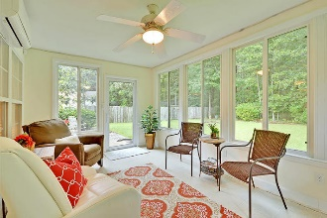
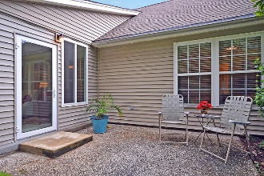
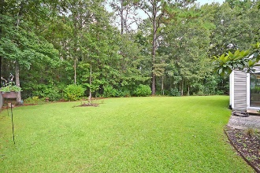
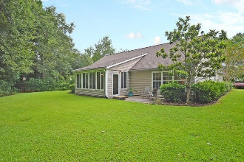

2876 Vanguard Place Mt Pleasant, SC 29466 · MLS# 17022538 · $350,000
Gas Card Give Away
Planters Pointe One Level!
BEAUTIFUL ONE LEVEL 3 bedroom, 2 bath open floor-plan home that backs to gorgeous private wetlands! This home is wonderfully landscaped and sits on a quiet cul-de-sac. Upon entering the home you are greeted with an abundance of natural light in the foyer that leads to the private dining room with wainscotting and large windows. The family room is open to the kitchen with breakfast bar seating for 4, white bright cabinets, and a large eat-in area. The family room/kitchen area is perfect for entertaining-you can cook, serve, and still be part of the party! The family room has built in cabinets, a fireplace and leads to the 4 season sunroom. The sunroom overlooks wetlands and is perfect for a morning cup of coffee, reading a good book, or relaxing after a day of work.
The master bedroom has a large walk-in closet and a private bath with tile floors, separate shower, and soaking tub. Two additional large bedrooms share a bath and are split from the master. Additional features are soaring ceilings, laundry area, and a 2 car attached garage and a SHORT WALK or golf cart ride to the grocery store! Planters Pointe in Mount Pleasant is a wonderfully landscaped community with a play park, tennis courts and community pool! The neighborhood is close to local shopping and grocery stores and is a short drive to downtown Charleston with 5-star restaurants, world class shopping and iconic history as well as a short drive to the beaches, the airport, Boeing and Daniel Island. Come take a look because you will not find another home that offers as much as this one-call today.
Stan Huff
843-670-2835 stan.huff@agentowned.com
Jill Marcacci
843-297-5590 jill@agentowned.com
www.agentownedrealty.com
AgentOwned Realty Co. Preferred Group, Inc. | 824 Johnnie Dodds Blvd | Mt Pleasant, SC 29464

