Slide 1
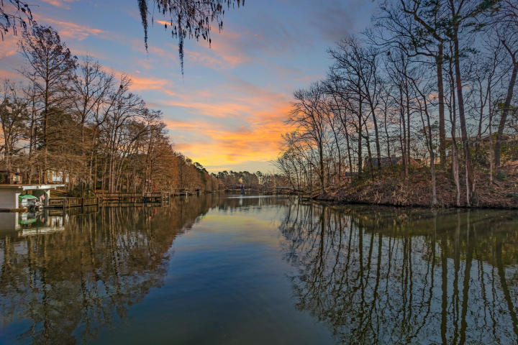
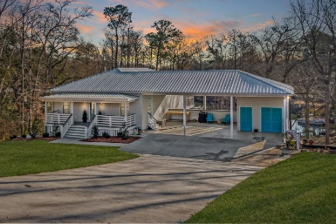
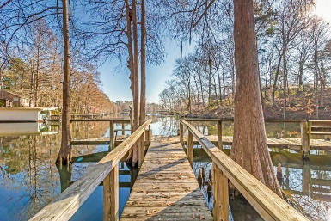
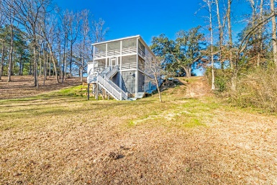
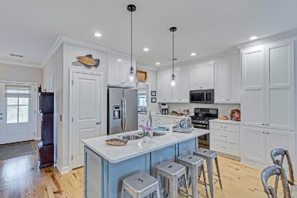
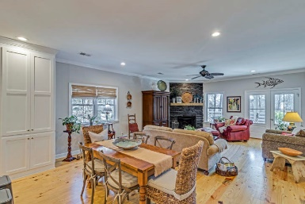
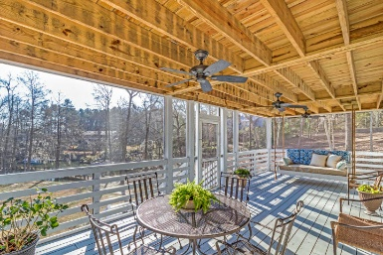
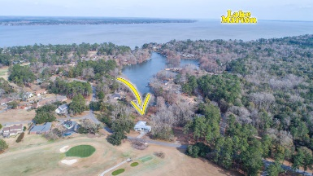


287 Santee Drive Santee Cooper Resort Santee, SC 29142 MLS# 19003929 | $600,000
SELLER OFFERING $2500 TOWARDS CLOSING COST AND A ONE YEAR HOME WARRANTY!
Live the Lake Life!
This is premier lake living at it's best! Upgraded water front home available now in the highly sought after gated community of Santee Cooper Resort! Built in 2016, this home offers 4 bedrooms, 3.5 baths, over 2700 sq. ft of living space, dual masters, dock, .85 acre lot, and more! Large front porch area that is perfect for relaxing in the evening and chatting with guest! As you enter into the main entry door, you are greeted by a warm and inviting foyer area! As you gaze into the room from the foyer area you are overwhelmed by the open concept the living/kitchen area has to offer! The main floor offers gorgeous pinewood flooring throughout! The kitchen offers high end quartz counter tops, stainless steel appliances, gorgeous and convenient kitchen island, and tons of cabinet space!
The main floor also offers crown molding throughout! The living area offers a plethora of space for additional seating and the beautiful fireplace makes it the perfect center piece of the room! Off the back of the living room area is the entry into the main floor screened in porch. This is the perfect spot for summer mornings and evenings or anytime of the year! The main floor master offers a wonderful view of the water, crown molding, dual closets, and more! The luxurious master bath provides a large walk in shower, granite counter tops, tile floor, and a dual vanity!
Downstairs are three additional bedrooms. The downstairs master is spacious and the master bath is to die for! The additional rooms are large with one room providing additional extra closet space for storage! Family members or guests are going to love having their own additional screened in porch providing the same great views of the water! If you have been dreaming of the "lake life," opportunities like this do not come up very often! Instead of dreaming of the lake life, make it a reality NOW and schedule to see this one of kind home located on Lake Marion! Whether you are looking for a primary or secondary home this home provides it all! Conveniently located just an hours drive from Charleston or Columbia! Santee Cooper Resort is a gated community offering an award winning 18 hole golf course, marina, boat storage, boat slips, pier, and more!
Brandon Ray
(843) 499-1928
brandon.ray@carolinaone.com
www.therightrayhome.com
Carolina One Real Estate
900 N Main St
Summerville, SC 29483

