Slide 1
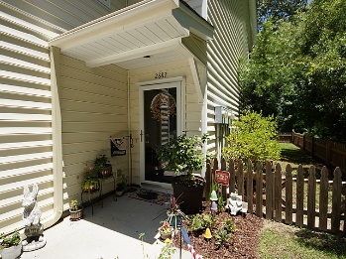
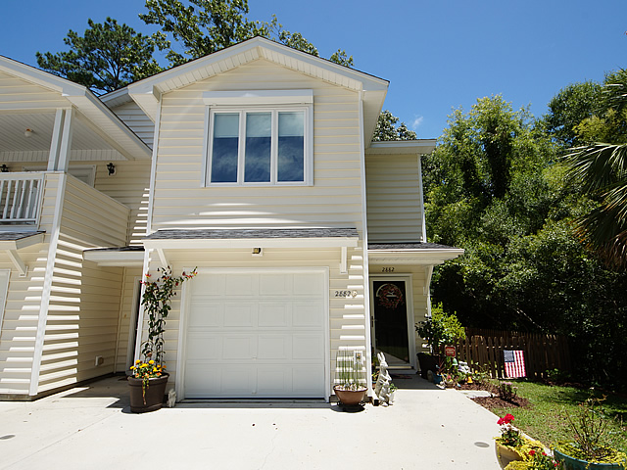
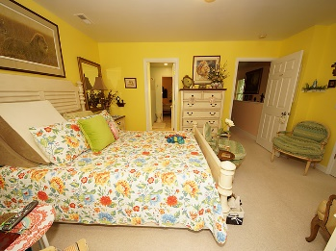
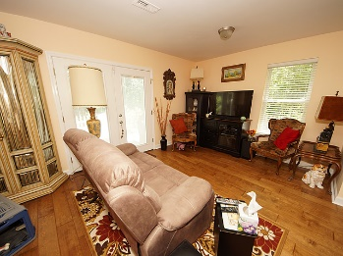
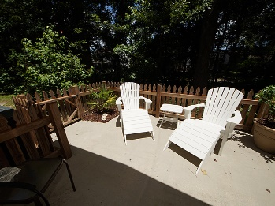
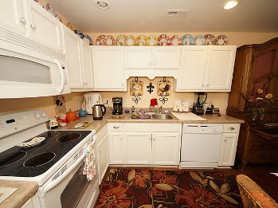
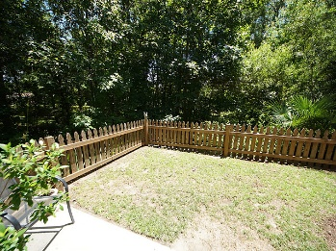
Beautiful Home in Paddock Point
Immaculate, Move In Ready Townhome
2882 Mackenzie Court The Village at Carol Oaks ~ Mt Pleasant ~ MLS# 17011223 ~ $259,900
HUGE PRICE REDUCTION!!!! SELLER SAYS BRING ALL OFFERS!! Come take a look at this immaculately cared for end unit home in The Village at Carol Oaks. The Owner has spared no expense in her renovations including landscaping, partial clearing of side wooded area , adding a patio in addition to adding a charming sitting/sun room area with double paned windows to the master bedroom. Other extras include French doors leading to patio, AND, in addition, its wired for alarm and cable throughout! Leaf Guard gutters with drains for virtually no maintenance. Convenient location- close to the Market at Oakland for your shopping needs! The beautiful hardwood floors and extra storage are 2 more reasons to come quick and take a look at this before it's gone!!!!!! NO HOA OR REGIME FEES!!
Betty McMichael
bmcmichaelchl@gmail.com | (843) 696-9867 | www.bmcmichael.com
Brand Name Real Estate | 4 Carriage Lane Suite 106 | Charleston, SC 29407

