Slide 1
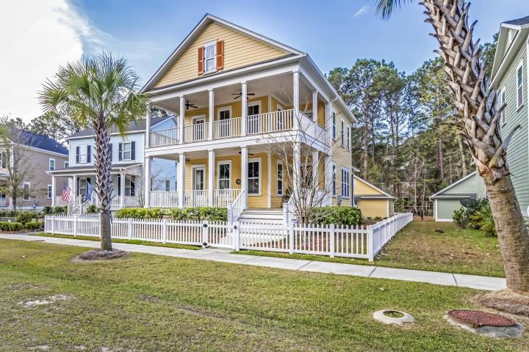
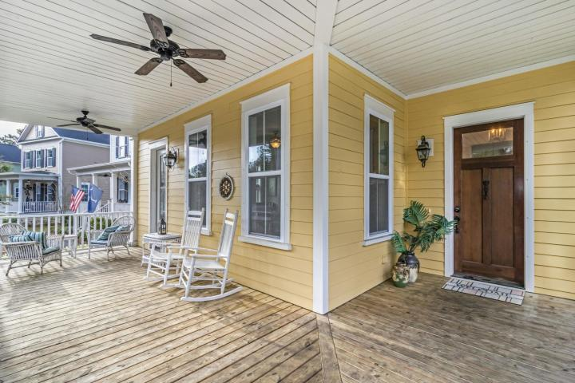
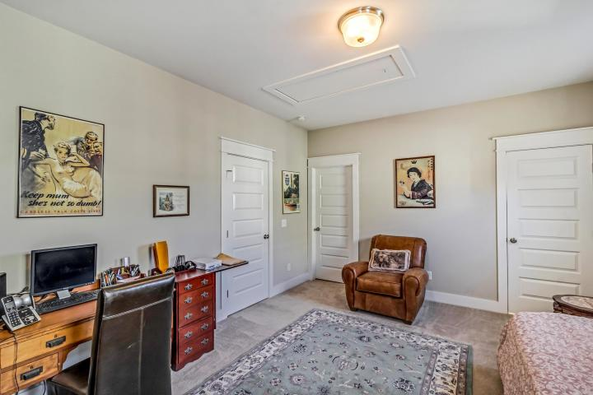
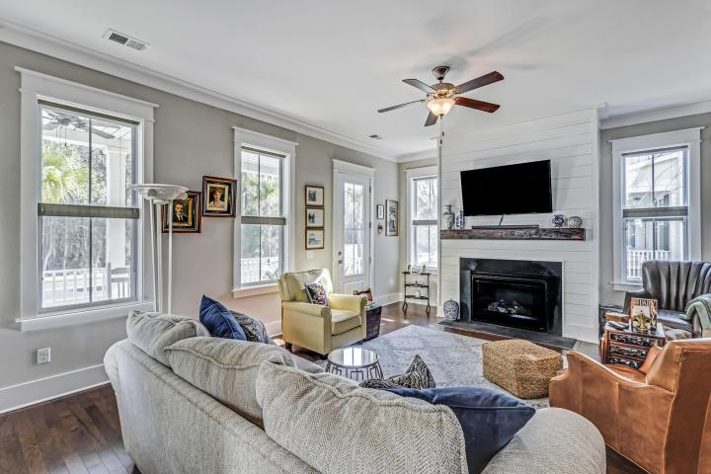
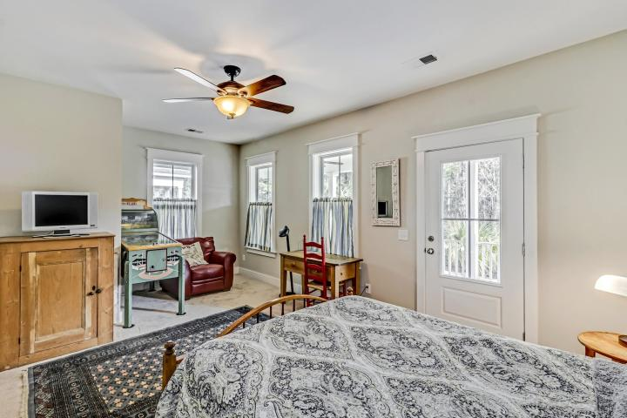
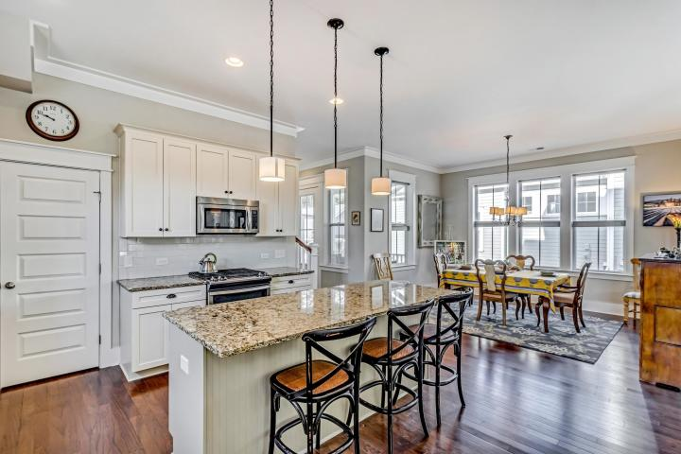
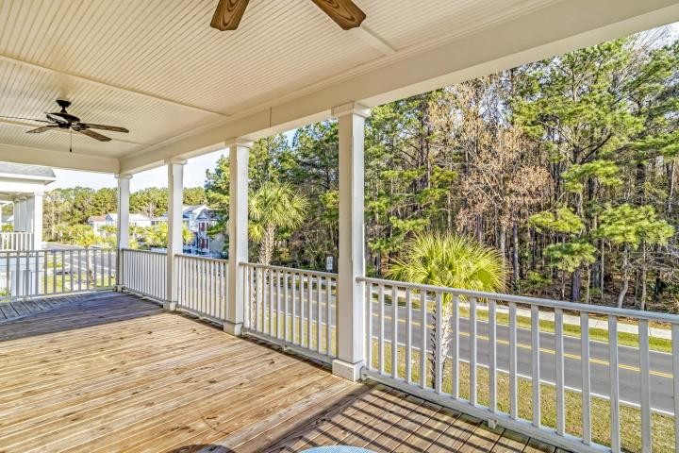
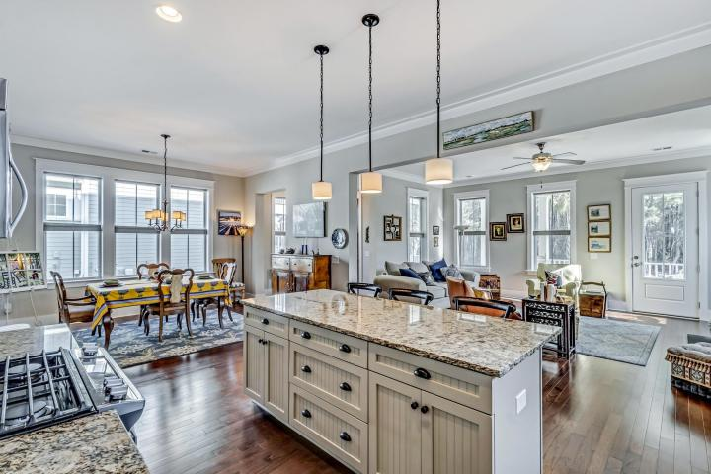
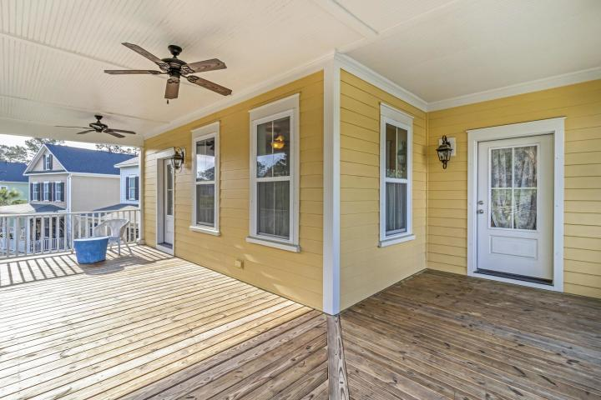
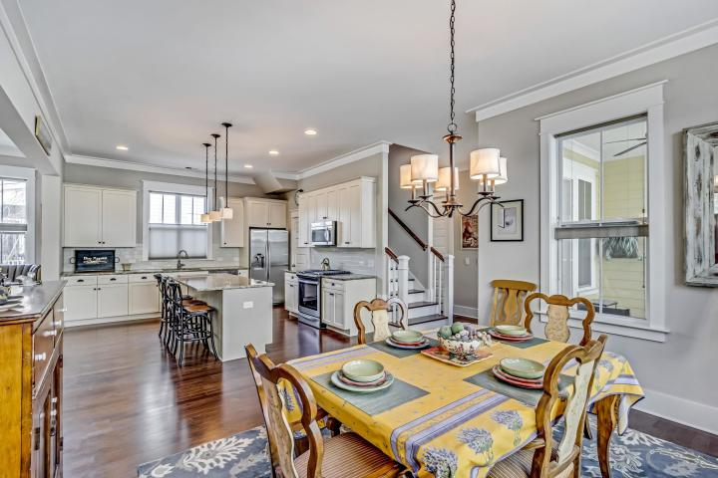
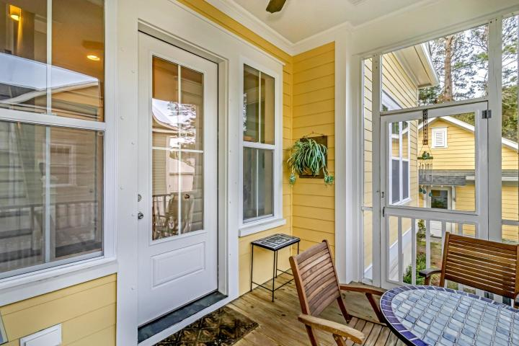
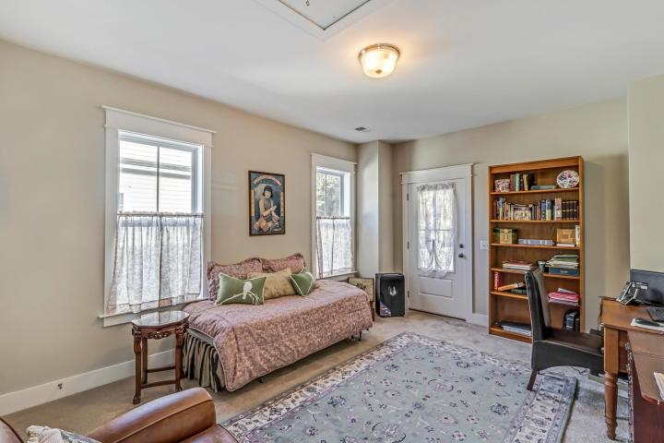
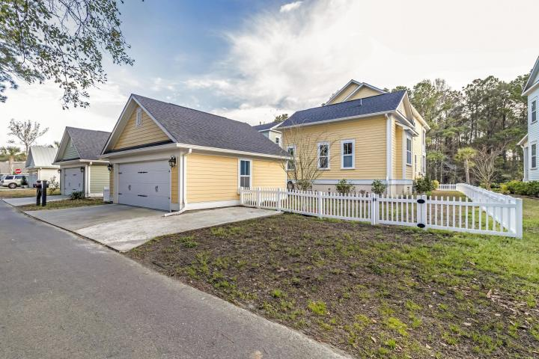


Open House
Wednesday 10:30a-1p
2896 Rivertowne Parkway
Rivertowne On The Wando
Mount Pleasant, SC 29466
MLS# 19007749 ~ $490,000
Foster Plan: First floor Master Bedroom. Charming Low-Country architectural style home. The Foster has expansive 10 foot ceilings and an open floor plan with a private downstairs master suite. Hardwood floors and granite counter tops and a plethora of other upgrades are the included features in this energy efficient and Eco-friendly home. A stone's throw away from Harris Teeter, retail, restaurants, amenities center with tennis courts, swimming pool and a community dock on the Wando river. You wouldn't need anything more than a golf cart if you lived in this wonderfully located home in Rivertowne.
Jason Newhauser
(843) 534-6564
jasonsellscharleston@gmail.com
www.jasonnewhauser.com
Coldwell Banker Residential Brokerage
1127 Queensborough Blvd. 103
Mt Pleasant, SC 29464

