Slide 1
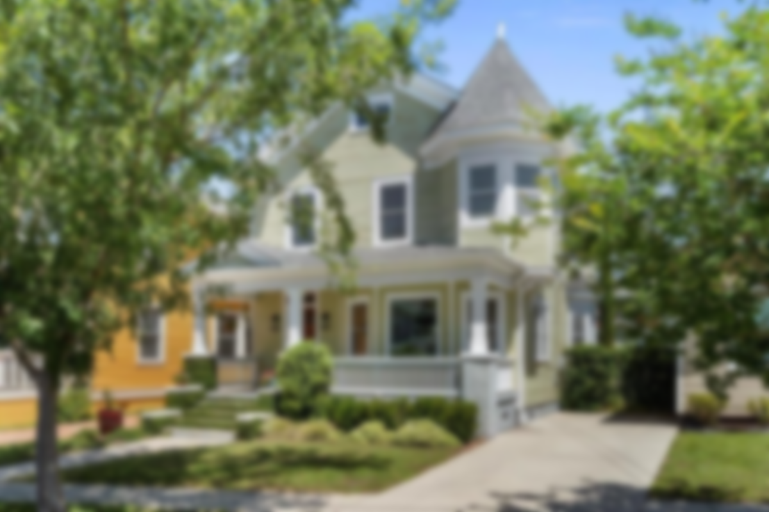



Be sure to check-out the YouTube video to see more!
28 Maple Street ~ North Central ~ MLS# 21013097 ~ $659,000
28 Maple Street is the perfect fusion of Downtown Charleston location and lifestyle. An accommodating 2072 sf, this 4 bedroom, 2.5 bath residence lives large and is well-maintained and move in ready. All the best of Charleston's food and drink hotspots, sports venues, parks, and historical landmarks are literally a short walk or bike ride outside your door. This picturesque Victorian beauty is located on a quiet street with no through traffic that ends where the future North Central section of the Lowcountry Lowlands park is to be developed. The property was renovated in 2011, creating an open feel and flow that lends to modern day living while retaining the 1935 original design features like original heart of pine floors, and nostalgic fireplaces with Charleston brick surrounds.
The present owner has added substantial improvements, including the addition of gutters, encapsulating the crawlspace, and insulating the attic space to provide substantial savings in utility costs. (See detailed list of special feature additions in documents section.) The downstairs is open and bright with natural light streaming through the front bay window through the living area. Perfect for entertaining, move freely from the living area to dining to kitchen. There's a room in the back that could be used as a guest bedroom or work/school office. A substantial utility room with sink opens to the back screen and a beautiful fenced outdoor oasis of landscaping. Perfect for outdoor BBQs and birthday parties! The shed was custom designed to match the main house and is fully wired for electrical. Upstairs you'll find the owners bedroom and bath, two guest bedrooms, guest bath with tile surround, and upstairs laundry that includes front-load washer and dryer. Imagine the life this property has lived and has yet to live! This description simply does not do this one of a kind home justice. You must tour 28 Maple and see for yourself.
Handsome Properties, Inc 53 Broad St Charleston, SC 29401
Yvette Grist
843-312-0696
yvette@charlestonfinehomes.com | www. charlestonfinehomes.com
Coldwell Banker Realty | 1127 Queensborough Blvd | Suite 103 | Mt Pleasant, SC 29464

