Slide 1
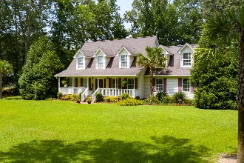
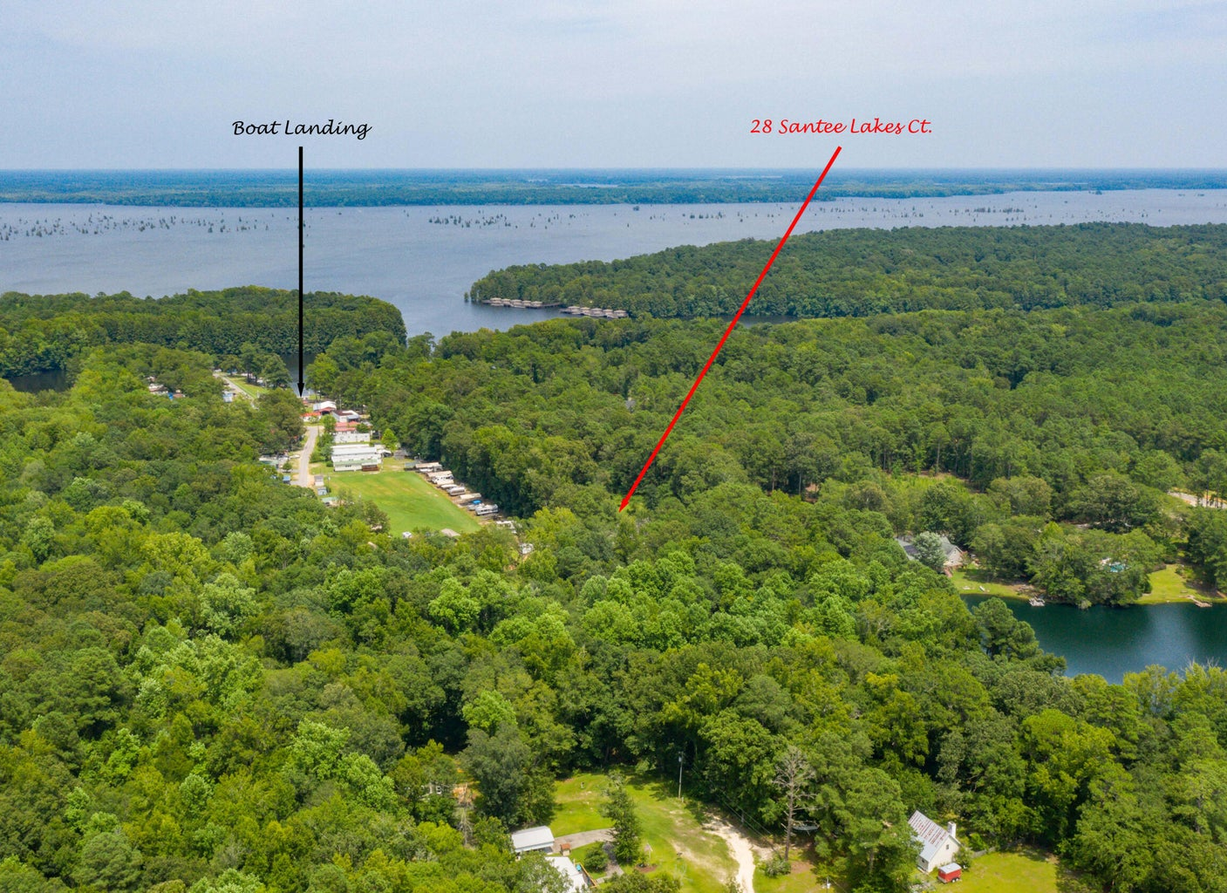
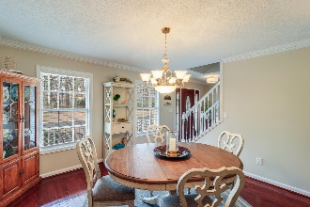
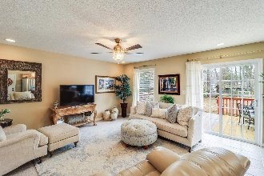
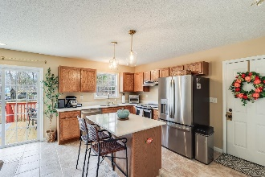
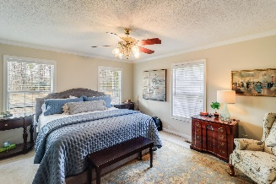
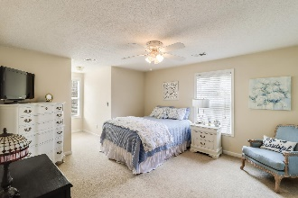
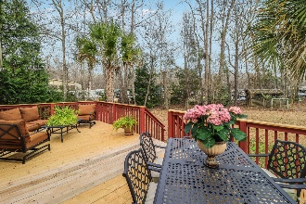
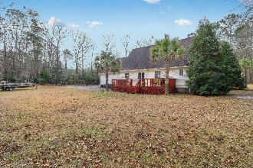
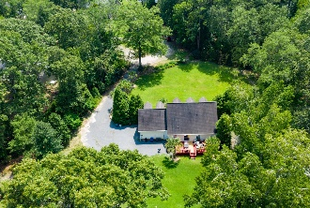


28 Santee Lakes Court
Santee Lakes | Elloree, SC 29047 | MLS# 24004111 | $384,900
Your Clients Dream Home Awaits!
Act Fast Before It's Gone!
Open House
Wednesday, 7/20
3-5PM
Welcome to this charming cape cod-style home located in the desirable Santee Lakes neighborhood. Situated on a spacious 1.47-acre lot, this property offers the perfect blend of country comfort and convenient amenities. With 3 large bedrooms, including a first-floor primary suite, and 2.5 bathrooms, this home is designed for comfortable living. As you approach the property, you'll be immediately drawn to the beautiful exterior featuring a large full front porch, a side entry 2-car attached garage, and meticulously cared-for mature landscaping, including peach trees and magnolia trees. The attention to detail is evident from the moment you arrive. Step inside and you'll be greeted by a beautiful foyer adorned with Brazillian cherry floors that extend through the hall entrance and dining room. The dining room is spacious and can accommodate a large table and hutch, making it ideal for hosting dinner parties and special gatherings.
The main living area has an open concept design, allowing for seamless views from the kitchen to the rest of the space. The kitchen offers ample cabinet storage, under cabinet lighting, quartz countertops, and stainless steel appliances, including a GE slide-in stove with air fryer and a GE dishwasher. The kitchen island provides the perfect space for meal preparation and entertaining.
Off the kitchen area, a sliding glass door leads out to a large outdoor deck, offering stunning views of the beautiful mature trees surrounding the property. This outdoor deck is perfect for hosting outdoor gatherings or simply enjoying the peaceful serenity of the surroundings. With 1.47 acres of land, there is plenty of outdoor space to explore and enjoy.
The first-floor primary suite is a true retreat, there is ample space for arranging bedroom furniture, dual closets, and your own private en-suite. The en-suite features ceramic floors, a large soaking bath, a glass door shower, and a dual sink vanity, providing a luxurious and convenient space for relaxation. Two additional generously sized bedrooms share a full bathroom with ceramic floors and a tub/shower combo, ensuring comfort and convenience for all.
Enjoy the best of both worlds with this home, embracing the country comfort while still being in close proximity to many amenities, including Lake Marion, golf courses, Poplar Creek public boat landing, fishing spots, restaurants, and shopping options. Don't miss the opportunity to make this exceptional property your own. Schedule your showing today and start envisioning the peaceful and comfortable lifestyle that awaits you in this beautiful Santee Lakes home.
Enjoy a video tour!
Brandon Ray
(843) 499-1928
brandon.ray@carolinaone.com
www.therightrayhome.com
Carolina One Real Estate
900 N Main St
Summerville, SC 29483

