Slide 1
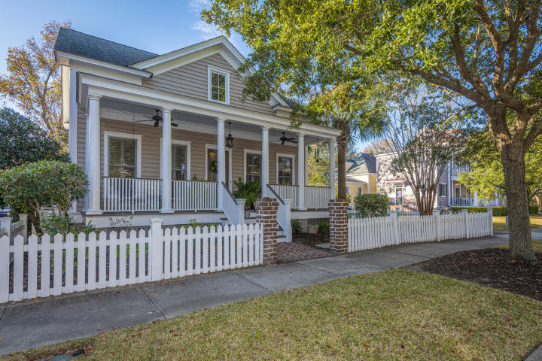
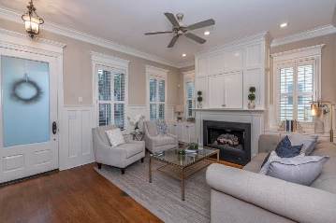
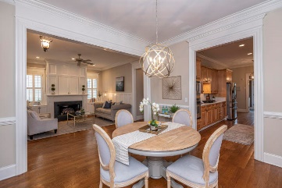
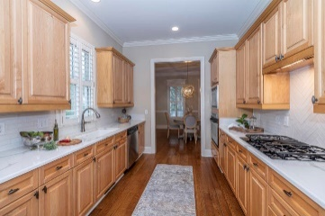
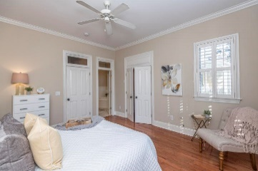
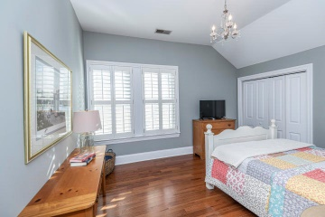
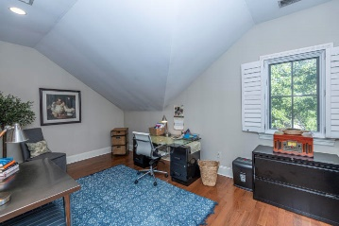
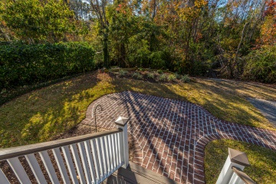
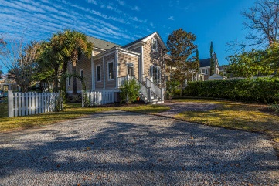


28 Sowell Street I'on | Mount Pleasant, SC 29464 MLS# 20003253 | $775,000
Come Out & Meet the Stager
Open House Saturday June 6, 2020 11a-2p
Custom Home w/Panoramic Views of Toomer Creek
Charming I'On cottage, 2,285 square feet, 3 Bedrooms, 2 1/2 Baths
Master Suite on the first floor!
Wood floors, gas fireplace, modernized kitchen
Lovely sunny rooms ~ 10 foot ceilings first floor, 9 feet upstairs
Privacy guaranteed with bird sanctuary in back
Versatile spaces upstairs + loads of storage
Room to add garage should you choose to
Duval Acker Mobile 843-693-0690
Office 843-884-1622
duval.acker@carolinaone.com www.searchingcharleston.com
Carolina One Real Estate
628 Long Point Rd.
Mt Pleasant, SC 29464-3032

