Slide 1
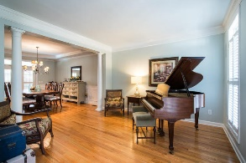
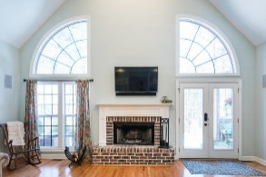
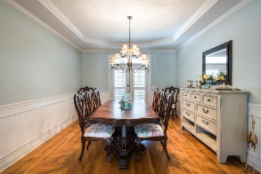
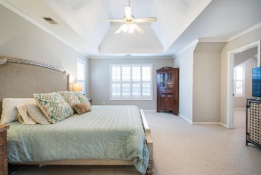
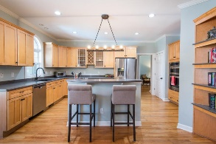
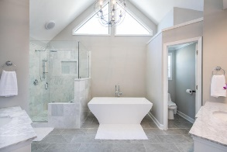
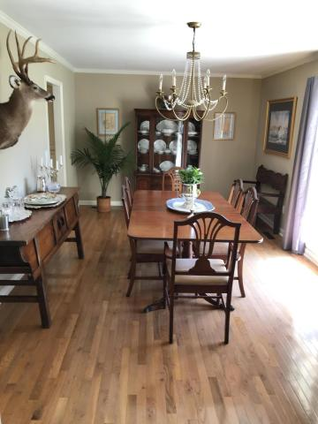
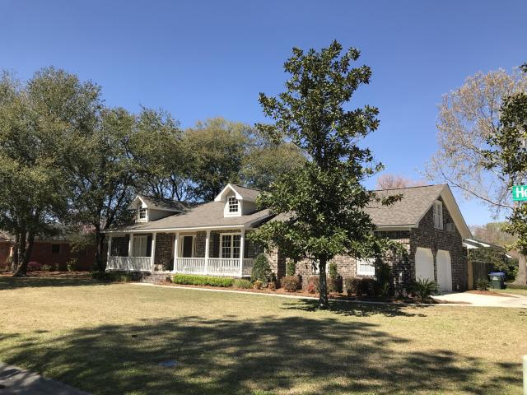
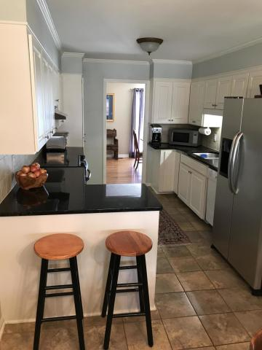
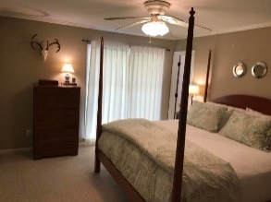
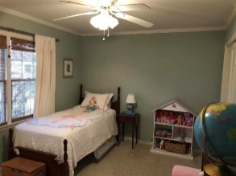
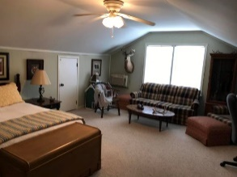
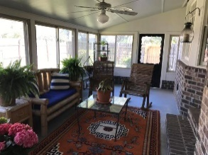
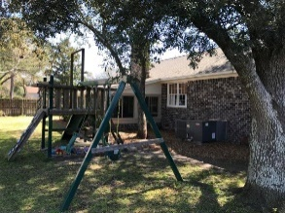
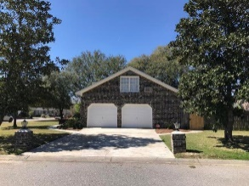


2903 Sugarbush Way
Hickory Hill Plantation ~ Charleston, SC 29414
MLS# 19007958 ~ $339,500
Location
Price
Condition
Best value in the area!
This 3 Bedroom, 2 Bath Brick Ranch home with large finished room over 2 car garage plus spacious sun room is well maintained in well established neighborhood located on large corner lot with a side entry double car garage and fenced yard.
Home is conveniently located to I 526, Boeing, Airport, Roper St Frances, MUSC , Shopping downtown Charleston schools and beaches. No flood insurance required for this property. The exterior of home has been freshly painted.
A new roof has been installed. The kitchen and other areas of home have been upgraded in the past. The Finished room over the garage (FROG) is being used as a 4th bedroom and the Sun room can be used year round. Both FROG and Sun Room are both included in the total square footage.
Tommy Lovett
Tommy - (843) 442-1276
tlovett@carolinaone.com
www.tommylovettrealestate.com
Carolina One Real Estate
628 Long Point Rd.
Mt Pleasant, SC 29464-3032

