Slide 1
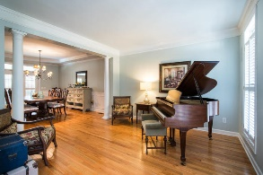
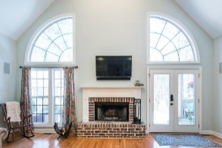
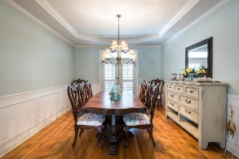
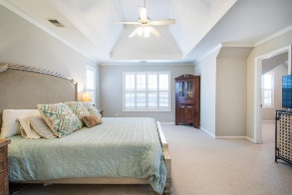
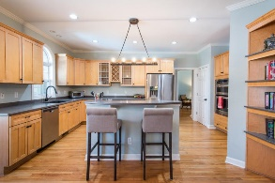
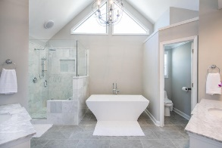
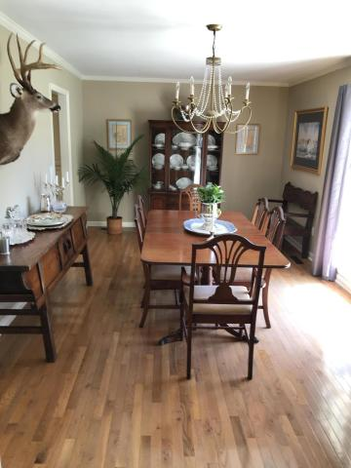
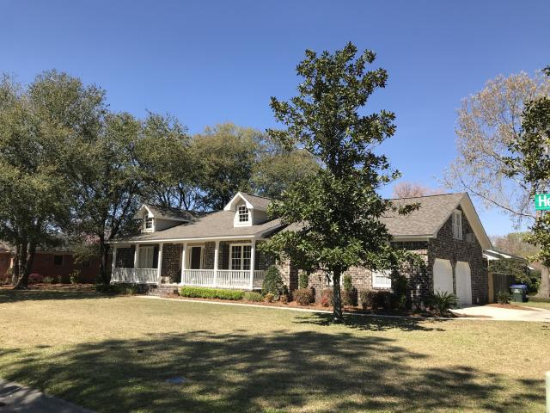
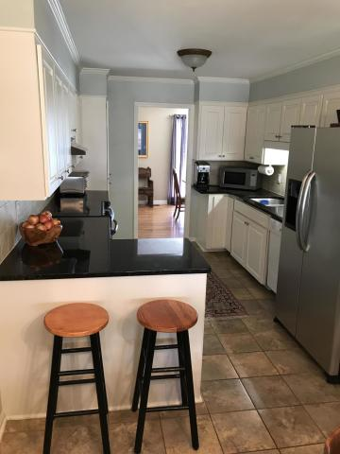
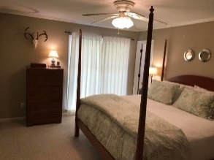
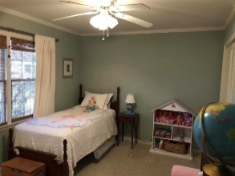
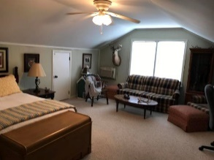
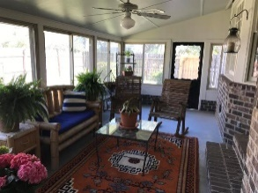
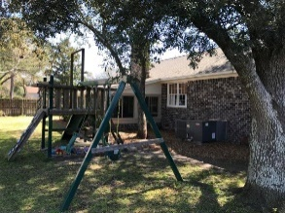
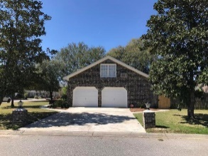


2903 Sugarbush Way Hickory Hill Plantation ~ Charleston, SC 29414 MLS# 19007958 ~ $330,000
Location
Condition
Reduced Price
Best value in the area!
This well maintained 3/4 BR, 2 BA Brick Ranch home w/4th Br bonus room & sun room is located on large corner lot with fenced yard. Home is conveniently located to I 526 , I 26, Airport, Roper St Frances, MUSC , Shopping downtown Charleston, schools and beaches. No flood insurance required for this property. The exterior has been freshly painted. A new roof has been installed. The kitchen and other areas of home have been upgraded in the past. The FROG is being used as a 4th BR and the Sun room can be used year round. Both FROG and Sun Room are both included in the total square footage.$1600.00 lender credit is available and will be applied towards buyers closing cost & prepaids if buyers choose to use Carolina One Mortgage. This credit is in addition to any negotiated sellers concessions.
Tommy Lovett Tommy - (843) 442-1276
tlovett@carolinaone.com www.tommylovettrealestate.com
Carolina One Real Estate
628 Long Point Rd.
Mt Pleasant, SC 29464-3032

