Slide 1
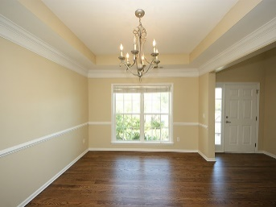
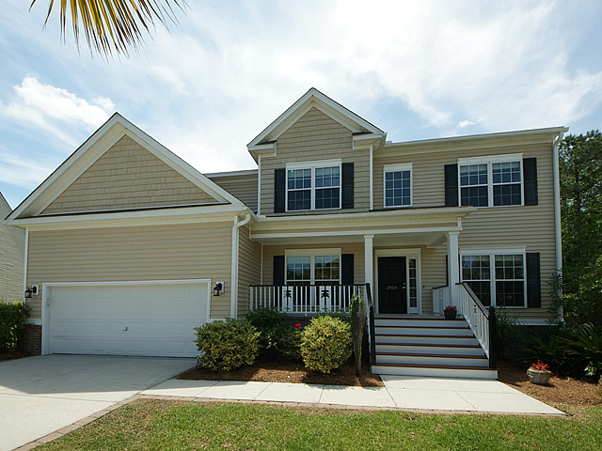
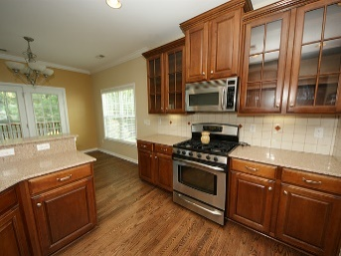
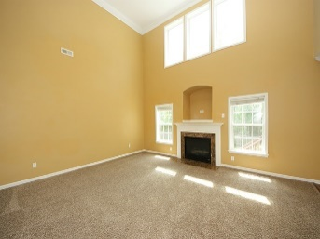
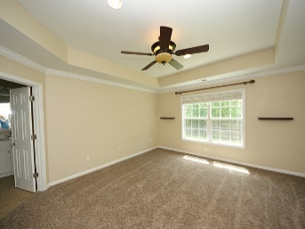
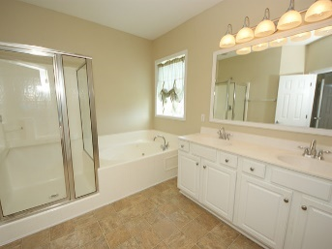
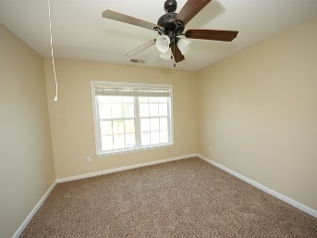
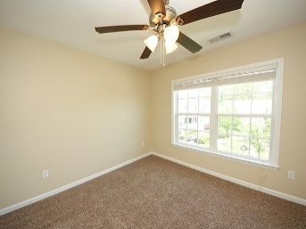
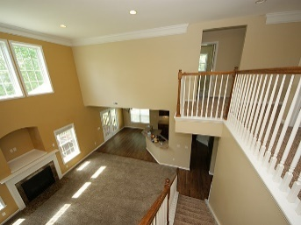
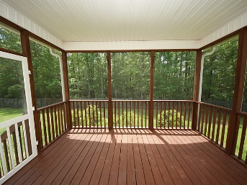
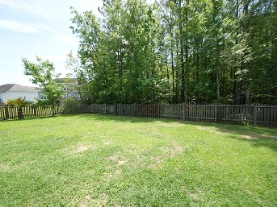
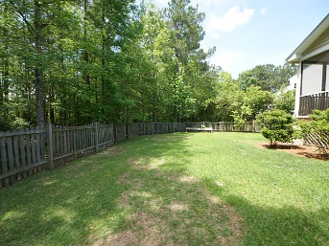
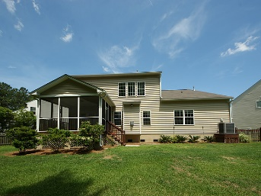


2904 Thornrose Lane
Planters Pointe ~ Mount Pleasant, SC 29466
MLS# 16010244 ~ $459,000
Immaculate and Move-In Ready
Immaculate and Move-In Ready
Visit this Family Friendly Neighborhood! Newly refinished, beautiful hardwood floors. New carpet. Fresh neutral paint throughout entire home. This home is vacant and ready for you to make it your own! 2900 sq.ft. open floor plan with five bedrooms and three and a half bathrooms is perfect Lowcountry Living. Situated on a large cul-de-sac lot, the elevated screened porch overlooks a private, fenced wooded back yard complete with the convenience of an installed irrigation system. The family room is open to the eat-in kitchen featuring all stainless appliances, Cherry Cabinetry complete with underlighting and Silestone Marble Countertops. Formal Dining Room as well as Separate Office Space with French Doors. Dual masters (one down) and three additional bedrooms upstairs. Top Rated Schools.
Sandra McLoone
O (843) 856-8800 | C (843) 276-4849
sandra.mcloone@cbunited.com
www.YourLowcountryHomeSearch.com
Coldwell Banker United, REALTORS | 1127 Queensborough Blvd. 103 | Mt Pleasant, SC 29464

