Slide 1
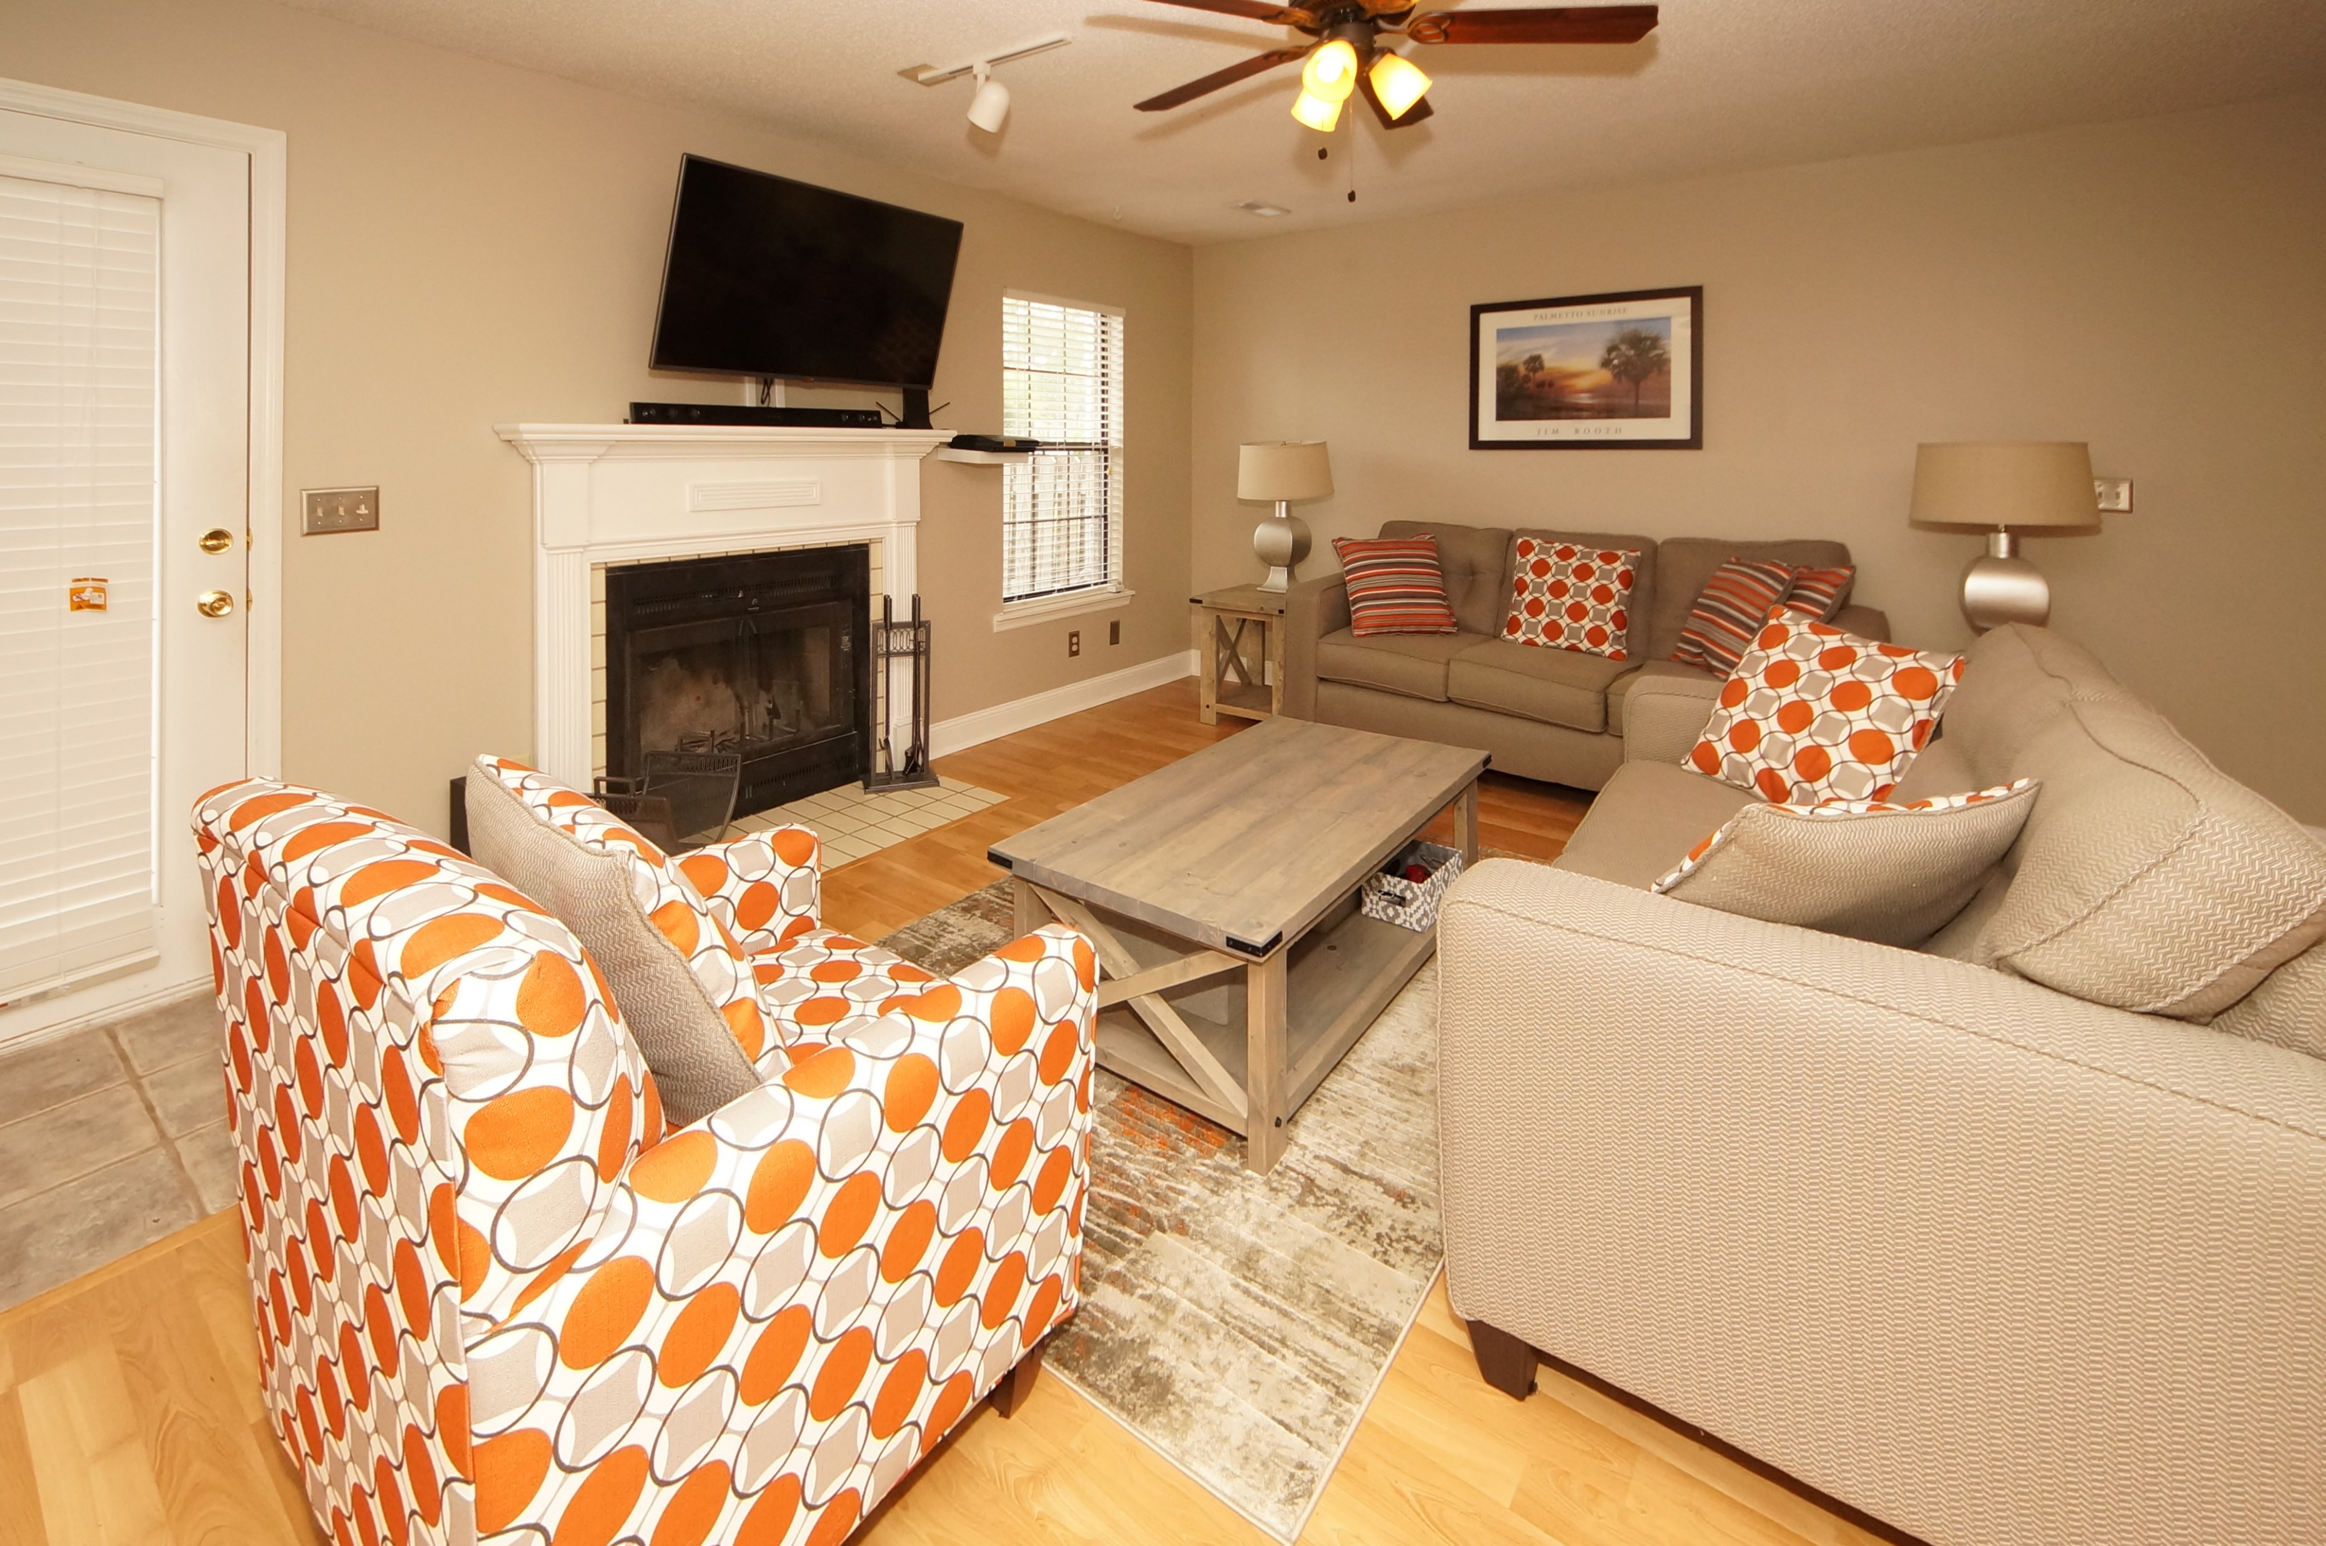
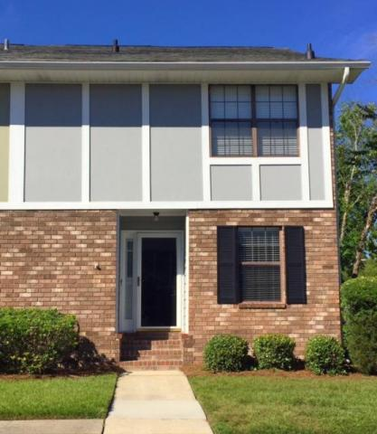
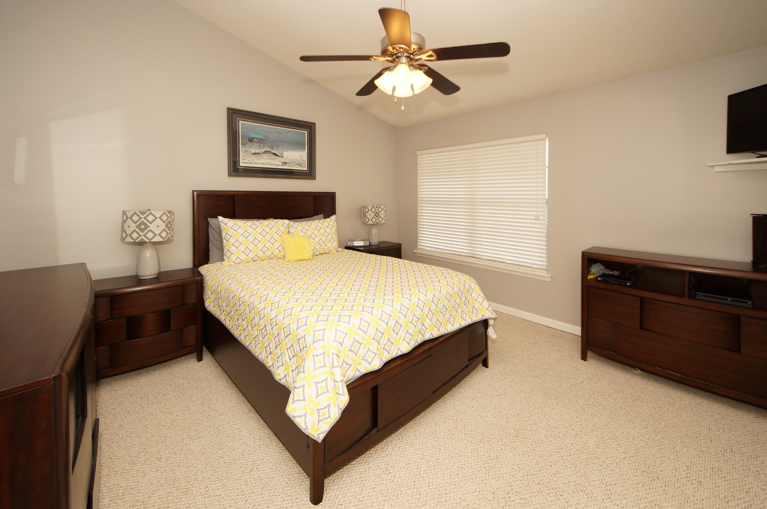
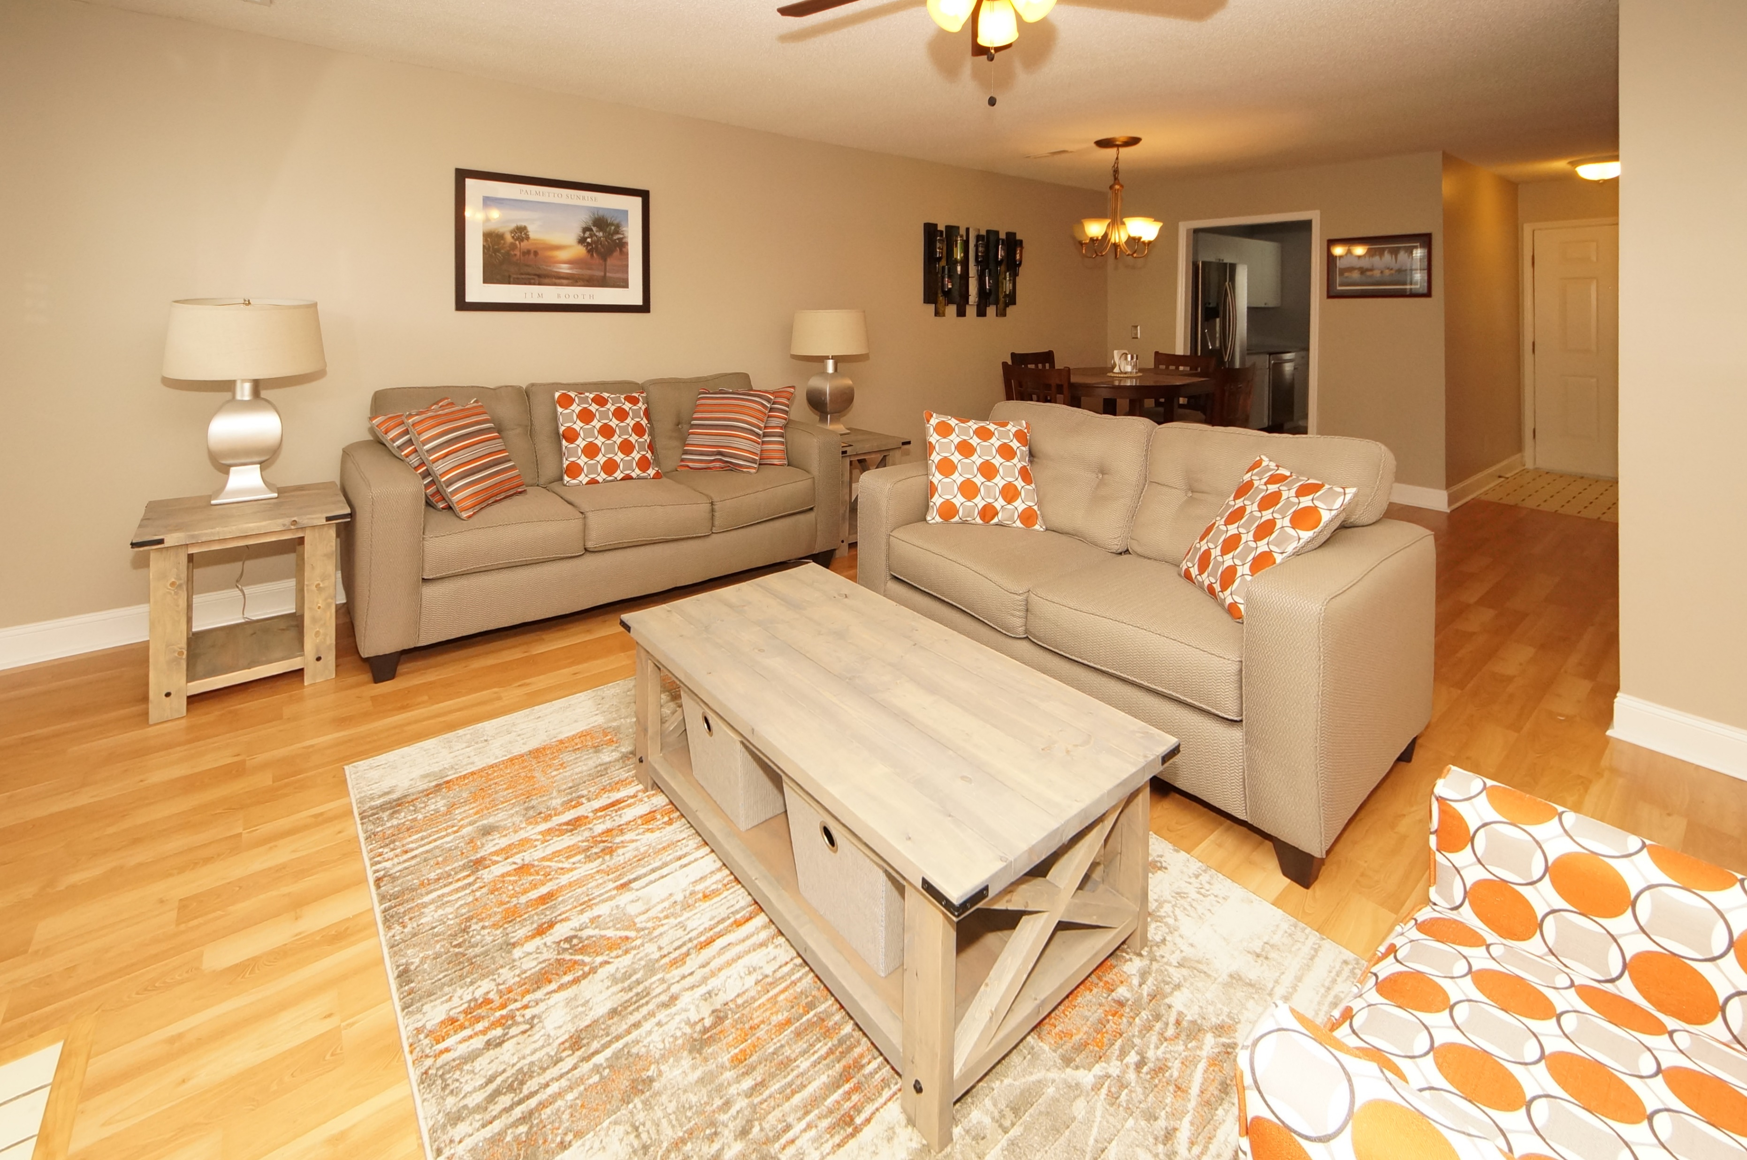
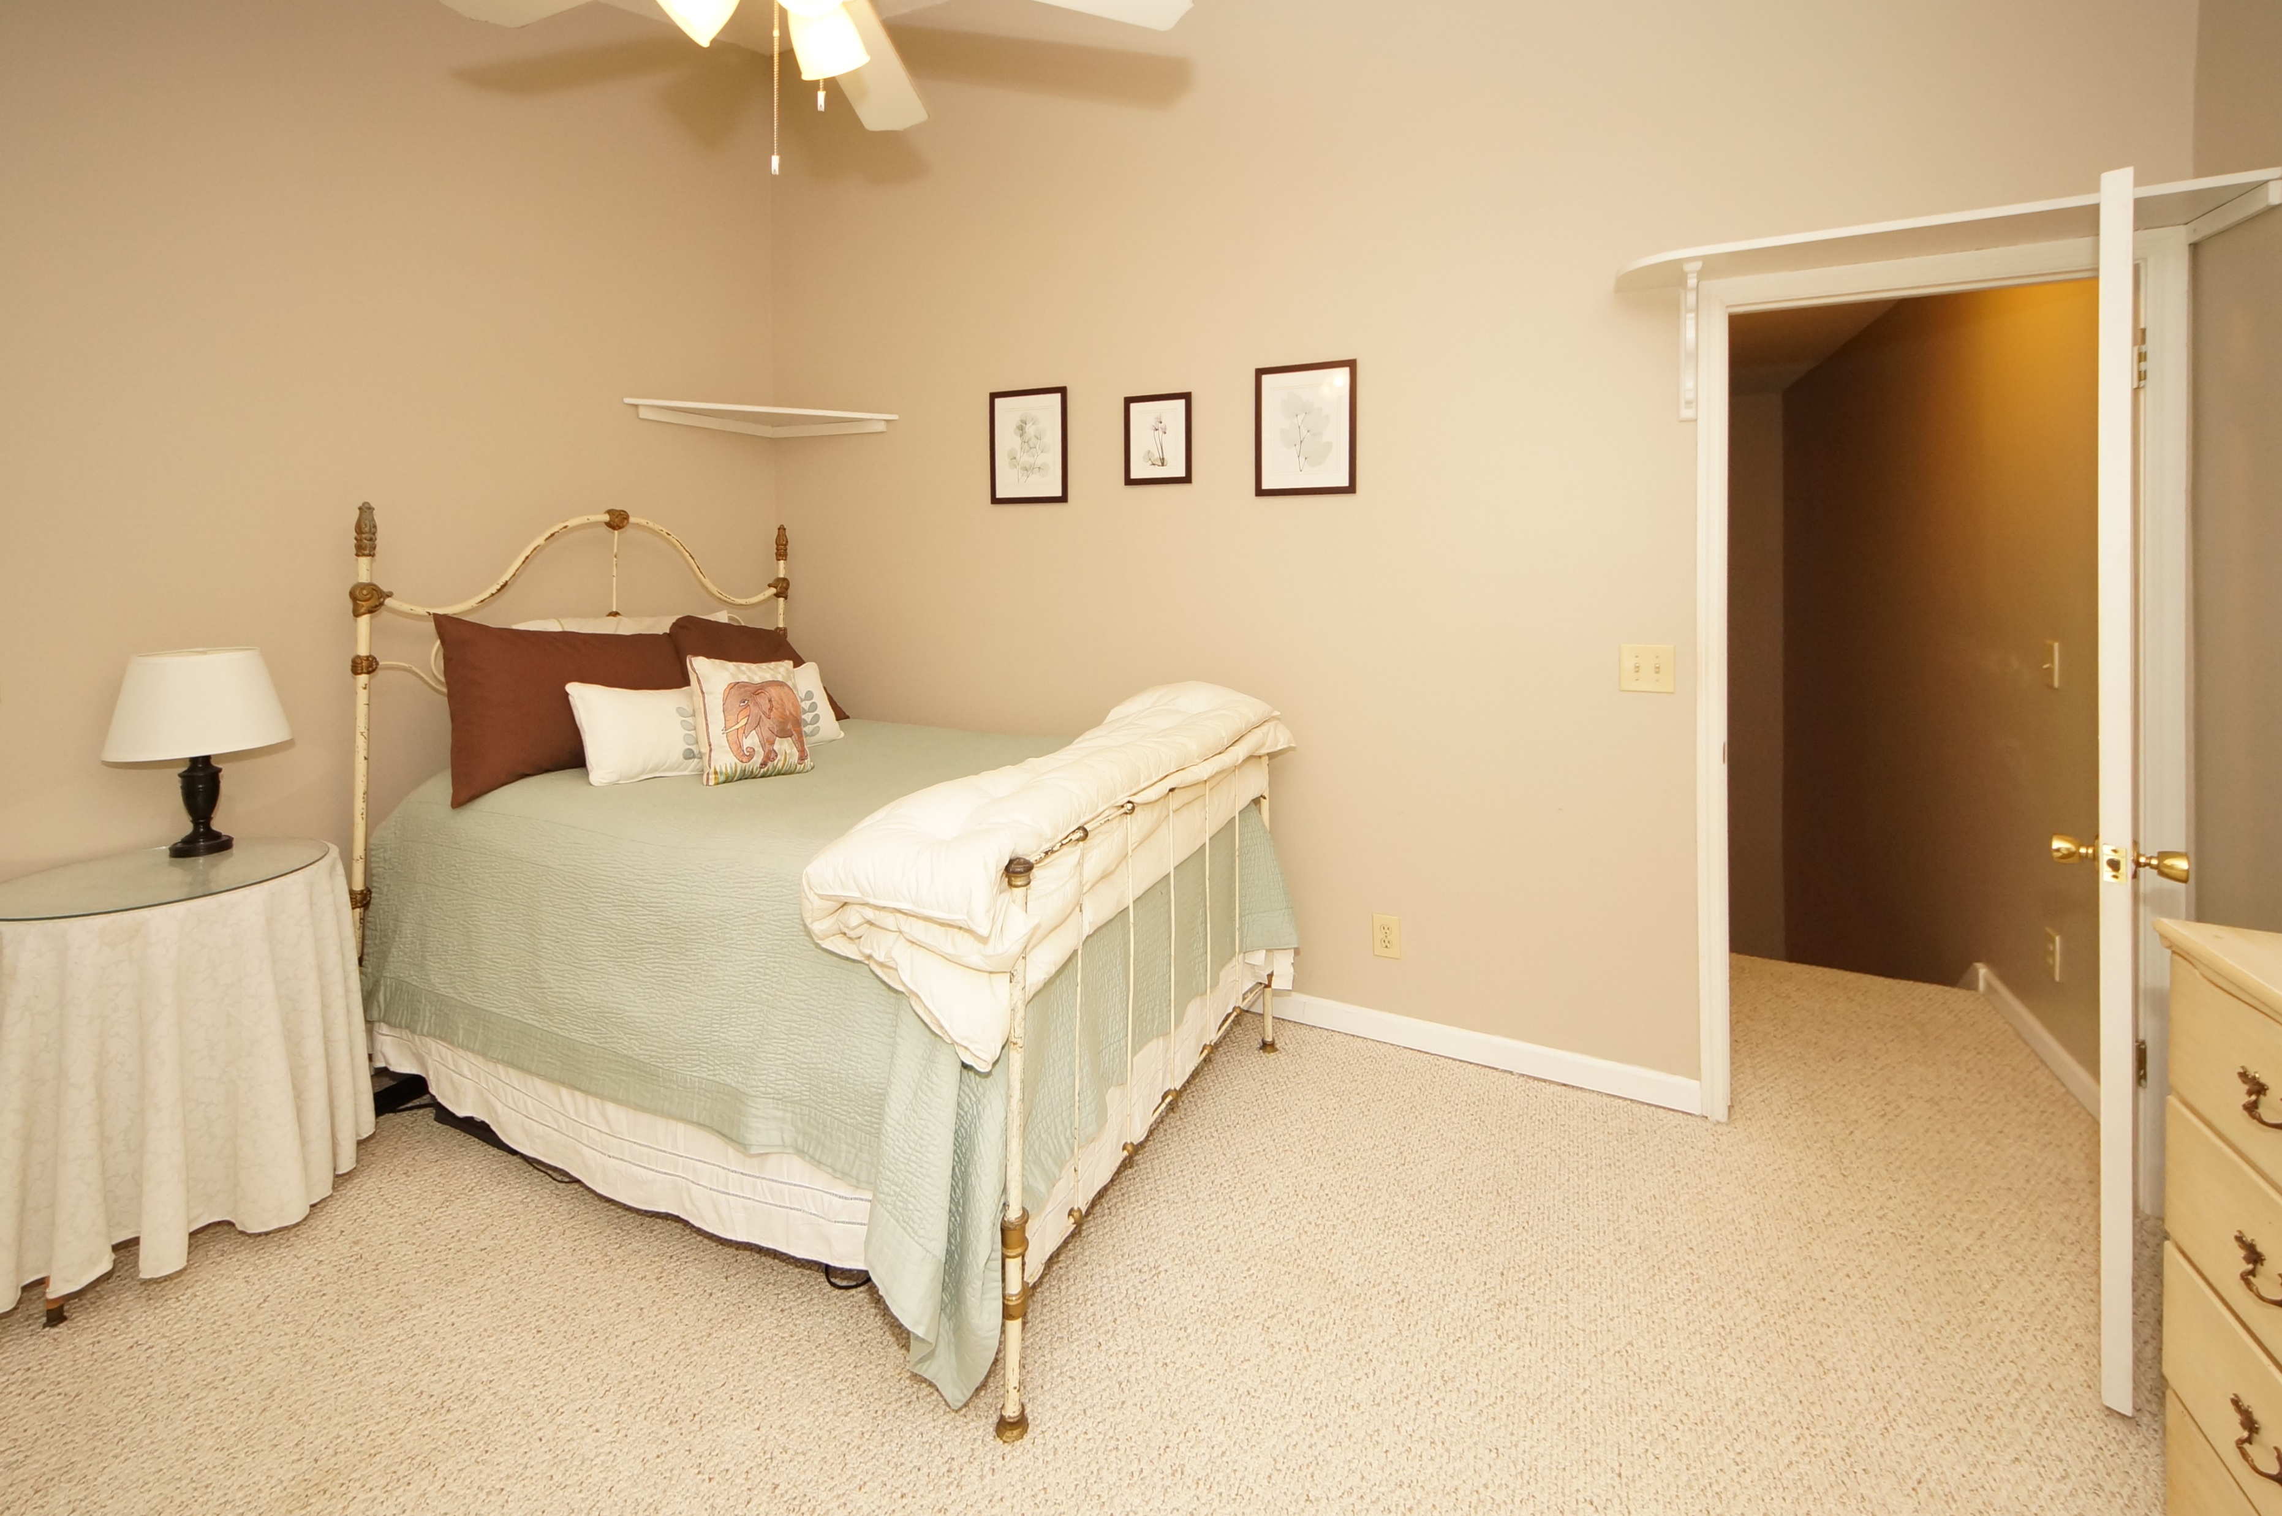
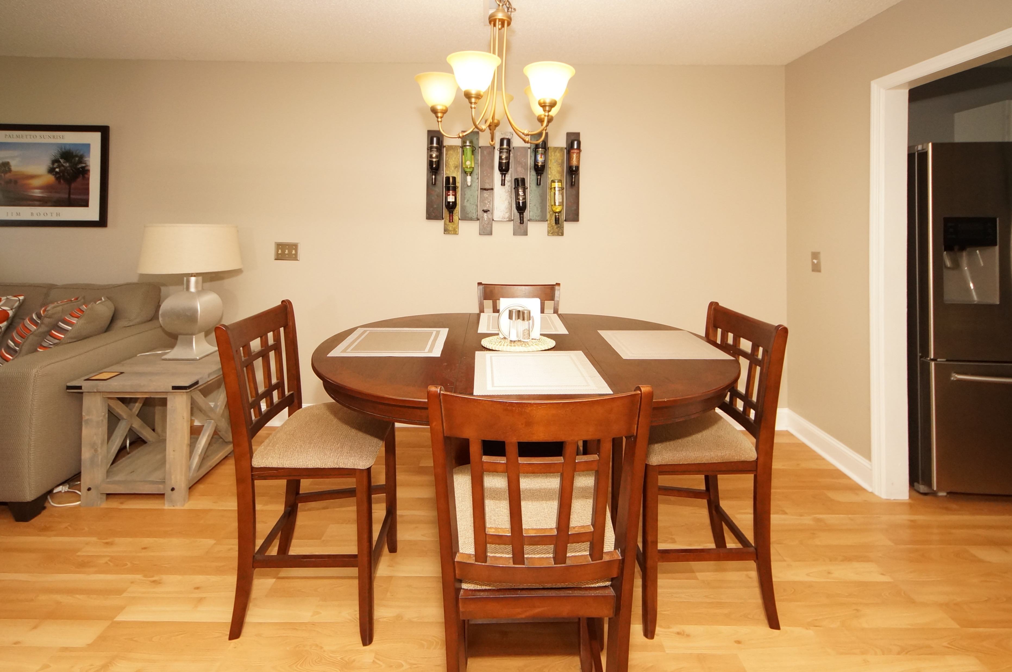
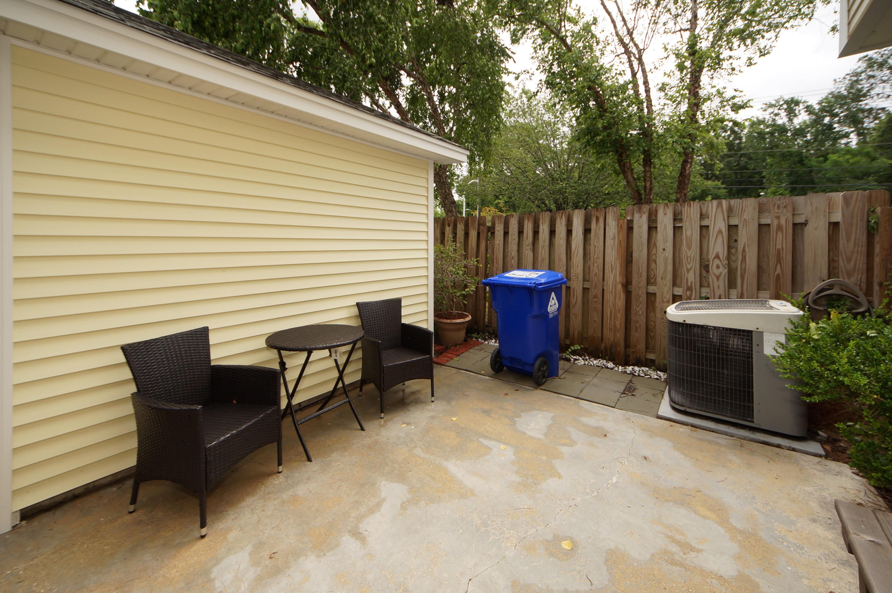
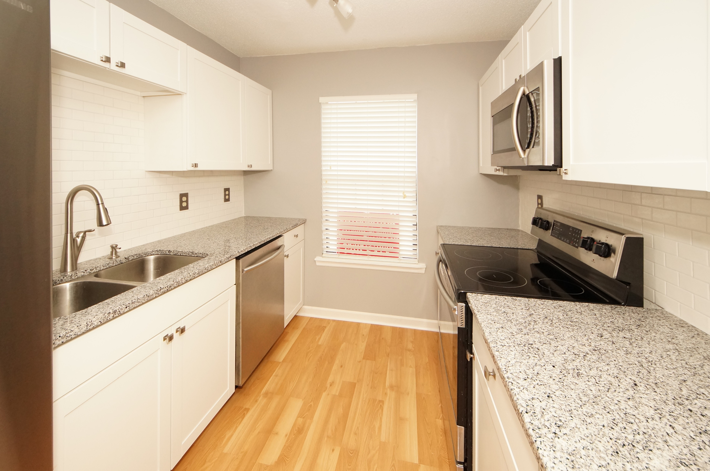
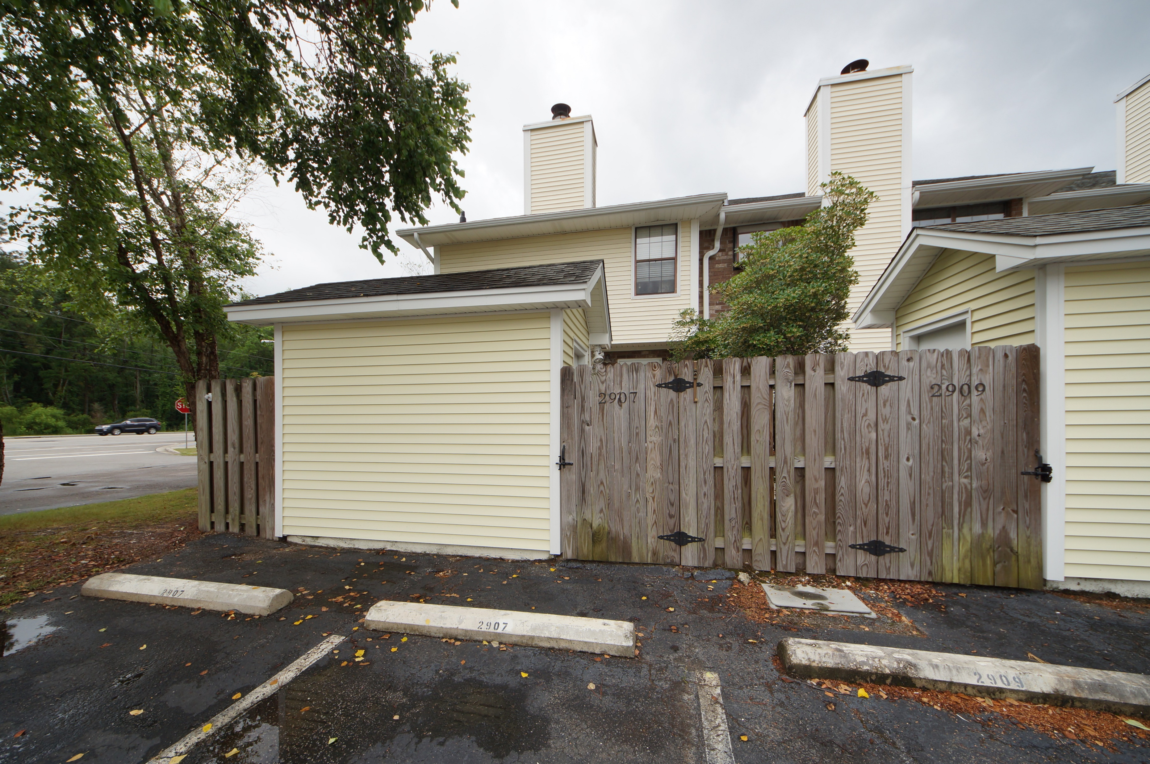


West Ashley Gem
2907 Oxford Place
Shadowmoss Plantation ~ Charleston
MLS# 17014612 ~ $182,900
FANTASTIC 3BR/2.5BA townhome in West Ashley for under $185K!! Don’t miss this opportunity to own a home just minutes from Saint Francis Hospital in the quiet, well- established, highly desired Shadowmoss Plantation community. **LOCATION, LOCATION, LOCATION** Located on Bees Ferry Road and close to a public golf course, the historic gardens on Hwy. 61, and tons of shopping, this place has it all as far as location is concerned. Even the beautiful beaches at Kiawah and Seabrook Islands are just a very short drive away. The care, upkeep, and love for this townhouse are obvious as you walk through the front door. The seller has completely updated the home. In the dining room, you'll see a closet that has been removed to be replaced by an inset glass-shelving space, complete with lighting. The kitchen has been upgraded with a brand new subway tile backsplash (last week), stainless steel appliances, granite countertops, new cabinets, and an undermount sink. The great room, complete with a wood-burning fireplace, and dining area are open, bright, and spacious. Upstairs are the nice-sized, cathedral ceiling bedrooms, which include a master suite, and two secondary bedrooms (sharing a jack & jill bathroom). This home also boasts a brand new master bathroom â€“ new floors, sink, cabinets, and toilet (last week), AND has a brand new water heater (last week).
Just off the great room is a sweet Charleston-style courtyard, an inviting space to relax, cook out, and entertain guests. The storage shed in the back yard is a fantastic storage space which measures 6'x10'. Enjoy taking a short walk down to the amenity area to see your beautiful swimming pool and clubhouse, a nice break from life, which also serves as the perfect place to meet your neighbors and make some new friends. The neighborhood is quiet, and the grounds are pristinely kept. This end-unit townhome offers so much privacy, with neighbors only on one side. The $160/mo regime fee pays for all outside maintenance including pressure washing (just this past week), lawn care, termite bond, amenity access and a new roof (approx. 5 years old). There are two assigned parking spaces behind the townhouse, along with generous visitor spaces throughout the community. This home is conveniently located, with quick access to Charleston's popular historic gardens, hospitals, shopping, Downtown Charleston, Summerville (via Hwy 61), beaches, Boeing, and The Charleston Int'l Airport. This large, move-in ready 1415 sq. ft. townhome is perfect for newlyweds, young families, and retirees. Don't miss out on this chance to own a piece of West Ashley!! Schedule your showing TODAY!
Tammy Thompson
843-412-1856 tammylthompson@live.com
Keller Williams Realty
496 Bramson Ct Ste 200
Mt. Pleasant, SC 29464

