Slide 1
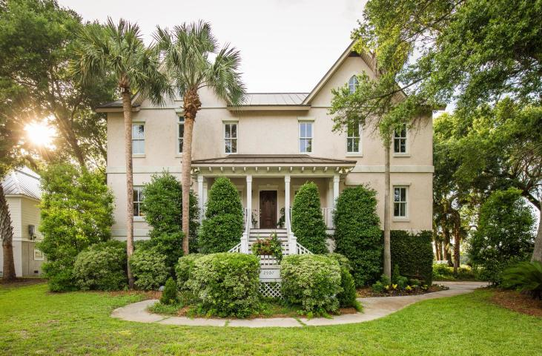
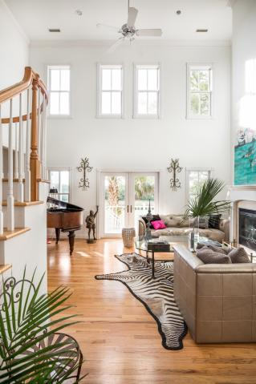
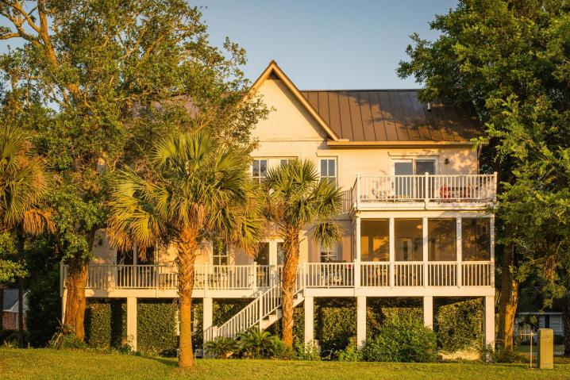
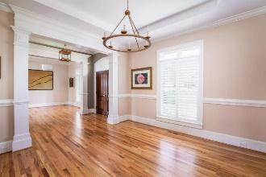
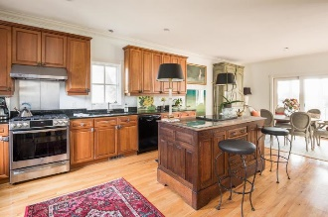
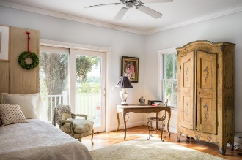
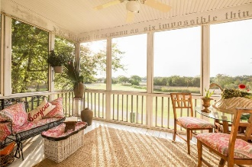
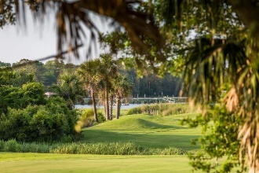
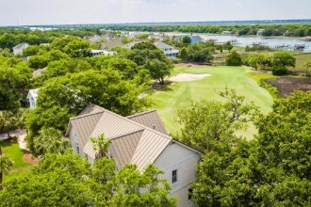
2907 Waterway Boulevard Isle of Palms, SC 29451 · MLS# 18016353 · $895,000
Darrell Creek Elevated Home With Elevator & Salt Pool
Best Priced Home On IOP With Golf Course & Waterway Views!!
This 3 bedroom, 3.5 bath island home was designed and constructed with extraordinary detail and care. Current owner is the original owner and she built the home to last using the expertise of three architects and one structural engineer. This property, as a whole, is solid as a rock. It sits on a magnificent quarter-acre lot on the 8th green of Wild Dunes golf course with golf course, marsh and Intracoastal Waterway views. Enter the home through the open foyer with 2-story views of the family room and out through the porch to the golf course. Kitchen is open to large dining area which leads to the screened in porch and open deck. All of the main areas open to the back porch, which spans the width of the house, and allow for views of the golf course, marsh, and Intracoastal Waterway.
Kitchen features an antique curator's desk from the Cannon Street Museum that is used as an island; top of the line appliances including stainless steel new gas range, stainless steel Sub Zero refrigerator, and new Bosch dishwasher; granite counter tops; and custom cherry wood cabinets. Home has three bedrooms, all complete with en suite bathrooms. Two are upstairs and one is down. Two of the suites have direct access to porches and views. An over-sized hallway between the two upstairs suites includes sitting areas and built-in bookshelves for holding library collections or decorative items. The entire house has hardwood flooring except for the bathrooms, which are tiled. Exterior of home was constructed using Hebel Autoclaved Aerated Concrete covered in REAL cement stucco. Hebel concrete is wind resistant to 185 mph, fire resistant, mold resistant, impervious to pests, sound and thermal insulating (lower energy costs), low maintenance, accredited by the Green Building Council, etc. The home's roof material, industrial 5-gauge metal (approx. 50 yr. lifetime), was chosen with the same thoughts of longevity and stability. Drive-under garage can accommodate 3 cars and has plenty of room storage. The lot is quiet and private with mature landscaping. The property is considered to be part of Wild Dunes, but sits outside the gates, so no community fees are required. However, property owner has the option to purchase a club membership if desired.
Andrea Rogers
(843) 532-3010 | andrearogers1@gmail.com | www.andrearogersrealtor.com
AgentOwned Preferred Group | 1400-G Palm Blvd | Isle Of Palms, SC 29451

