Slide 1
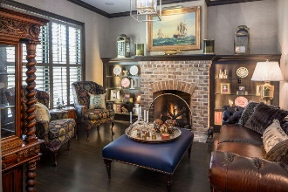
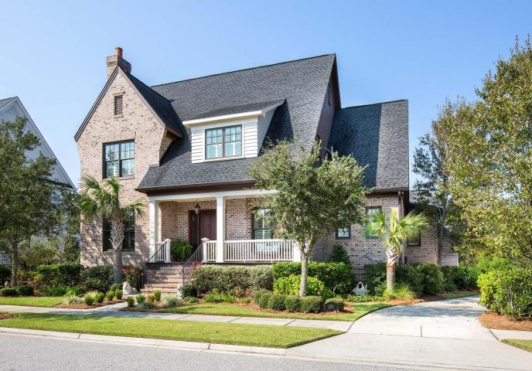
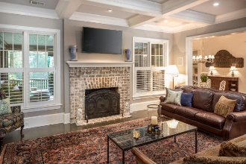
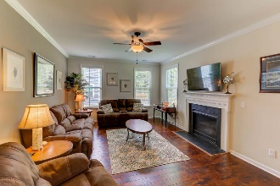
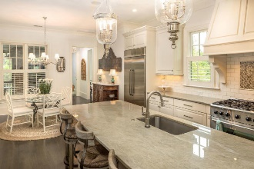
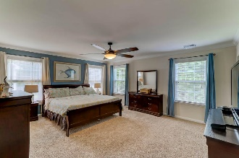
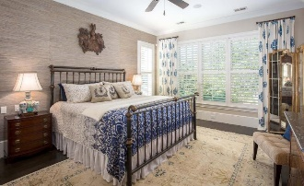
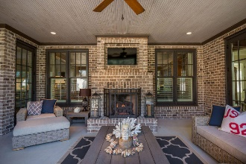
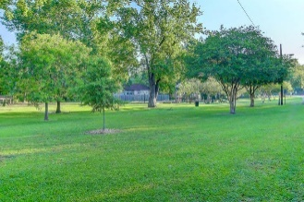
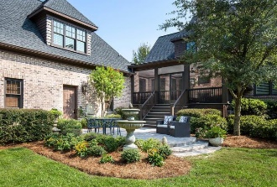


Daniel Island Park Open House
Wednesday, October 25th – 11:30-1:30
290 Furman Farm Place
Charleston, SC 29492 ~ MLS# 17026232 ~ $1,575,000
This gracious custom all brick home was designed and owned by one of Daniel Island’s leading Architects, Jerry DeWitt. Conveniently located in the country club neighborhood of Daniel Island Park overlooking green space and backing up to woods, this home boasts an open floor plan with plentiful living areas complete with all the bells and whistles including a hard to find three car garage and mother-in-law suite. Upon entry you are immediately drawn to the open flow this home offers with gleaming dark ebony stained oak floors throughout the home and an abundance of natural light. Off the foyer sits a dramatic study boasting custom built-ins and a fireplace with an exposed handmade brick finish. The dining room directly across the foyer flows freely into the family room.
There are so many more features of this home than I can fit here. Do your buyer a favor and stop by to see this gem!
Catered lunch provided by Mrs Hamby
Ariel Trouche
(843) 568-0595 | charlestonaddress@yahoo.com
www.LoCountry.com
Carolina One Real Estate | 1265 Folly Rd | Charleston, SC 29412

