Slide 1
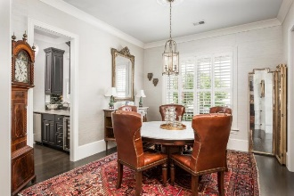
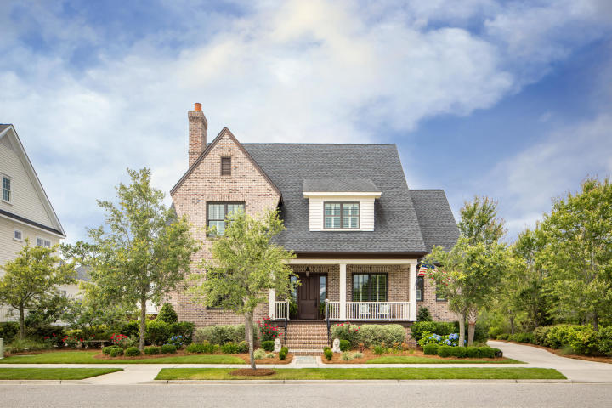
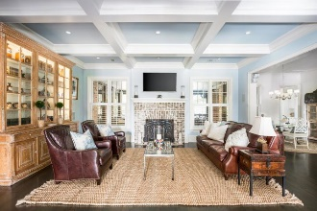
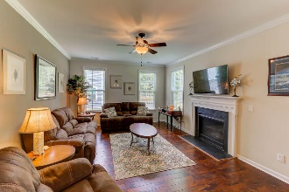
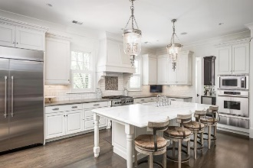
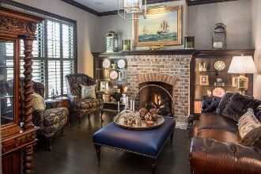
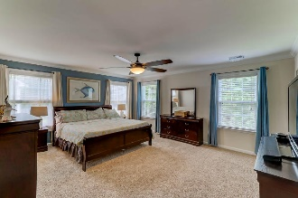
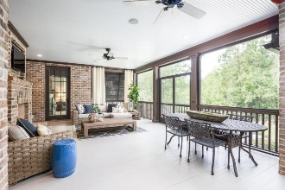
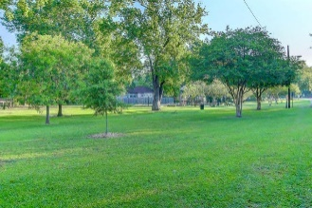
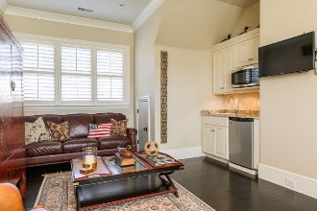
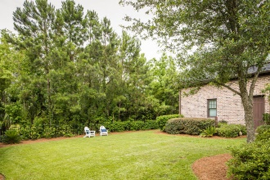


Broker Open House
Monday, Sept 10th 1:00-2:30 pm
$7,500 Agent Bonus
290 Furman Farm Place
Charleston, SC 29492 ~ MLS# 18015474 ~ $1,560,000
Welcome home to 290 Furman Farm Place located on one of the best streets in the Daniel Island Park neighborhood. This custom built all brick home is truly a magnificent find. With its DOUBLE front and rear porches, generously tree lined private yard (with room for a pool), attached in-law suite and three car garage, you will find the ease of classic lowcountry living and endless entertaining here. Upon entering the home you immediately feel welcomed by the flow of the open concept floor plan. Throughout the home you will find, 10' ceilings, 12' arched openings, 8' doorways, extensive trim work, coffered ceiling, three charming fireplaces and gorgeous oak floors in EVERY room.
There are so many more features of this home than I can fit here. Be sure to check the listing for complete details! Or call me to schedule a showing!
Ariel Trouche
(843) 568-0595 | charlestonaddress@yahoo.com
www.LoCountry.com
Carolina One Real Estate | 1265 Folly Rd | Charleston, SC 29412

