Slide 1

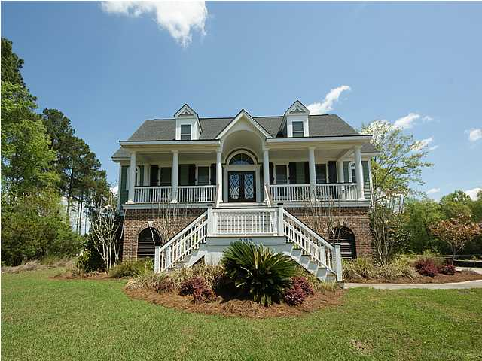
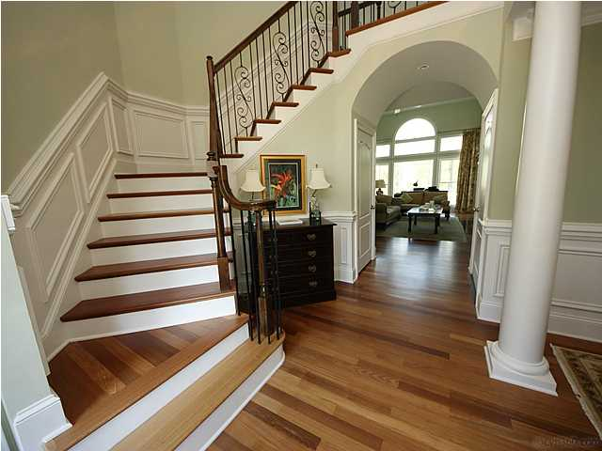
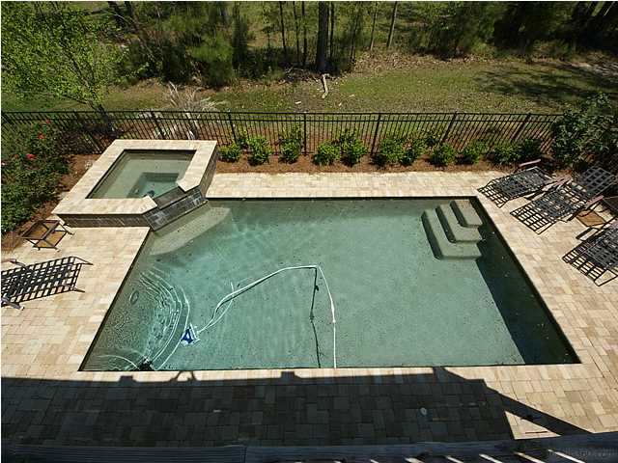
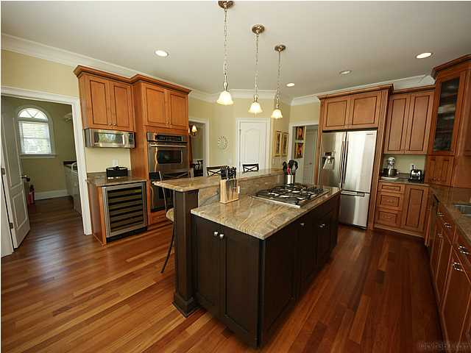




OPEN HOUSE
Dunes West – 5BR w/Pool
2913 YACHTSMAN DRIVE
Sat, May 16 from 2-5P & Sun, May 16 from 2-5P
Home Features
• Saltwater Gunite Pool/Hot Tub
• Beautiful Chef’s Kitchen
• Brazilian Cherry Floors
• Elegant First Floor Master Retreat
• In-Law Suite on Terrace Level
• Elevator for all Three Levels
• Two-Story Family Room with Built-ins
• Outdoor Living Galore: Front Porch, Back
Deck, Screened Porch, Patio, and Pool Deck
Beautiful 5BR, 4.5 bath CUSTOM home awaits the buyer who appreciates quality. This elevated lowcountry home has so many upscale features: ELEVATOR, grand foyer with custom wrought iron turned staircase, abundant Brazilian Cherry hardwoods, elegant first floor master suite, in-law/guest space on terrace level, chef's kitchen with beautiful granite and high-end appliances, and so much more!. Terrace level in-law suite offers full bath, private flex room and ample adjacent storage in oversized extended garage. Flexible floor plan will appeal to families at many life stages.
Margaret Hekker
Realtor/BIC
843-296-7520

