Slide 1

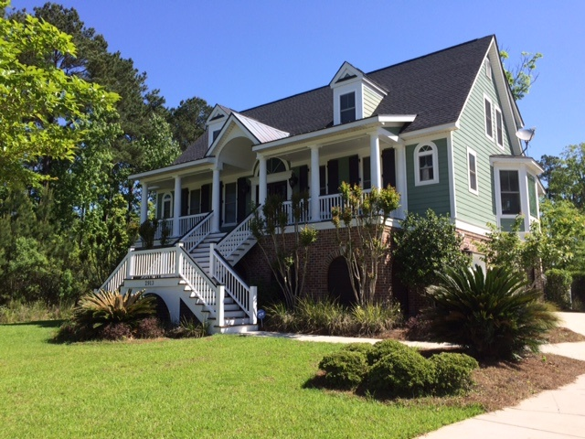
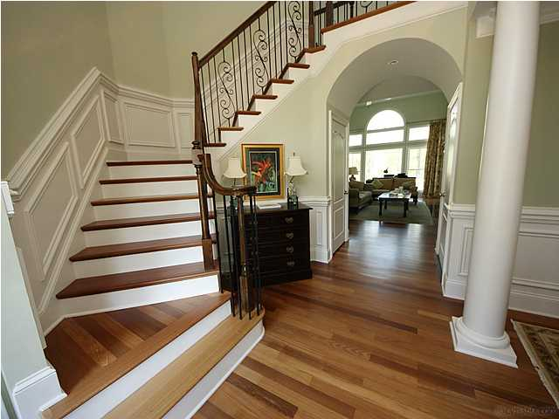
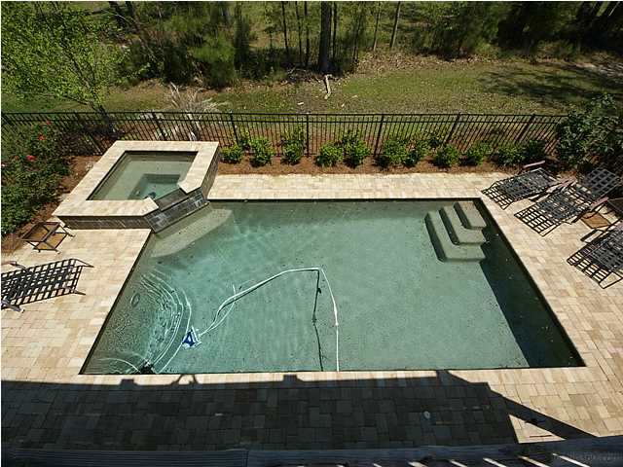
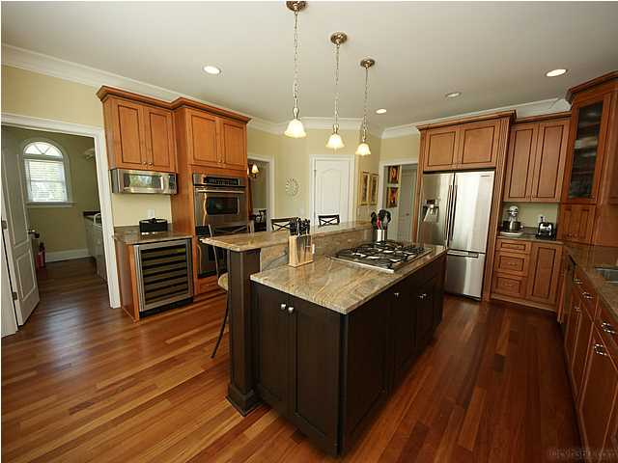



In the Spotlight…
2913 YACHTSMAN DRIVE
Incredible Value at $725,000
ONLY DUNES WEST ELEVATED POOL HOME UNDER $1 MILLION!!
SUMMER FUN AWAITS!
• Saltwater Gunite Pool/Hot Tub
• Outdoor Living Spaces : Front Porch, Back
Deck, Screened Porch, Patio, and Pool Deck
• Welcoming Traditional Floor Plan filled with
Natural Light
Beautiful Dining Room for Entertaining
• Chef’s Kitchen
Relaxing First Floor Master Retreat
• Terrace Level with Guest Suite
• Elevator for all Three Levels
Bring in an offer and let your buyer kick off summer in this stunning custom home in the Harbour section of Dunes West. Your buyer will enjoy lowcountry living with a spacious and grand home with its own backyard POOL and HOT TUB. Those who appreciate a traditional floor plan and quality details will enjoy living in this welcoming and gracious Southern home. Features include a chef’s kitchen, master suite with dual closets and elegant bath, family room with built-in bookshelves, rocking-chair front porch, and photo-worthy grand turned staircase. For family enjoyment, there’s a huge screened porch, deck, and patio. Spacious bedrooms, including a lower level guest suite, allow lots of space for family and visitors to be comfortable. Large lot adjoins neighborhood green space! Oversized extended garage with loads of storage space.
Debbie L. Michael
Realtor
Lighthouse Realty Group, LLC
lighthouserealtygroupsc.com
Cell: 704-877-1472
dlmichaelhomes@gmail.com

