Slide 1

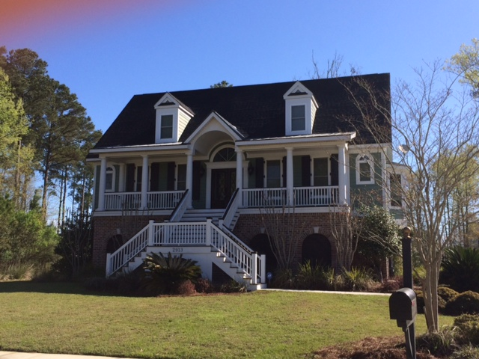
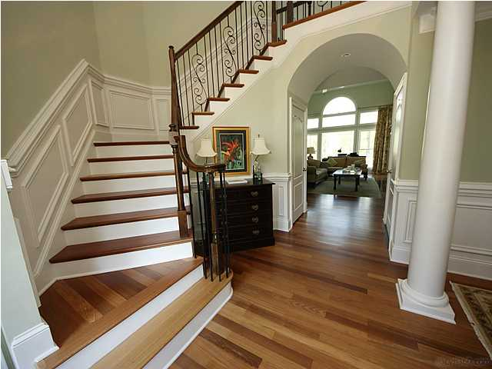
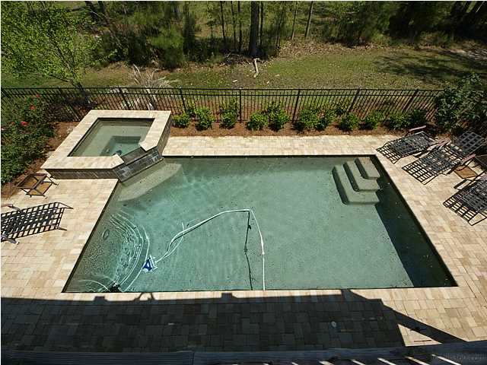
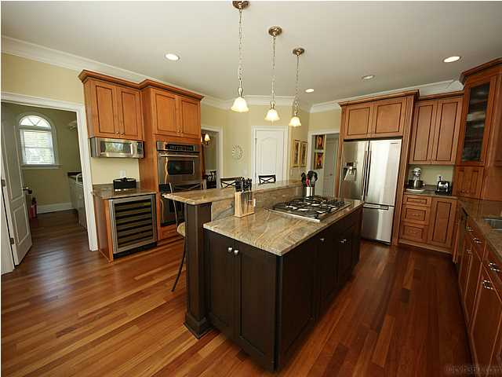




Custom Built 5BR Home with POOL, HOT TUB & Elevator!
A must see at $725,000
DUNES WEST - 2913 Yachtsman Drive, Mt. Pleasant, SC
Home Features
• Saltwater Gunite Pool & Hot Tub
• Beautiful Chef’s Kitchen
• Brazilian Cherry Floors
• Elegant First Floor Master Retreat
• In-Law Suite on Terrace Level
• Elevator for all Three Levels
• Two-Story Family Room with Built-ins
• Outdoor Living Galore: Front Porch, Back
Deck, Screened Porch, Patio, and Pool Deck
Seller spent over $50,000 on a beautiful Gunite Pool & Hot Tub surrounding by spacious decking. Custom-built 5BR, 4.5 bath home awaits the buyer who appreciates quality. This elevated Traditional Southern home has so many upscale features: Grand Foyer with custom wrought iron turned staircase, Brazilian Cherry hardwood flooring, elegant first floor master suite, in-law/guest space on terrace level, chef's kitchen with beautiful granite and high-end appliances, elevator, extensive trim and so much more!. Terrace level in-law suite offers full bath, private flex room and ample adjacent storage in oversized extended garage. Flexible floor plan will appeal to families at many life stages. A must see!
Margaret Hekker
BIC/Realtor
843-296-7520

