Slide 1

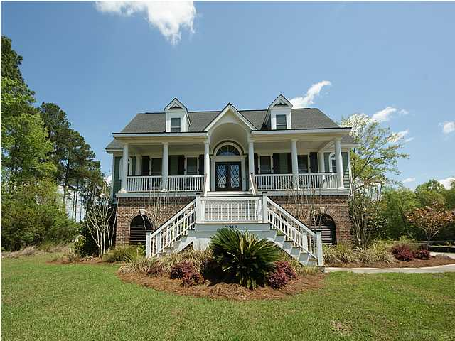
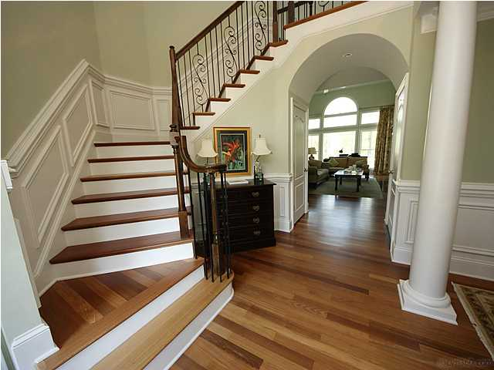
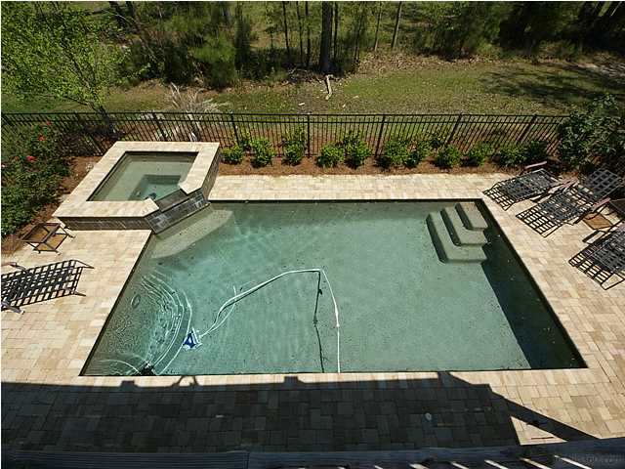
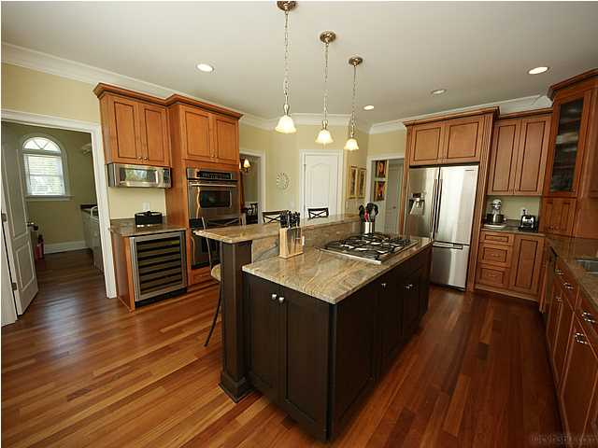



In the Spotlight…
2913 YACHTSMAN DRIVE
Custom Dunes West Pool Home
Home Features
• Recently Reduced to $775,000
• Saltwater Gunite Pool/Hot Tub
• Beautiful Chef’s Kitchen
• Brazilian Cherry Floors
• Elegant First Floor Master Retreat
• In-Law Suite on Terrace Level
• Elevator for all Three Levels
• Two-Story Family Room with Built-ins
• Deck, Screened Porch, Patio, Pool Deck, and
Covered Front Porch
For the buyer who truly wants to enjoy the best of low country living … take a look at this beautiful CUSTOM BUILT home with pool in the exclusive Harbour at Dunes West. Saltwater Gunite pool and hot tub highlight the five outdoor living spaces. Inside the home, walk across Brazilian cherry floors and explore three finished levels of living. A grand entry foyer with turned staircase and wrought iron detailing welcome friends and family in style. Chef’s kitchen features Dacor gas cooktop, wine cooler, stainless and granite. Beautiful first floor master retreat with elegant bath. In-law suite with full bath and flex room. 5 total bedrooms, 4 ½ baths, and storage galore. Abundant natural light makes this home shine! Flexible floor plan will appeal to families at many life stages, with elevator to accommodate all!
Debbie L. Michael
Realtor
Lighthouse Realty Group, LLC
lighthouserealtygroupsc.com
Cell: 704-877-1472
dlmichaelhomes@gmail.com

