Slide 1

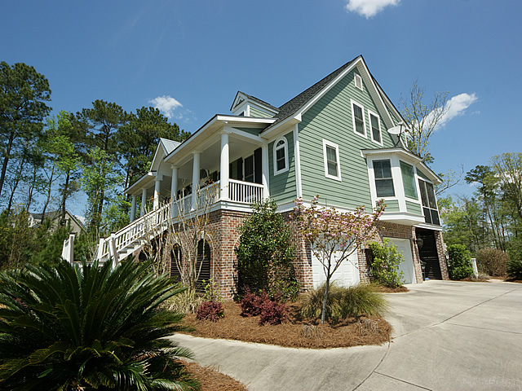
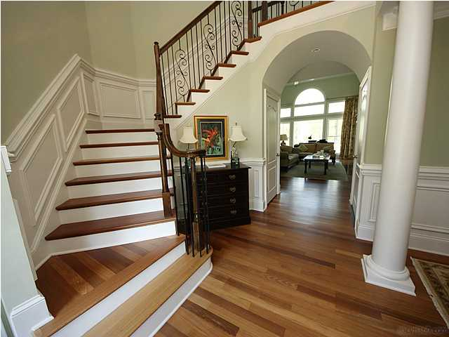
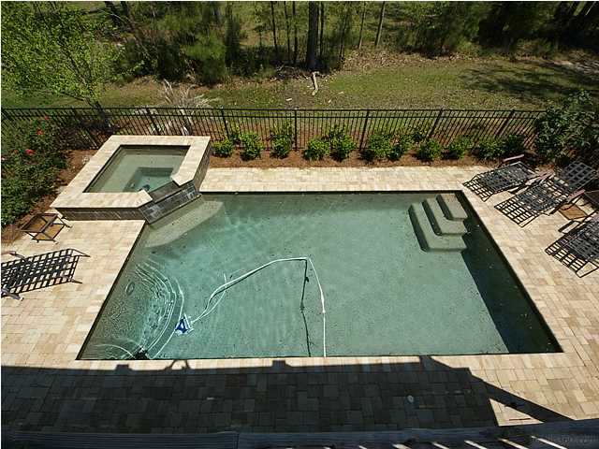
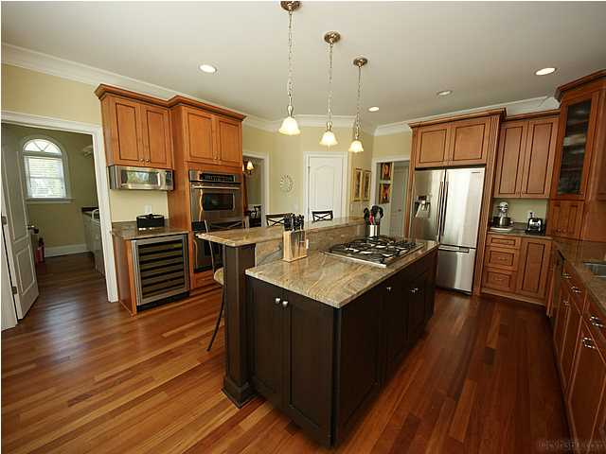



In the Spotlight…
2913 YACHTSMAN DRIVE
Custom Dunes West Elevated Pool Home
Home Features
• Recently Reduced to $769,999
• Saltwater Gunite Pool/Hot Tub
• Beautiful Chef’s Kitchen
• Brazilian Cherry Floors
• Elegant First Floor Master Retreat
• In-Law Suite on Terrace Level
• Elevator for all Three Levels
• Two-Story Family Room with Built-ins
• Outdoor Living Galore: Front Porch, Back
Deck, Screened Porch, Patio, and Pool Deck
PRICE REDUCED $30,000 from original list. Buy now and still have time to enjoy the fall weather in the private saltwater POOL and HOT TUB! This beautiful 5 BR, 4 1/2 bath CUSTOM home awaits the buyer who appreciates quality. This elevated lowcountry home has so many upscale features: ELEVATOR, grand foyer with custom wrought iron turned staircase, abundant Brazilian Cherry hardwoods, elegant first floor master suite, in-law/guest space on terrace level, chef's kitchen with beautiful granite and high-end appliances, and so much more!. Terrace level in-law suite offers full bath, private flex room overlooking pool , and ample adjacent storage in oversized extended garage. Flexible floor plan will appeal to families at many life stages.
Debbie L. Michael
Realtor
Lighthouse Realty Group, LLC
lighthouserealtygroupsc.com
Cell: 704-877-1472
dlmichaelhomes@gmail.com

