Slide 1

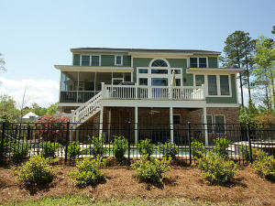
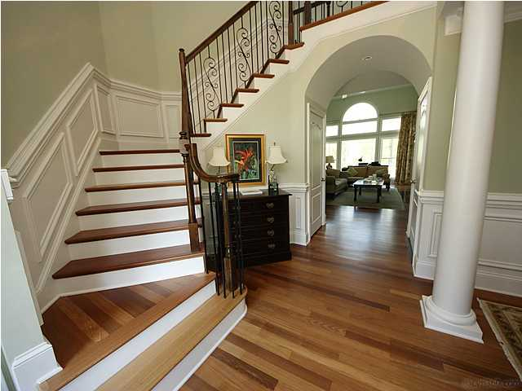
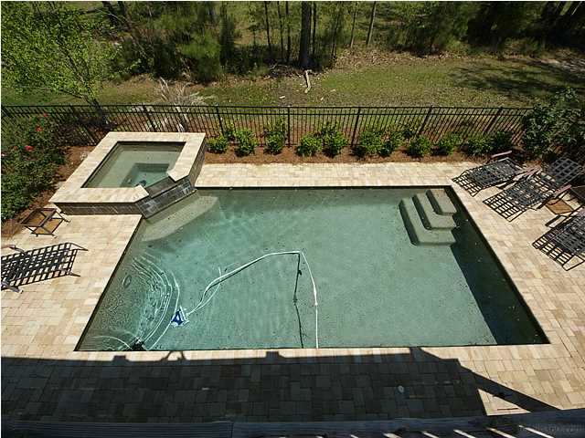
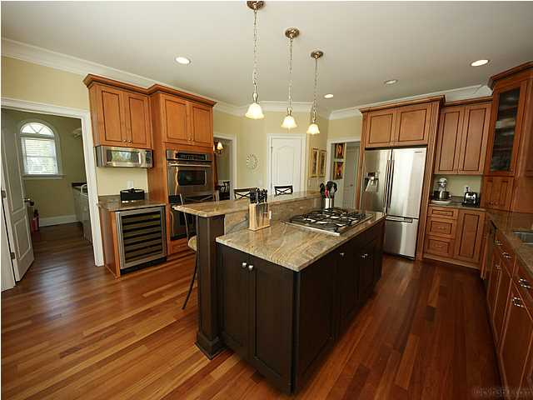




CUSTOM BUILT 5BR HOME
With Saltwater Gunite Pool/Hot Tub
DUNES WEST - 2913 Yachtsman Drive, Mt. Pleasant, SC
Home Features
Can’t Build For This Price - $725,000
Elevator for all three levels
Saltwater Gunite Pool & Hot Tub
Beautiful Chef’s Kitchen
Brazilian Cherry Floors
Elegant First Floor Master Retreat
In-Law Suite on Terrace Level
Two-Story Family Room with Built-ins
Outdoor Living Galore: Front Porch, Back
Deck, Screened Porch, Patio, and Pool Deck
Gracious Southern custom home with POOL, HOT TUB & ELEVATOR! You would not be able to rebuild this home for anywhere near this price including the lot cost and all the upgrades this home has to offer! For the discerning buyer looking for a quality, custom built home. Enjoy the pool, elevator, central vac, extensive trim package, custom lighting, wine cooler, brazilian hardwood flooring & so much more. Elegant formal dining off two-story Foyer. Soaring Great Room with gas fireplace & wall of windows overlooks a large deck & open HOA space behind home. Gourmet Kitchen with granite and stainless includes 5-burner gas cooktop & double oven. Huge laundry room. Tranquil Master BR suite on main, with three BR's up. Lower level finished w/BR or office, full bath & second Living Area! A Must See!
Margaret Hekker
BIC/Realtor
843-296-7520

