Slide 1

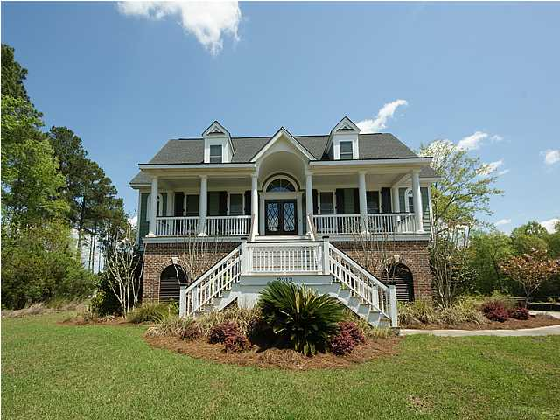
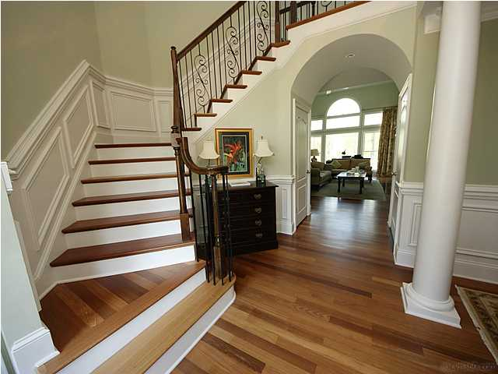
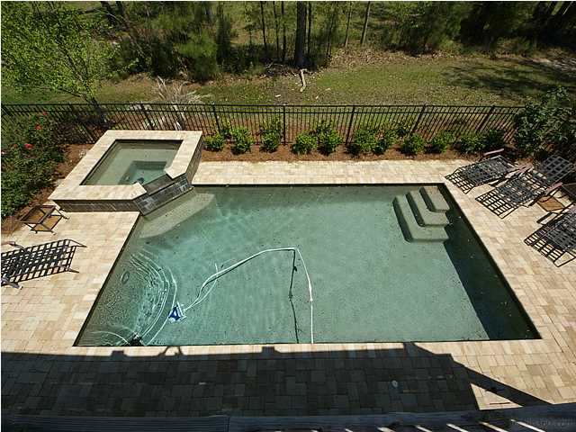
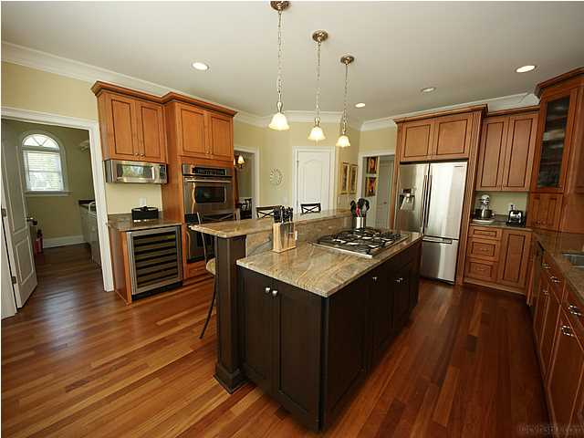



In the Spotlight…
2913 YACHTSMAN DRIVE
DUNES WEST
JUST REDUCED to $750,00 … OFFERS WELCOME
Custom Home Features
• Saltwater Gunite Pool/Hot Tub
• Beautiful Chef’s Kitchen
• Brazilian Cherry Floors
• Elegant First Floor Master Retreat
• In-Law Suite on Terrace Level
• Elevator for all Three Levels
• Dramatic Foyer opening to Two-Story Family
Room with Built-ins
• Outdoor Living Spaces : Front Porch, Back
Deck, Screened Porch, Patio, and Pool Deck
Buy now and enjoy the holidays in this stunning custom home, then look forward to enjoying spring weather in the backyard POOL and HOT TUB! This beautiful 5 BR, 4 1/2 bath home awaits the buyer who appreciates quality. This elevated lowcountry home has so many upscale features: ELEVATOR, grand foyer with custom wrought iron turned staircase, abundant Brazilian Cherry hardwoods, elegant first floor master suite, in-law/guest space on terrace level, chef's kitchen with beautiful granite and high-end appliances, and so much more!. Terrace level in-law suite offers full bath, poolside den/exercise room, and ample adjacent storage in oversized extended garage. Flexible floor plan will appeal to families at many life stages.
Debbie L. Michael
Realtor
Lighthouse Realty Group, LLC
lighthouserealtygroupsc.com
Cell: 704-877-1472
dlmichaelhomes@gmail.com

