Slide 1

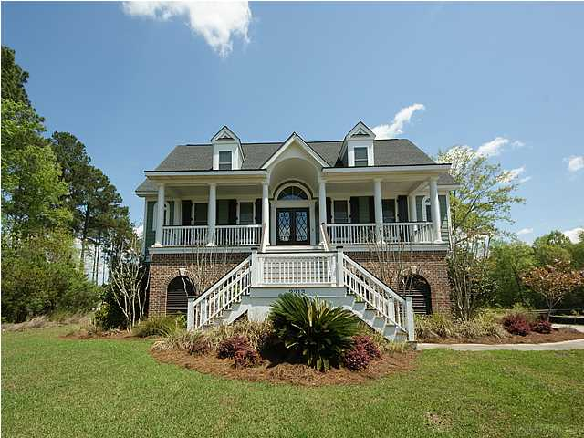
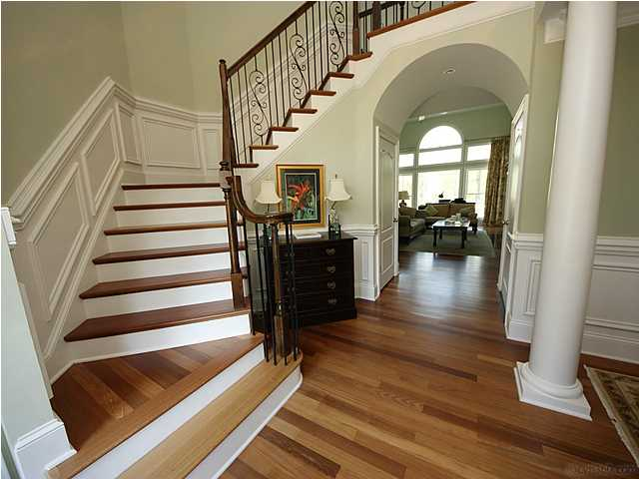
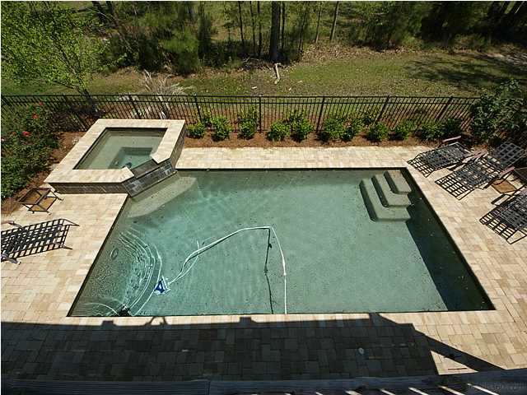
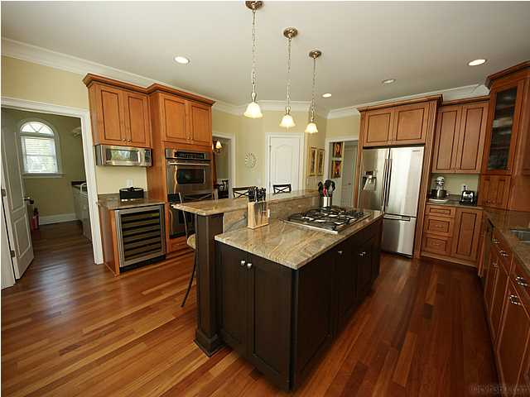



In the Spotlight…
2913 YACHTSMAN DRIVE
DUNES WEST
REDUCED to $750,000 … OFFERS WELCOME
Custom Home Features
• Saltwater Gunite Pool/Hot Tub
• Gracious Traditional Floor Plan
Large Formal Dining Room off Dramatic Foyer
• Chef’s Kitchen
Elegant First Floor Master Retreat with
Furniture-Quality Bath Cabinetry
• In-Law Suite on Terrace Level
• Elevator for all Three Levels
• Outdoor Living Spaces : Front Porch, Back
Deck, Screened Porch, Patio, and Pool Deck
Buy now and spend the holidays in this stunning custom home, then enjoy the spring weather in the backyard POOL and HOT TUB! The buyer who is looking for a traditional floor plan will enjoy gracious Southern living with a generous formal dining room, chef’s kitchen, master suite with elegant bath, family room with built-in bookshelves, rocking-chair front porch, and photo-worthy grand turned staircase. For family enjoyment, there’s a backyard pool, patio, and large screened porch. Spacious bedrooms, including a lower level guest suite, allow lots of space for family and visitors to be comfortable. Large lot adjoining neighborhood green space awaits a new owner’s green thumb! Oversized extended garage with loads of storage space.
Debbie L. Michael
Realtor
Lighthouse Realty Group, LLC
lighthouserealtygroupsc.com
Cell: 704-877-1472
dlmichaelhomes@gmail.com

