Slide 1


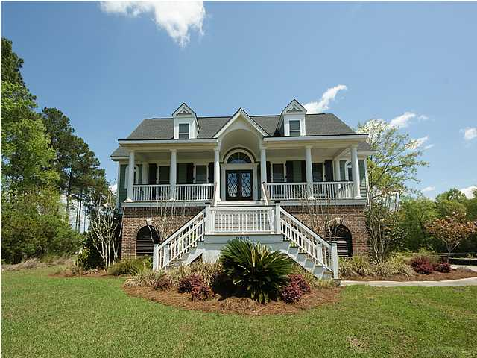
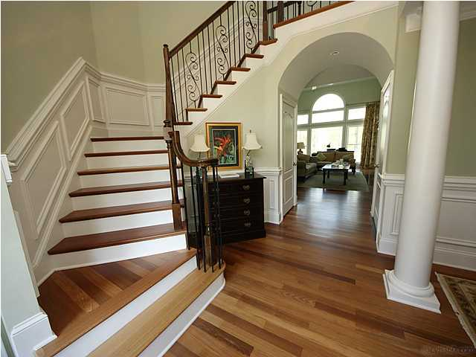
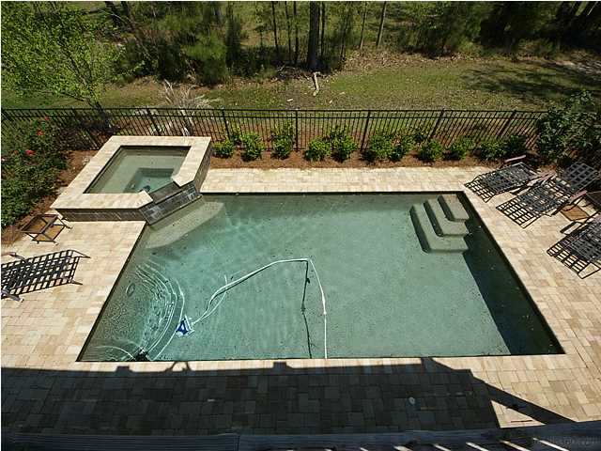
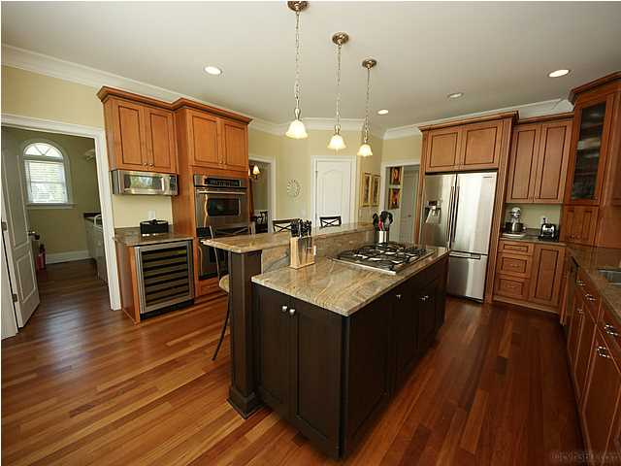



In the Spotlight…
2913 YACHTSMAN DRIVE
POOL HOME IN DUNES WEST
REDUCED TO $750,000! WRAP IT UP IN AN OFFER!
A NEW HOME FOR
THE NEW YEAR!
• Saltwater Gunite Pool/Hot Tub
• Gracious Traditional Floor Plan
Large Formal Dining Room off Dramatic Foyer
• Chef’s Kitchen
Elegant First Floor Master Retreat with
Furniture-Quality Bath Cabinetry
• In-Law Suite on Terrace Level
• Elevator for all Three Levels
• Outdoor Living Spaces : Front Porch, Back
Deck, Screened Porch, Patio, and Pool Deck
Bring in an offer and help your client ring in 2015 in this stunning custom home in fabulous Dunes West. Your buyer will look forward to spring weather with a backyard POOL and HOT TUB plus resort-style living in a gated golf and tennis community. Those who appreciate a traditional floor plan and quality details will enjoy gracious Southern living in this welcoming home. Features include an elegant formal dining room, chef’s kitchen, master suite with dual closets and upscale bath, family room with built-in bookshelves, rocking-chair front porch, and photo-worthy grand turned staircase. For family enjoyment, there’s a huge screened porch, deck, and patio. Spacious bedrooms, including a lower level guest suite, allow lots of space for family and visitors to be comfortable. Large lot adjoining neighborhood green space awaits a new owner’s green thumb! Oversized extended garage with loads of storage space.
Debbie L. Michael
Realtor
Lighthouse Realty Group, LLC
lighthouserealtygroupsc.com
Cell: 704-877-1472
dlmichaelhomes@gmail.com

