Slide 1
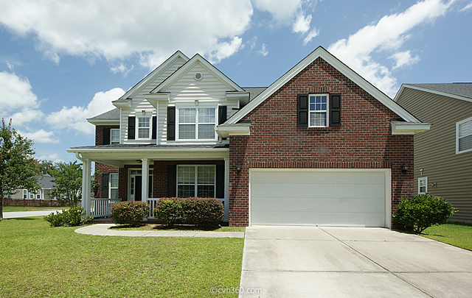
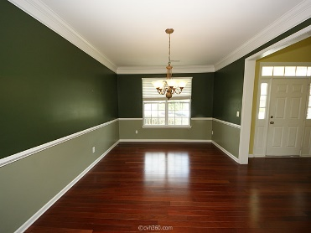
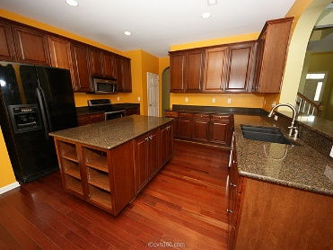
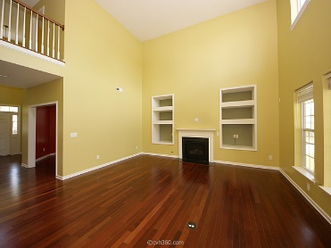
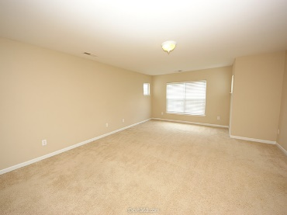
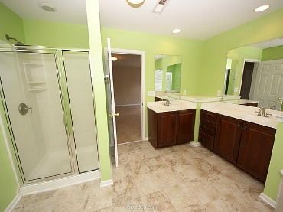
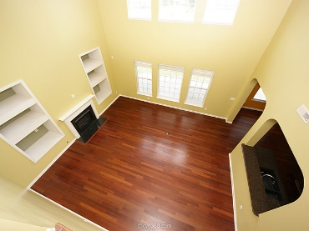
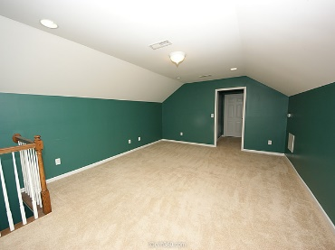
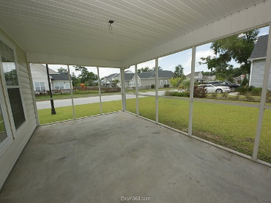
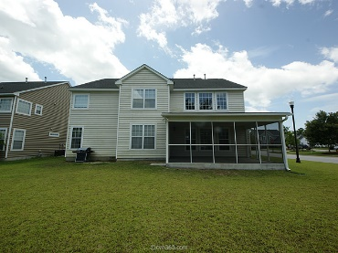
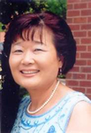

2916 Amberhill Way
Carolina Bay
Charleston, SC 29414
MLS# 15015201
Reduced to $350,000
5 bedrooms and 4 full bath with third floor bonus room in Carolina Bay with screened porch and 2 car garage. The first floor features a guest room adjacent to a full bathroom with a 5' shower, dining room, Study and family room with fire place. Large eat-in kitchen with Island. Corian counter top, upgrade 42 inch cherry glaze cabinets. Crown molding on cabinets. Laundry room has wall cabinet above washer and dryer. Brazilian Cherry Hardwood in Living room, dining room and study. Spacious master suite with large walk-in-closet. The 3rd floor bonus room could serve as a TV room, playroom or guest bedroom. 5ft jetted corner garden tub and separate shower. Community pool and very convenient location. Close to Hwy 17 and 526. 7.5 miles to Downtown Charleston. Thank you for showing.
Cathy Rosenblum
843-817-7869
crosenblum@comcast.net

