Slide 1
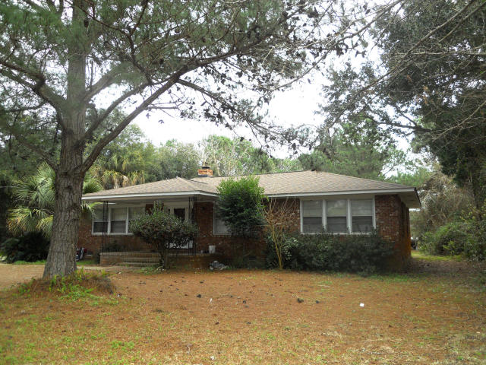
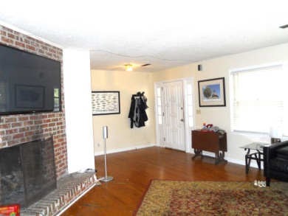
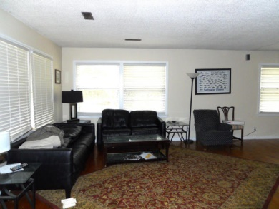
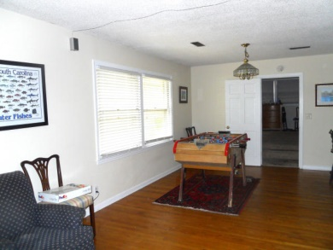
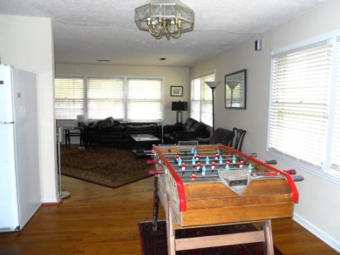
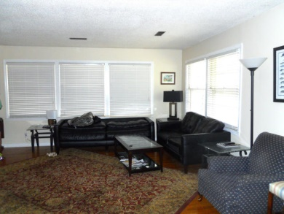
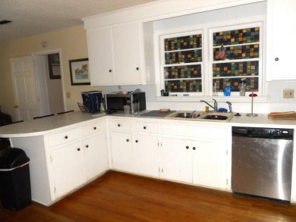
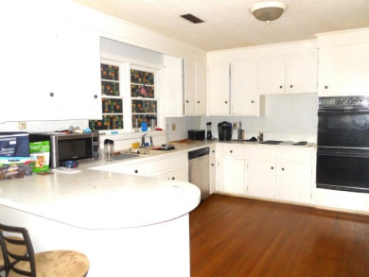
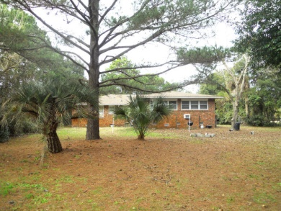


Classic Sullivans Island Beach Home
2917 Jasper Boulevard
Sullivans Island, SC 29482 | MLS# 15002175 | $739,900
$5,000 Buyer's Agent Bonus at Closing!
Great Opportunity to own on Sullivan's Island.
Only a few blocks to the beach and restaurants.
The home has a nice floor plan with hardwood floors, fireplace, large kitchen and dual masters.
The bedrooms are large and have ample closet space.
This home sits on a large wooded lot with a ton of potential.
There is a detached 2 car garage with tons of storage.
The roof was replaced in 2009.
AgentOwned Preferred Group
824 Johnnie Dodds Blvd
Mt Pleasant, SC 29464
Amee Baker
(843) 343-1778
ameebaker@comcast.net
www.agentownedrealty.com

