Slide 1

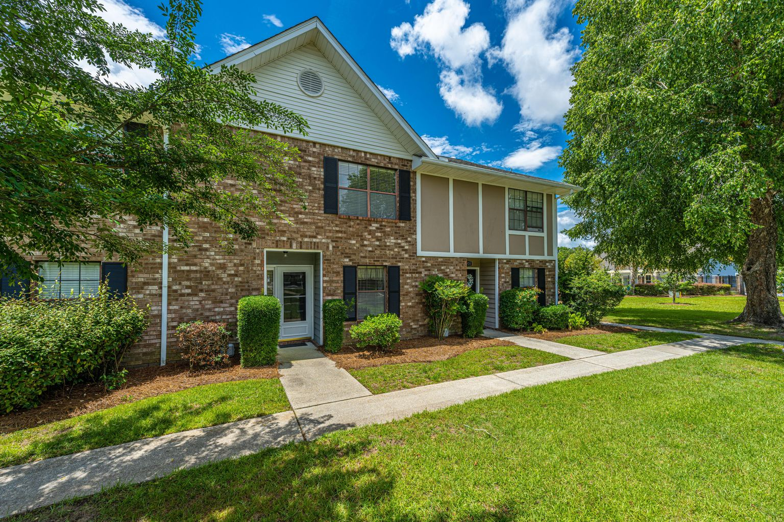
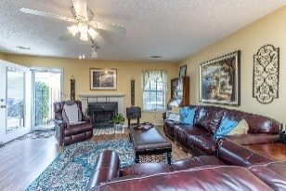
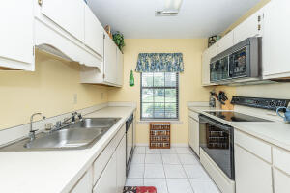
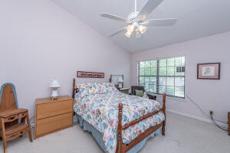

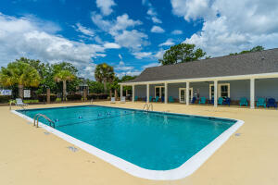


Premiere Location In West Ashley!!
2918 Oxford Place
Old Towne Villas ~ Charleston, SC 29414
MLS# 22018061 ~ $260,000
Bees Ferry and 61! Across the street from Lowe's grocery, coffee shop, dining options. Neighborhood has a newly renovated clubhouse and pool! Located in Shadowmoss. Welcome to this well maintained home which includes 2 large bedrooms, each with a private bath. Enter from the beautiful tree lined front courtyard into the tiled foyer. Half bath and laundry to the left. Continue straight to enter the main living area which is large and can accommodate friends and family for gatherings. Kitchen is located at the front of the unit with views of the courtyard and offers plenty of counter space for meal prep. The dining area is conveniently located between the kitchen and family room. This space is about comfort. Relax with a fire in winter or for every day relaxing. The back door can be open to the patio, a storm door keeps out the elements. An added bonus is shelving and cabinet tucked in the corner, can be used for work space. Also on main level is a coat closet. Laminate flooring flows through the main living area. Bath and kitchen are tiled. Upstairs find the 2 large bedrooms with vaulted ceilings and full baths. Master has large walk in closet and added shelving behind the door. Second bedroom has dual closets. Small loft area allows for a desk. This home has been well maintained! The HOA covers the roof, pest control/termite bond, exterior maintenance, common area, including the clubhouse and pool; a great value! High efficiency Trane unit was installed outside in 2011. There are 2 assigned parking spots directly behind the unit, with over flow by pool area. Nice size shed is located in patio area for extra storage. Call today for your private showing.
Laurie Loparo
(843) 442-1290 | laurieloparo@gmail.com
www.lauriesellscharleston.com
Carolina One Real Estate | 873 Orleans Road, Ste 102 | Charleston, SC 29407-5753

