Slide 1
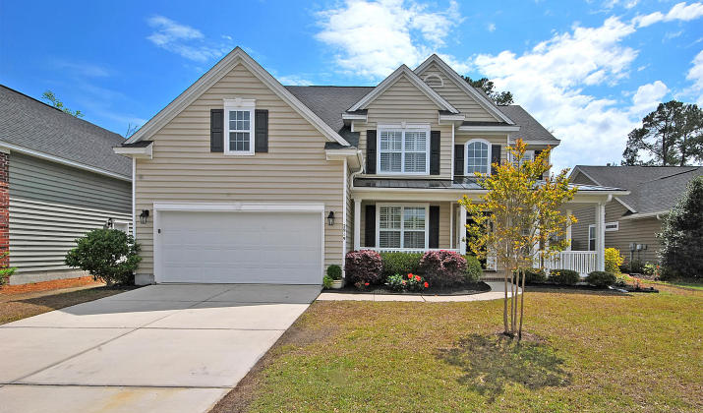
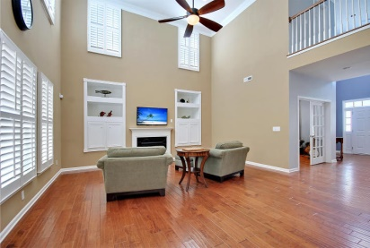
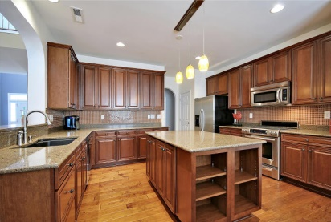
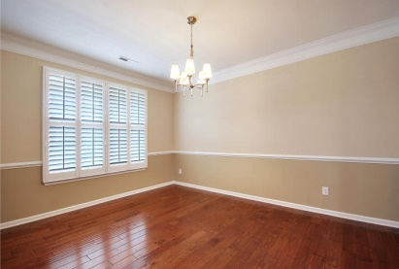
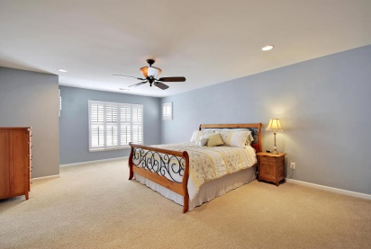
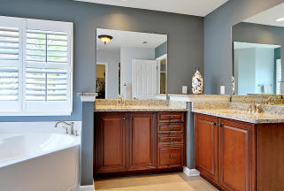
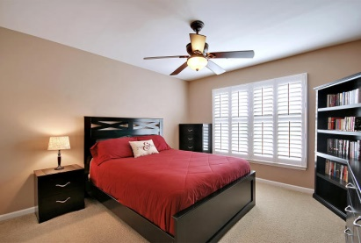
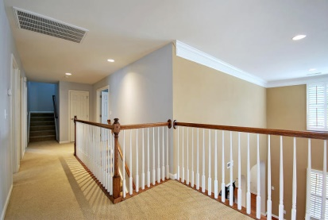
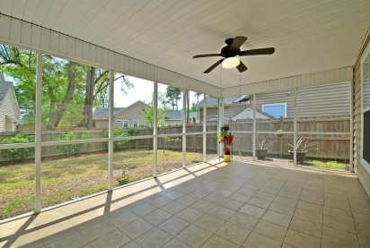
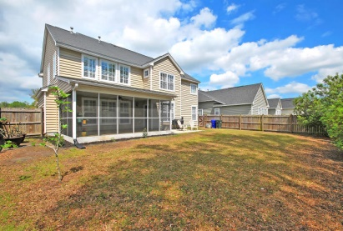


2919 Amberhill Way
Carolina Bay - Charleston, SC 29414
MLS# 15009241 - $399,000
Immaculate! You must see this house to appreciate all the upgrades and details. This Timmerman plan is loaded with over $122K in upgrades including beautiful wide plank Pasadena hardwood flooring on the 1st floor except for the guest bedroom. Neutral ceramic tile in all bathrooms and laundry room. Upgraded carpet in bedrooms and bonus room. Beautiful Plantation shutters throughout.
The gorgeous gourmet kitchen features Cambria countertops, large center Island, 42'' cherry glazed cabinets, glass tile back splash and is sure to become the favorite family gathering place. All upgraded kitchen Aid Stainless Steel Appliances including gas stove w/warming drawer, side-by-side refrigerator, built-in microwave and dishwasher. Custom built-ins with bookcases flank both sides of the black granite fireplace.
The first floor features a guest bedroom adjacent to a full bathroom with granite countertop and 6' shower-could be a perfect mother-in-law suite. Four bedrooms on the 2nd floor including a huge spacious master suite with large walk-in closet. Master bath features raised granite countertops with under mount sinks, porcelain tiled shower w/custom seamless shower door and large garden tub. The 3rd floor bonus room could serve as a TV theater room, playroom or additional guest bedroom.
Features include a full bathroom, closet, home theater speakers with surround sound system and extended storage area. The garage has 4' extension and additional overhead storage area. Backyard is privacy fenced and fully landscaped. Ceramic tiled front porch and back screened porch. Only 5 houses down from the community pool. Thank you for showing this beautiful home.
Cathy Rosenblum
843-817-7869
crosenblum@comcast.net

