Slide 1
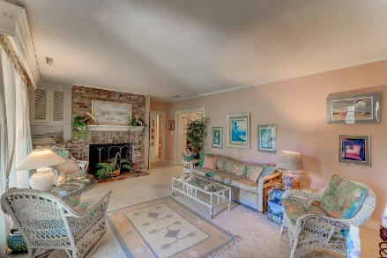
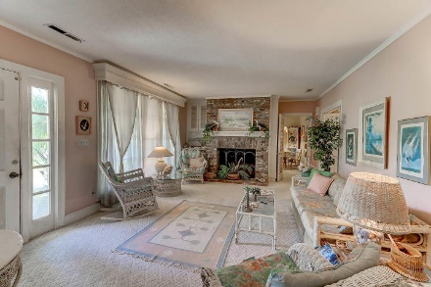
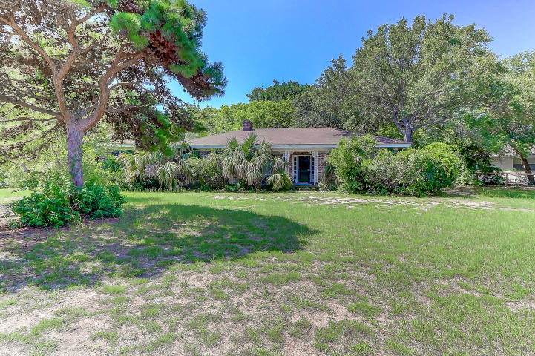
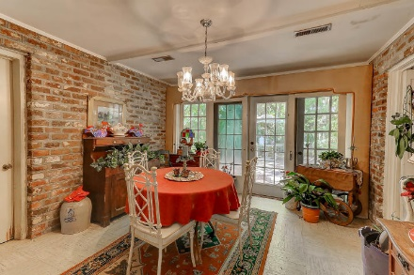
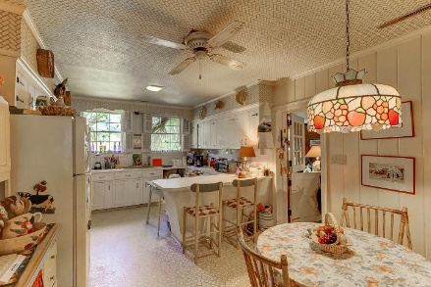
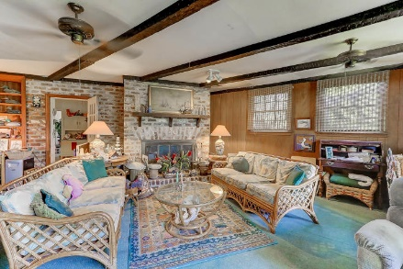
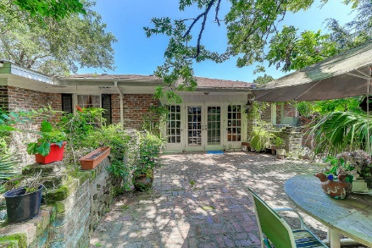
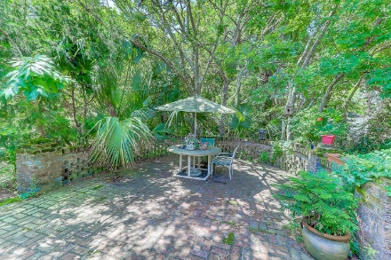
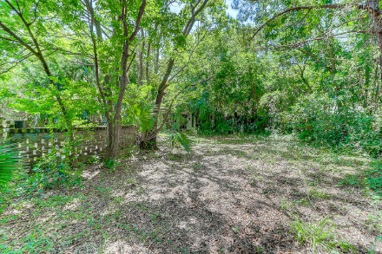


2921 Jasper Boulevard
Sullivans Island, SC 29482
MLS# 17018637 | $1,050,000
.49 Acres close to Beach
w/3bd 2ba Ranch
Great Corner Lot
Charming older brick ranch on a great corner lot close to the beach. Being sold AS IS with no repairs--needs some TLC.
2 car garage, large great room with fireplace and formal living room with fireplace, eat in kitchen and private, brick patio in the rear.
Great access to the beach.
Darlene Smith
Office - (843) 886-8110
Mobile - (843) 696-7824
darlenesmith@carolinaone.com
DarleneSmithTeam.com
Carolina One Real Estate
1503 Palm Blvd Ste
Isle of Palms, SC 29451

