Slide 1
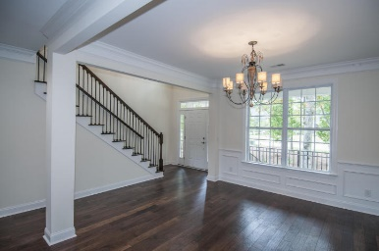
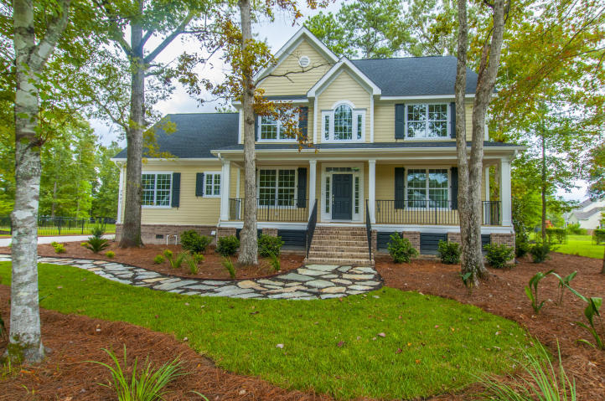
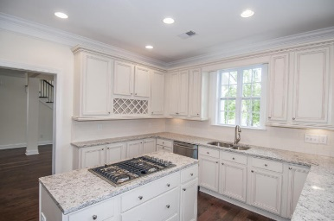
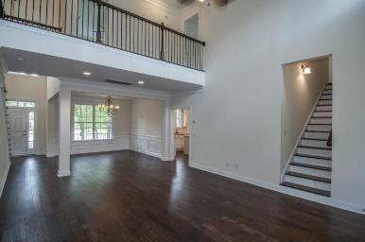
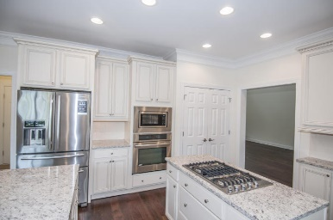
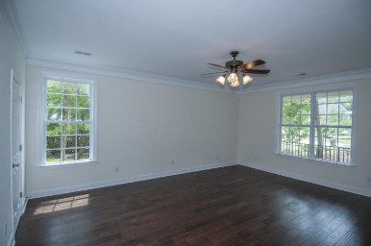
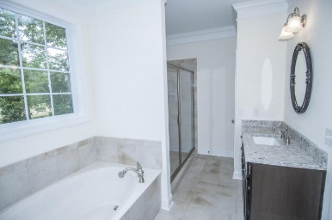
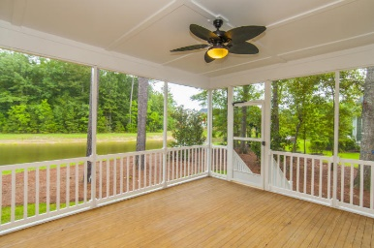
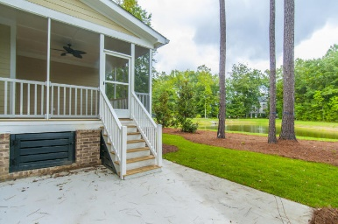
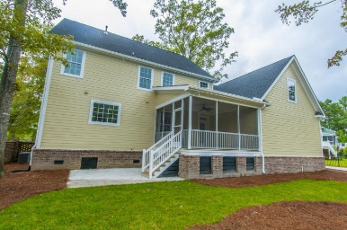
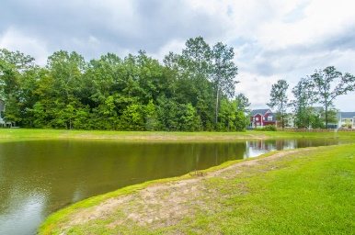


2921 Yachtsman Drive Dunes West ~ Mount Pleasant MLS# 15017954 ~ $700,000
Custom Home In Highly Sought After
Gated Golf Community!
Overlooking a serene pond, this 5 br/3.5ba home has all the luxury upgrades: beautiful hickory hardwood floors throughout the entire first floor, ceramic tile in laundry and all bathrooms, & brushed nickle fixtures. From the full front porch, you enter the 2-story foyer and find a spacious open floor plan flowing from great room, to dining room to kitchen. Fabulous for entertaining! Also the great room opens to the large screened porch and grilling patio. The kitchen is fantastic with granite counter tops, subway tile backsplash, stainless appliances, under-mount sink, and island w/jenn-air downdraft cooktop. The kitchen flows into the large and quite delightful morning room. There's even a breakfast bar connecting the two spaces. Again, this is great for entertaining or everyday family time. The master suite is downstairs and it is spectacular! Hardwood floors, his & hers walk-in closets, his & hers vanities (granite), garden tub, separate shower w/seat (cultured marble) and separate water closet...Really perfect!! Upstairs you'll have 4 more wonderfully large bedrooms and 2 more full baths...and a bonus room! Oh, the possibilities!! All closets are nice and big and there's tons of accessable attic storage! And location, location, location!! 15-20 min. to the beach; 20-25 min. to historic downtown Charleston; 5-10 min. to movies, dining & shopping!!! Plus Dunes West has a beautiful 18-hole golf course, tennis courts, super-pool w/ waterslide, clubhouse, fitness center, community dock, boat storage, and neighborhood activities galore!!!!
Bob Crawford
ABR, EPRO, SRES, REALTOR
Mobile - (843) 860-8008
bcrawford@carolinaone.com
www.CharlestonGolfProperties.com
Carolina One Real Estate
2713 Highway 17 North
Mt. Pleasant, SC 29466

