Slide 1
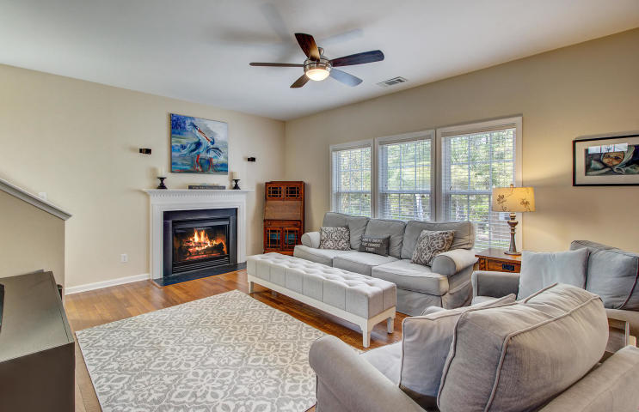
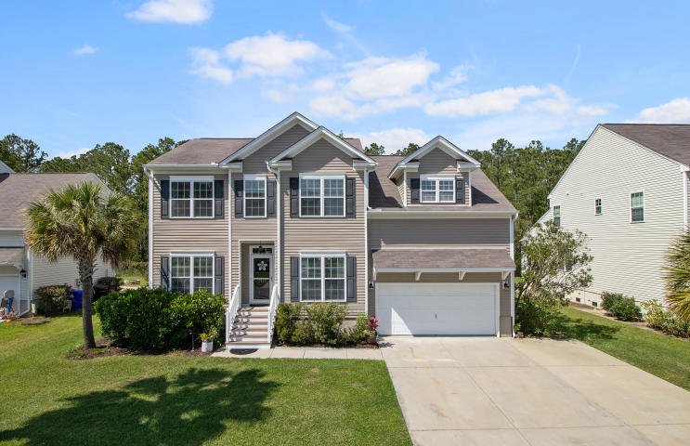
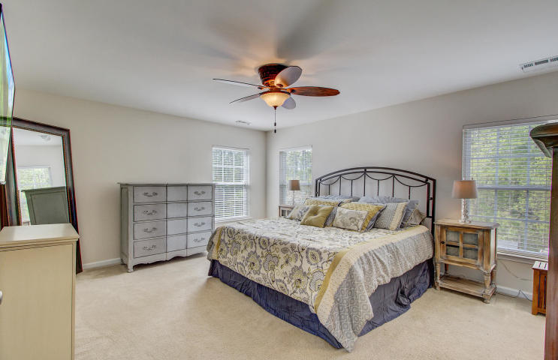
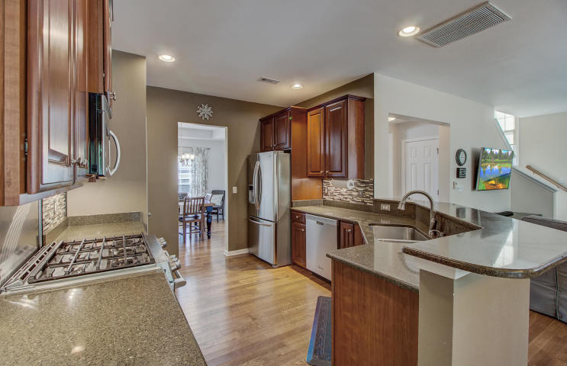
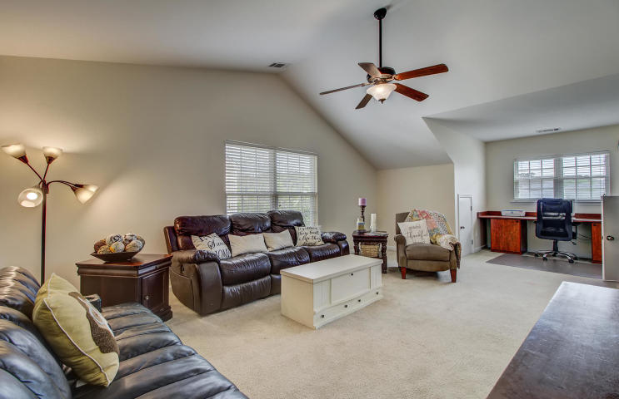
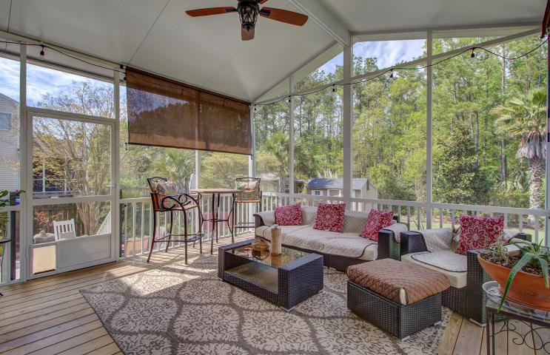
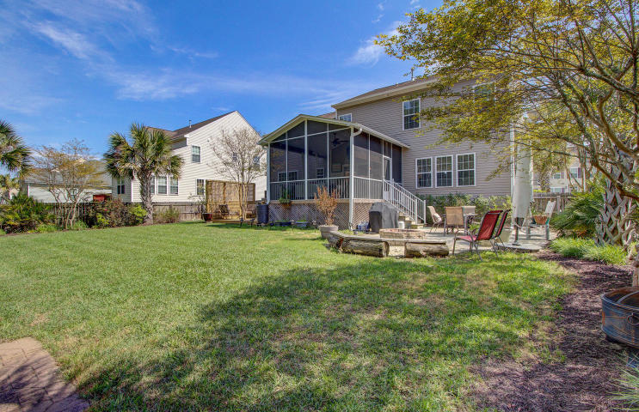


JUST LISTED!
A gem of a home located in the desirable Planters Pointe community
2925 Thornrose Lane
Planters Pointe
Mount Pleasant, SC 29466
MLS# 20009009 | $450,000
A gem of home located in the desirable Planters Pointe community with sidewalk lined streets and gorgeous amenities. 2925 Thornrose Lane offers a fantastic floorpan sure to please families and those who love to entertain. The current owners have gone to great lengths to enhance the home during their ownership: New AC in 2017, installation of a tankless water heater, the addition of a screened porch, concrete patio, ground level deck and garden shed, adding gutters to the home, and more! The kitchen is outfitted with quartz counters, a tile backsplash and stainless steel appliances including a new dual fuel stove. Yes you have gas cooking on the stove top plus double ovens (electric) making meal preparation a joy! The eat in kitchen overlooks the family room with gas fireplace. A separate dining room is available for large gatherings and working from home is convenient with the office on the main level enhanced with a new barn door to ensure privacy when needed. It's a rare find, but this home has a guest suite / mother in law suite on the main level adjacent to a full bath! Upstairs are the additional four bedrooms and laundry room. The master suite is very large and overlooks the beautiful back yard. Double sinks are an added bonus in the large master bath which leads to the walk in closet. You will be impressed with the California Closet System which provides abundant storage and organization! Two additional guest bedrooms separated by the laundry room are on the front of the home. At the end of the hall is the fifth bedroom with multiple closets, including a special little nook where young ones can read, color, and be creative! A built in desk makes a perfect work station or study area in this room which could easily be utilized as a media room or upstairs bonus area for the family if a fifth bedroom is not needed. The versatility of this floor plan makes it a winner! You will notice that this home has incredible storage throughout. The two car garage has a built in loft for additional storage and take note of the Garage Tek organization systems that have been installed. Think of this as the California Closets of Garages- adjustable to suit your needs! If you love a private yard with lots of space for the family and pets to play then you will be very impressed when you step out the kitchen into the new 15 by 14.5 foot screened porch with upgraded No See Um screens. It is an additional living space to enjoy most of the year. The beautiful landscape design enhances the beauty of this wooded lot. Step down from the porch onto the 17 by 17 foot concrete patio with fire pit. The expansive yard with gorgeous landscaping will be your own private oasis- and it is completely fenced in! How convenient that an 8 by 12 foot garden shed is there for the green thumb of the family to store their tools and lawn care equipment. An additional ground level deck was built beside the screened porch creating a private nook. The amenities for residents of Planters Pointe are second to none! A stunning clubhouse, which can be rented for private events, radiates southern charm with its red metal roof and wrap around porches. A gorgeous swimming pool and tennis courts give a country club feel to this community, while the new pickle ball courts have become a popular amenity. Enjoy the outdoor kitchen and fireplace area beside the pool and the little ones will have lots of fun on the playground equipment while others may prefer to shoot hoops on one of the basketball courts. Planters Pointe is conveniently located close to shopping and restaurants. Students attend award winning schools. With proximity to local beaches at Isle of Palms and Sullivan's Island as well as being a short ride to historic Downtown Charleston, the location is simply ideal. This move in ready home will allow the new owners the opportunity to enjoy all that the Mt. Pleasant lifestyle has to offer!
Check out the virtual tour here: https://my.matterport.com/show/?m=DEWpCU5vZFG
Ellen O'Neil
Broker/Owner, ABR, e-PRO, CNE
Charleston Realtor of Distinction
(843) 300-8530
www.EllenONeilProperties.com

