Slide 1
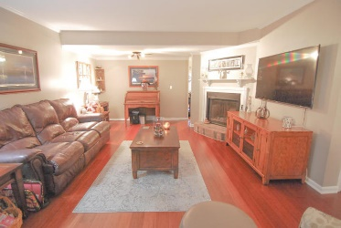
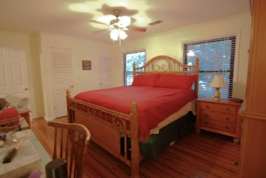
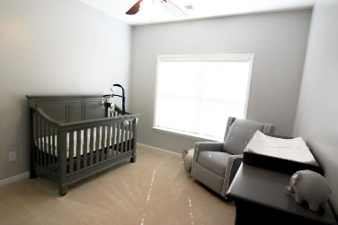
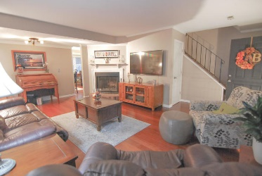
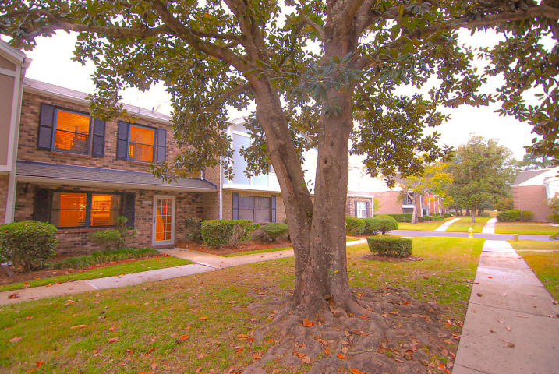
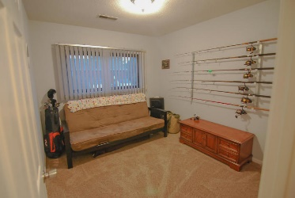
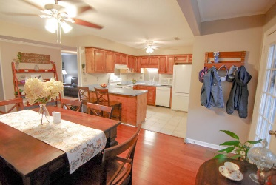
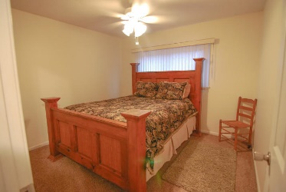
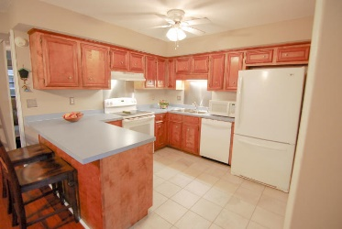
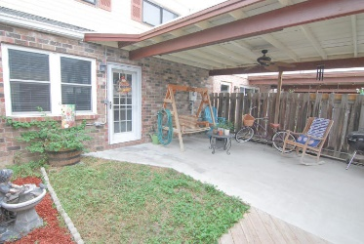



2928 Cathedral Lane
Old Towne Villas
Charleston, SC 29414
MLS# 19029051 | $179,900
3 Bedroom Townhome
With Deeded Parking
Just Listed!
Under $280,000
Almost 1500 sqft with 3 bedrooms, 2.5 baths, fenced yard, deeded off street parking, amazing amenities including a pool, baby pool and brand new clubhouse which is slated to be completed soon! This is low maintenance living with beautiful courtyards throughout the community and is on the cusp of Shadowmoss, a short walk to the Bi-Lo shopping center and the new shopping center at Glen McConnell where you can enjoy multiple restaurants and stores, as well as the new Starbucks and Harris Teeter! The owners have updated the majority of the home including new hardwood floors in the great room and master, ceramic tile in the kitchen, laundry and bathrooms, new vanities with solid surfaces in all of the bathrooms, lighting, ceiling fans, paint, water heater and range! You won't find a better deal!
Pool
Clubhouse (Coming Soon)
Walkways
Exterior Maintenance Included
Low HOA Dues
Awesome West Ashley Location
AFFORDABLE
Beth Moore
M (843) 532-4892
bmoore@carolinaone.com
Meg H. Kandik
M (843) 814-5137 | O (843) 603-4659
Meg@HolyCityRE.com | www.holycityre.com
Bennett Construction & Realty | 792 Folly Rd | Charleston, SC 29412

