Slide 1
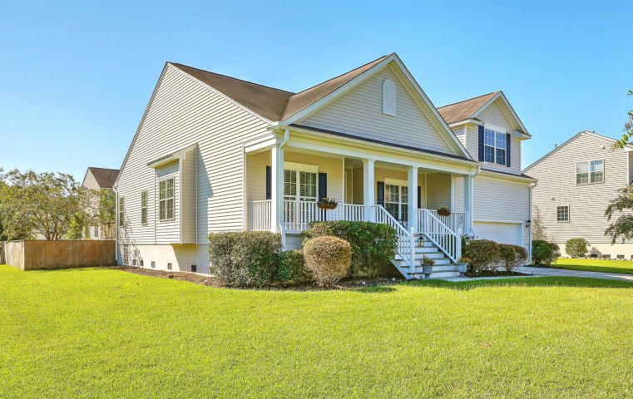
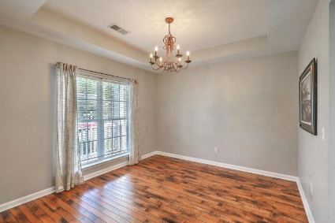
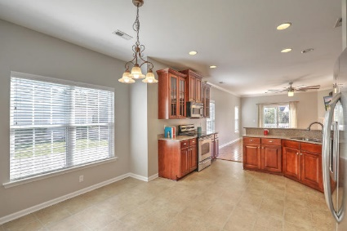
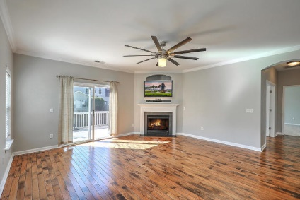
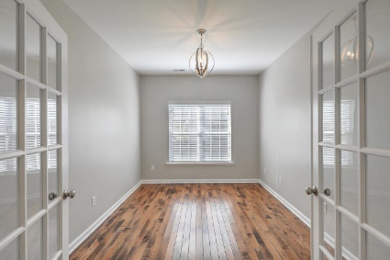
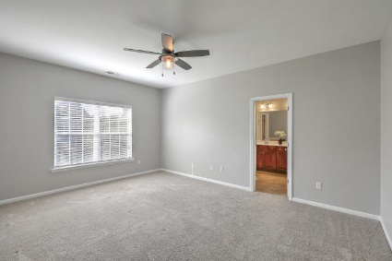
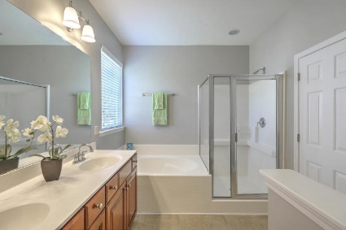
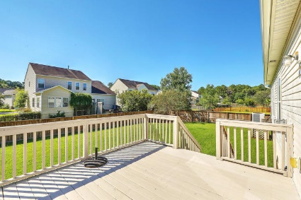
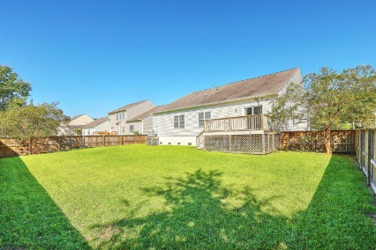

2928 Thornrose Lane Mt Pleasant | MLS# 18026359 | $390,000
Price Reduced!
4br/3ba for $390,000 in Planters Pointe
4 BR / 3 Full baths
2,208 SF
Master Down
FROG with full bath
Separate Dining Room
Large eat in Kitchen with breakfast bar
Separate Study with French doors
Solid Hardwood Floors
Neutral paint throughout
Deck overlooking big back yard
Quiet location/street - great for kids
Neighborhood pool and play park
Biking, walking, exercise trails
Close to shopping, recreation, marina, restaurants
Easy to show and move in ready!
Charming community with tree-lined streets!
Beth Ryan
(843) 375-2776 - O
(843) 214-5063 - M
beth.ryan@cbcarolinas.com
Coldwell Banker Residential Brokerage
1127 Queensborough Blvd
Suite 103
Mt Pleasant, SC 29464

