Slide 1
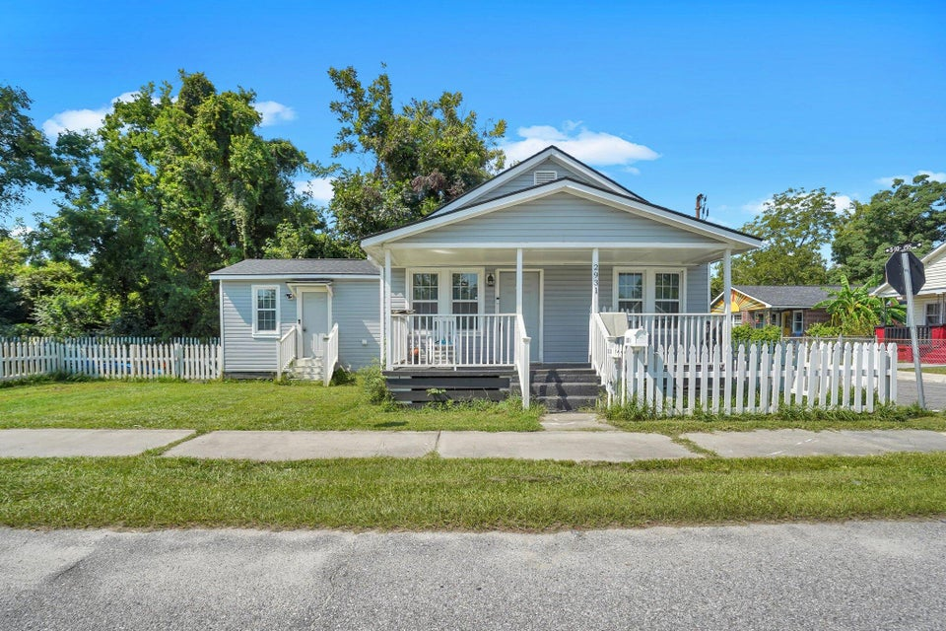
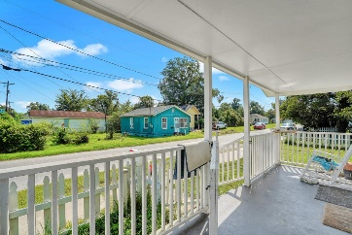
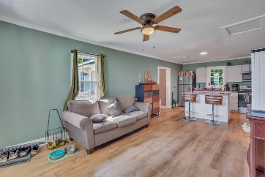
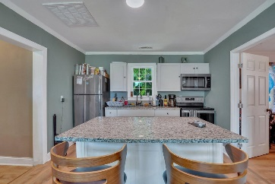
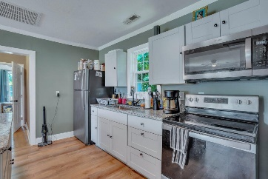
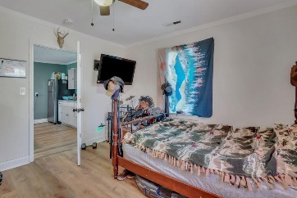
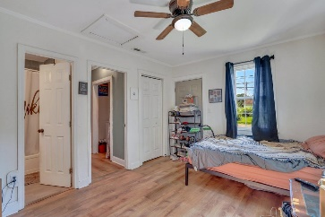
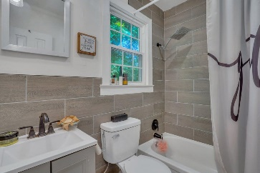
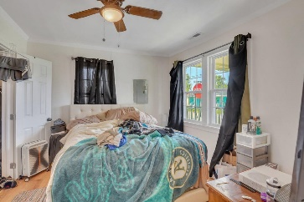
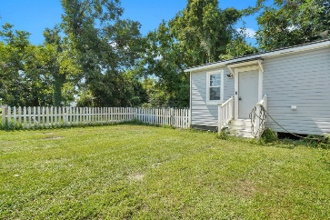
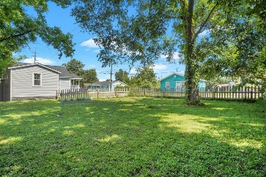



North Charleston Cottage for $250,000!
2931 Baker Avenue
Accabee
North Charleston, SC 29405
MLS# 24020909
$250,000
3 Bed | 2 Bath | 876 sf
Welcome home to 2931 Baker Ave, this cozy cottage in the center of North Charleston with easy access to I-26, West Ashley, Downtown, and Park Circle!
This cottage was just repainted and was renovated in 2022. Features LVP flooring, stainless steel appliances, kitchen island, with 3 bedrooms and 2 full renovated bathrooms. This cottage features a fenced-in side yard with plenty of room to host events, holidays, or backyard barbecues - plus plenty of running room for your four-legged family members!
Don't miss this opportunity!
Nick Mazzilli (843) 640-5575
nick@themazzilliteam.com
nickmavencharleston.com
Maven Realty
2180 McMillan Ave
#71672
Charleston, SC 29405

