Slide 1
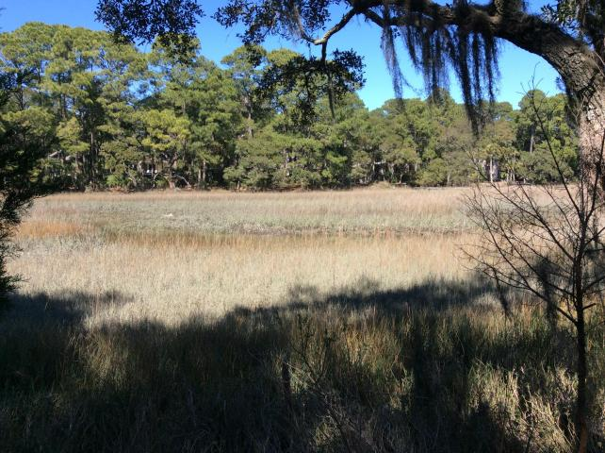
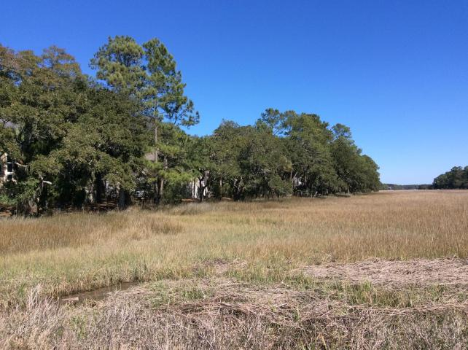
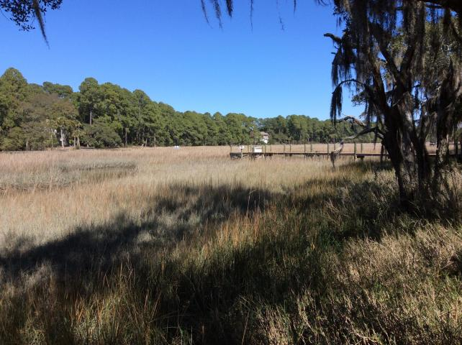
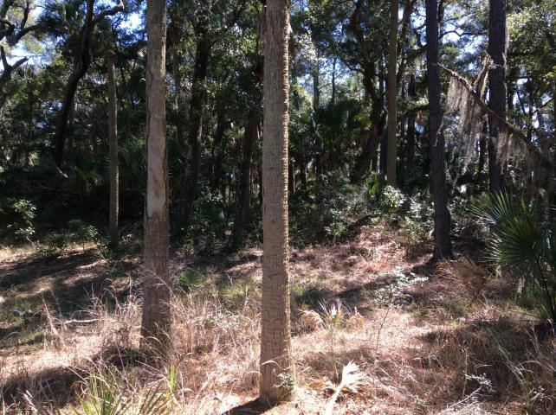


Price Reduced on Pristine Marshfront Lot Near Beach!
Buy.......Build.....Begin
2932 Deer Point Drive
Seabrook Island, SC 29455 | MLS# 16005786 | $429,000
Buy…Build…Begin…
Quiet and secluded marsh lot located on a cul-de-sac on one of Seabrook's most desirable streets. Long panoramic vistas of the tidal marsh from this spectacular piece of property. Truly a special lot to build a custom home.
Keller Williams Realty Charleston West Ashley
1180 Sam Rittenberg Ste 105
Charleston, SC 29407
Amy Zonarich
Realtor
(843) 534-3523
amy@amyzonarich.com
www.liveandlovecharleston.com

