Slide 1
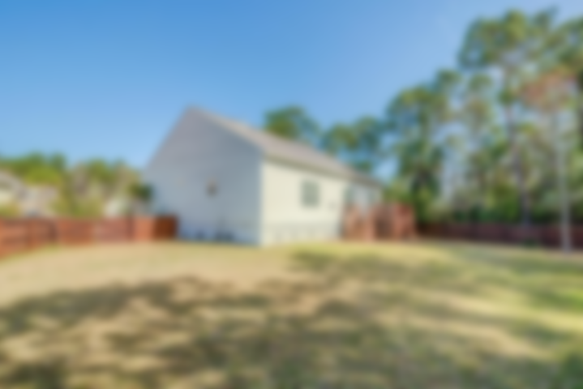
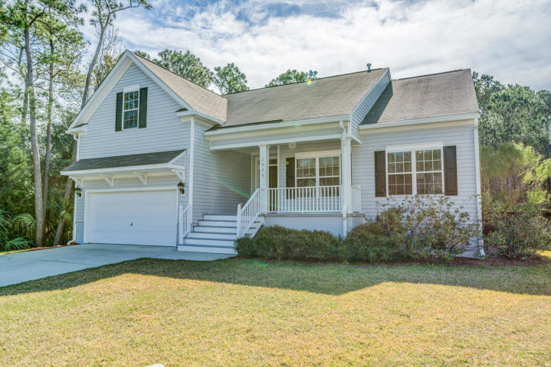
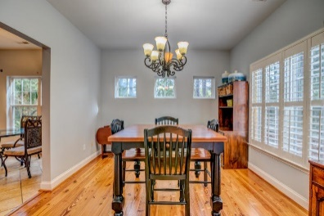
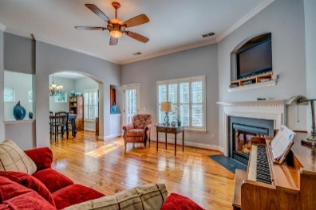
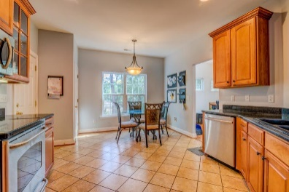
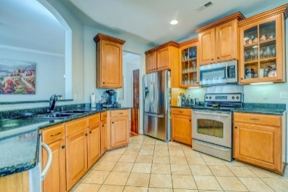
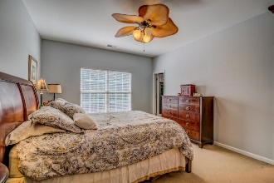
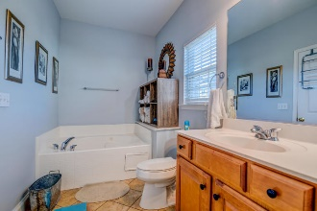
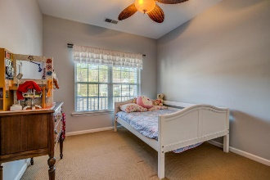
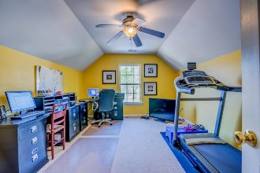
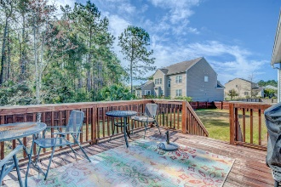



2936 Thornrose Lane Mount Pleasant, SC 29464
Wonderful 1-Story in Planters Pointe
Perched at the tip of a quiet cul-de-sac adjacent to a wooded buffer, this cute cottage style home offers a peaceful setting and much desired single story living. The bright and airy interior is accented with custom details such as gorgeous heart-of-pine wood flooring, arched openings and plantation shutters. An entry foyer greets you and opens to a spacious living room awash in natural light and featuring crown moulding and a focal point gas fireplace with mantle and television niche above. The architectural details of cased openings and knee walls lend an open, flowing floor plan feel yet provide definition for each room. The formal dining room offers plenty of space for hosting special occasion celebrations with family and friends gathered around the table. The cook in the family will delight in preparing those dinners in the beautifully appointed kitchen. Polished black granite rests atop upgraded wood cabinetry featuring under cabinet lighting, staggered tops and raised panels, some with glass fronts, perfect for displaying your cherished glass and serve ware. Stainless steel appliances give an element of glam to the warm and traditional kitchen. A sunny breakfast nook and pantry complete the kitchen. The master bedroom boasts a walk-in closet with custom shelving and an en-suite bathroom complete with double vanity, large soaker tub and separate shower. Two additional bedrooms share a full bathroom with tub/shower combination. A bonus room above the garage is a tucked-away space perfect for use as a media room, playroom, home office, exercise room, man-cave, teen retreat or secondary family room. The possibilities are endless! Outdoor living is easy on the large deck. Grill dinner or just relax with a drink while kids and pets enjoying running and playing in the large, fully fenced in backyard. Located in Planter's Pointe, residents enjoy neighborhood amenities such as the beautifully updated clubhouse, olympic sized swimming pool, tennis courts, children's play park and convenient location close to beaches, I-526, the new Roper Mount Pleasant Hospital, Shipyard Park and the world-class shopping and dining of historic downtown Charleston.
Asking $385,000
MLS# 19007927
2,036 SqFt
4 Bed/2 Baths
Short Drive to Downtown Charleston & Beaches
Don Dawson 843-514-0452 ddawson@carolinaone.com Carolina One Real Estate • 2713 Highway 17 North • Mount Pleasant, SC 29466
www.TeamDawsonSC.com

