Slide 1
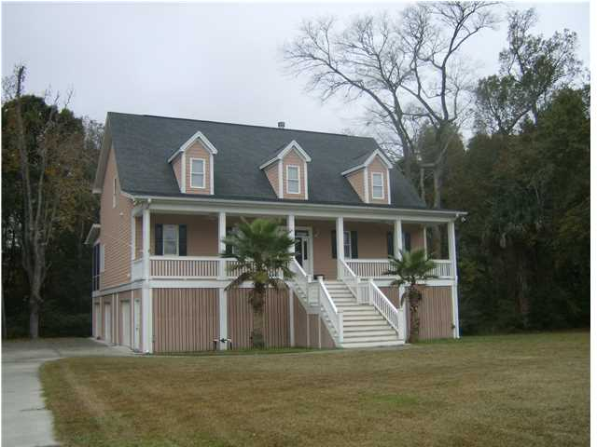
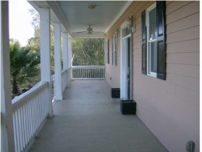
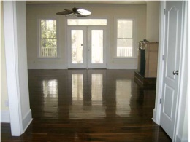
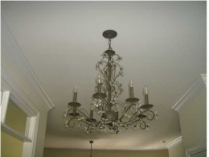
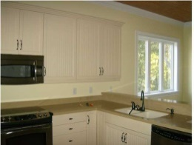
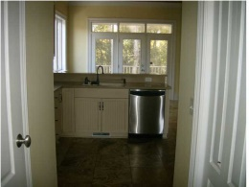
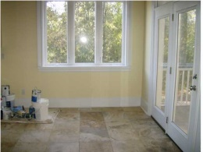
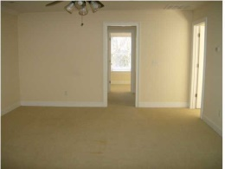
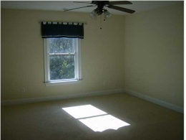
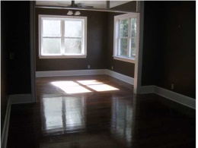
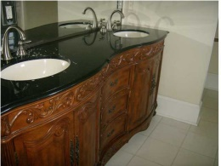
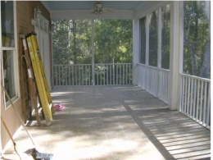
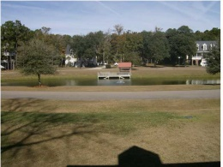


Back on the Market!!
2940 Old Tavern Ct
Yough Hall – Mt Pleasant - MLS#1329592 - $500,000
BANK APPROVED AT $493,600 - READY TO CLOSE!!!!
ABOUT $100,000 UNDER SIMILAR COMPS!! ELEGANT TRADITIONAL HOME FILLED WITH MANY UNUSUAL UPGRADES! OWNER WAS THE BUILDER. ENJOY VIEWS OF POND AND PRIVATE LARGE WOODED LOT ON BOTH FULL FRONT AND BACK PORCHES, WITH DOWNSTAIRS MASTER ACCESS DOOR TO BACK PORCH OUTSIDE OF MASTER SITTING ROOM. A SECOND MASTER IS UPSTAIRS ALONG WITH LARGE ADDITIONAL FAMILY ROOM/MEDIA ROOM/OFFICE AND 2 ADDITIONAL BEDROOMS. THERE IS AN ELEGANT DINING ROOM WITH A BEAUTIFUL CHANDELIER IN DINING ROOM AND ENTRANCE FOYER. THIS HOME IS LOCATED IN AN IDEAL LOCATION, AWAY FROM TRAFFIC AND CENTRALLY LOCATED IN MOUNT PLEASANT WITH EASY ACCESS TO SHOPPING AND RESTAURANTS.
Nancy Price
843.810.1259
nprice@carolinaone.com

